Slide 1
DEVELOPMENT OF INCD ECOIND RESEARCH INFRASTRUCTURE IN ORDER TO EXTEND AND DIVERSIFY RESEARCH ACTIVITIES INFRAECO & MEDIND
Sectoral Operational Programme “Increase of Economic Competitiveness”
Priority Axis 2: Research, technological development and innovation for competitiveness
Key area of intervention: Investments in RDI infrastructure
Operation 2.2.1: Development of existing RDI infrastructure and creation of new infrastructures (laboratories, research centers)

Slide 2
INFRAECO – PROJECT 115/2600
Duration: March 1, 2009 – February 29, 2012
Budget: 32.846.412 Lei + VAT
Financing: European Regional Development Fund + National Budget
Project’s general objective:
Expanding, diversification and opening new research directions in industrial ecology, by developing a new infrastructure for the National Research – Development Institute for Industrial Ecology and providing/upgrading the research departments / laboratories with modern and high performance equipments / installations / apparatus / intangible assets.

Slide 3
MEDIND – PROJECT 1881/48693
Duration: August 8, 2014 – December 31, 2015
Budget: 9.989.080,63 lei Lei + VAT
Financing: European Regional Development Fund + National Budget
Project’s general objective:
Development of an advanced interdisciplinary research center to cover a wide spectrum of activities related to industrial ecology as well as to open new research directions with major international impact, but insufficiently or not at all addressed at the national level.

Slide 4
Ecoind need for the projects implementation
Dynamic research themes, still needs diversification toward specific niches
The institute hadn’t its own infrastructure, high cost of rent, inadequate space for lab researches
Research focused on market needs imposes new services for economic environment
Competent and devoted personnel needs support for career development, training
SWOT analyze
Adequate endowment needs completion / diversification in order to obtain the same level as EU reference labs
Insufficient capitalization of results and partnership opportunities, especially for international ones

Slide 5
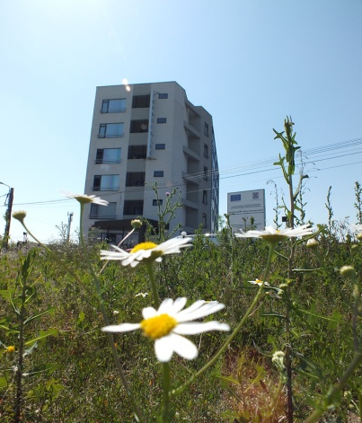
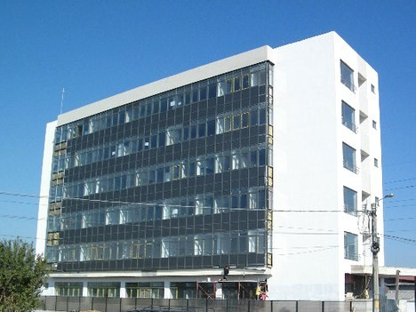
Specific objectives
New research infrastructure

Slide 6
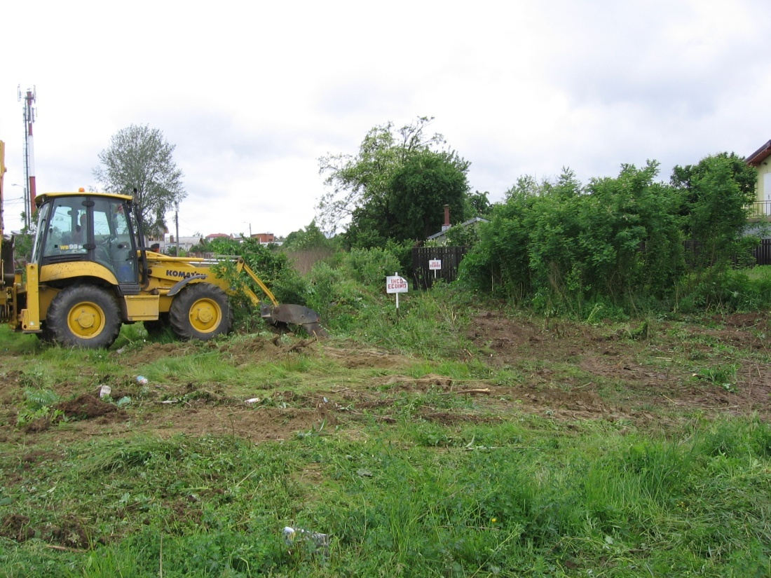
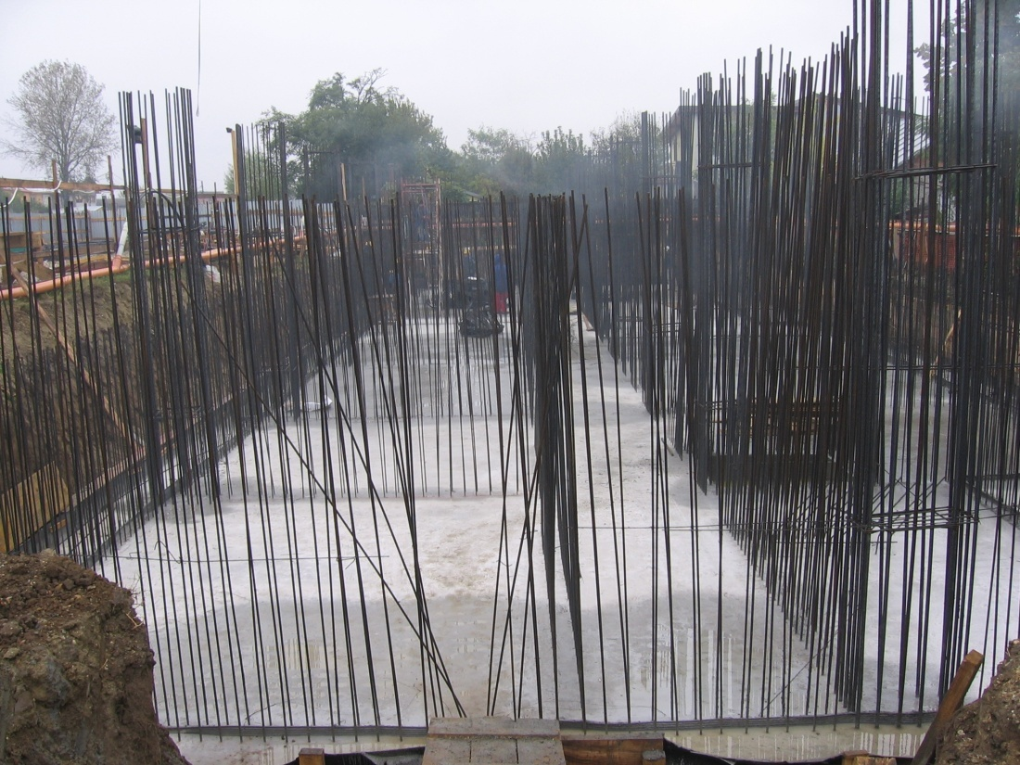
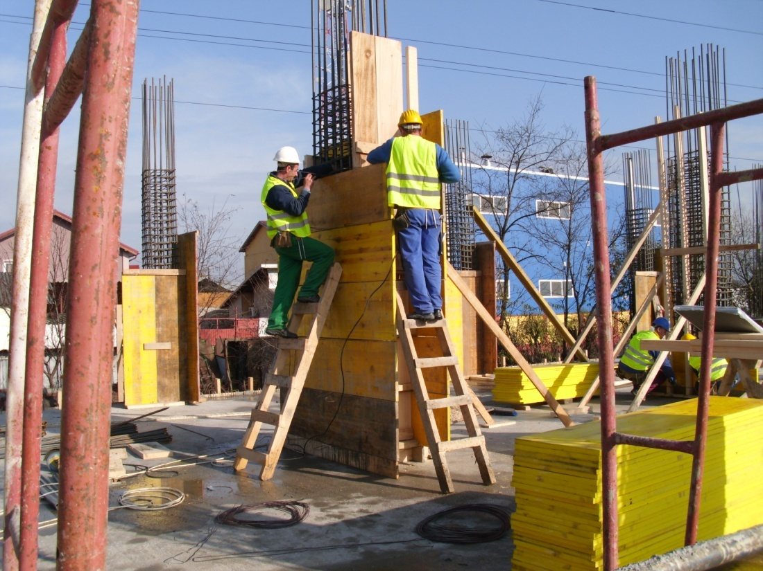
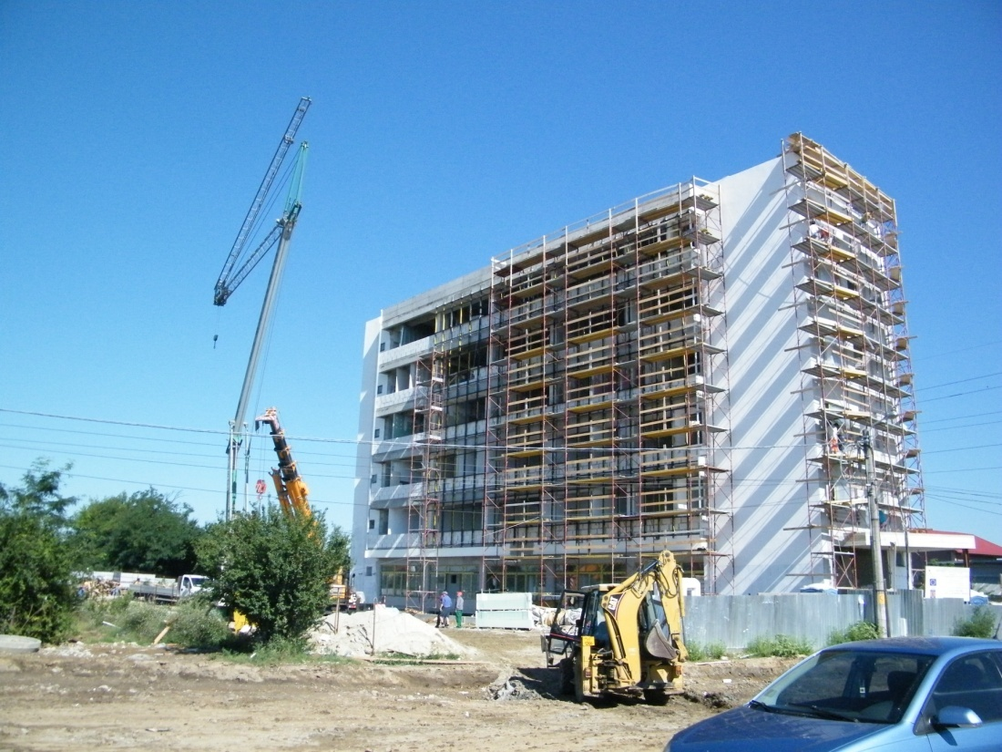

Slide 7
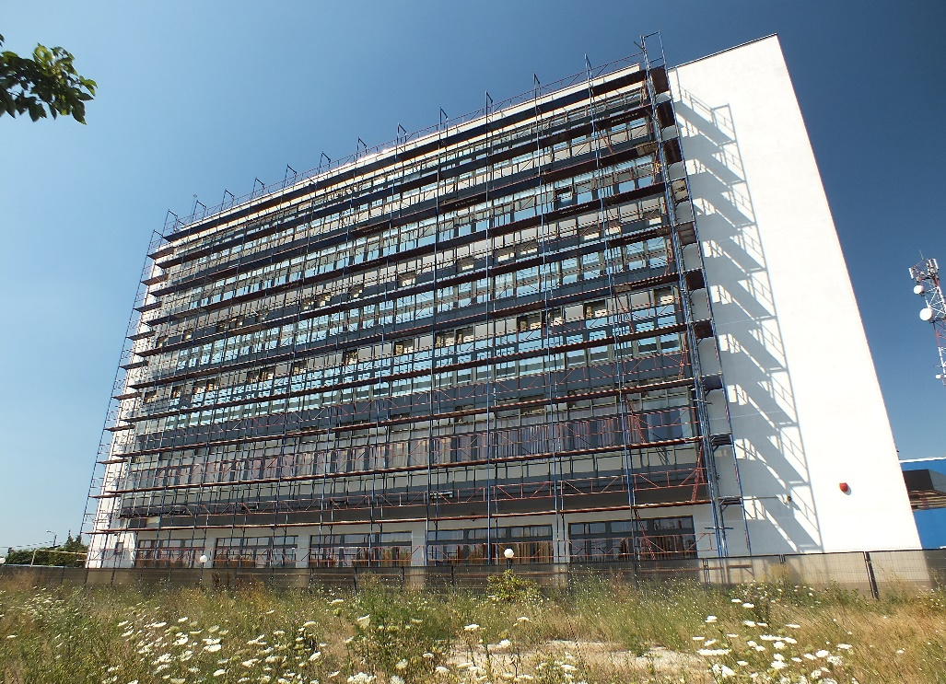
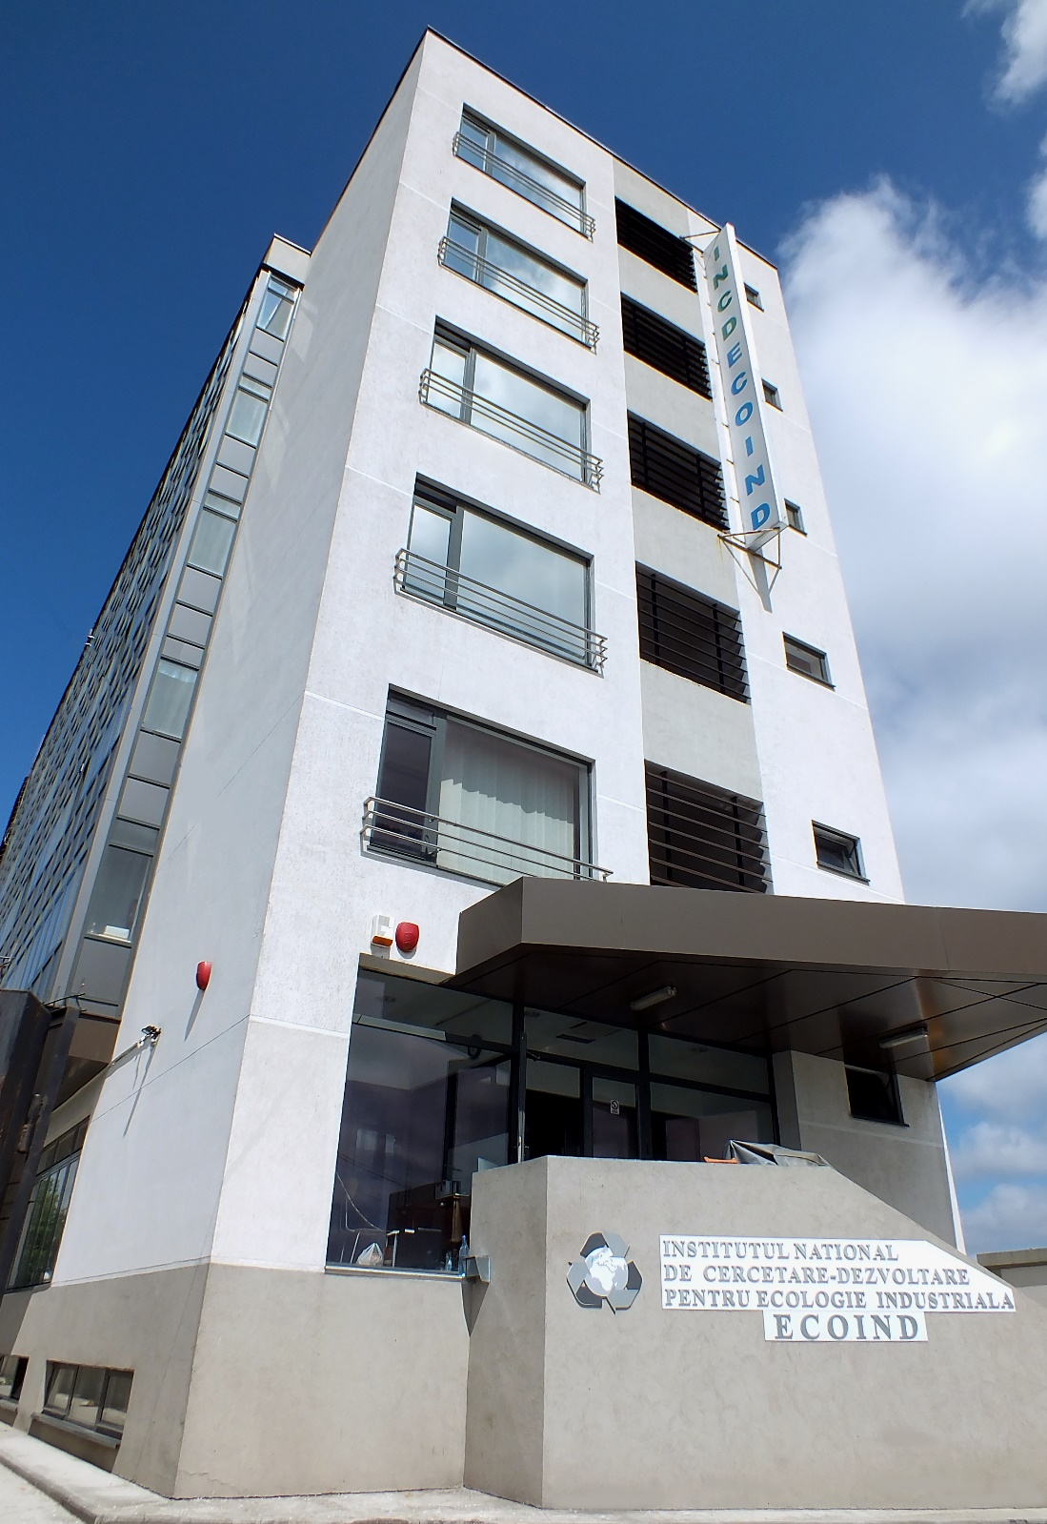

Slide 8
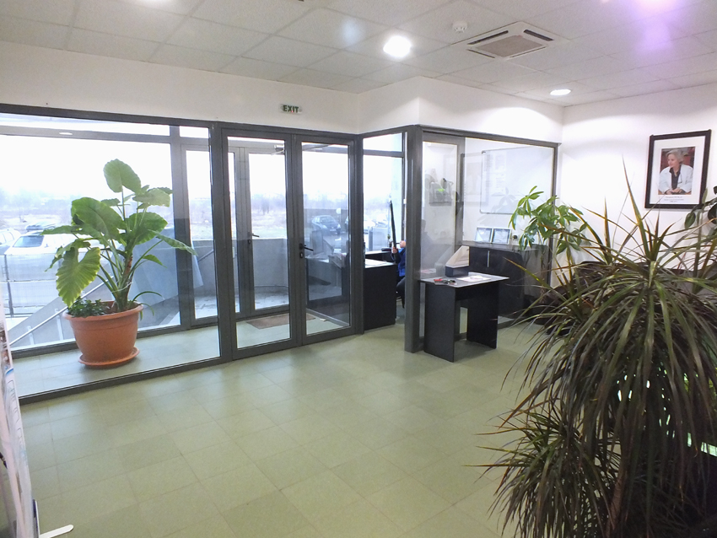
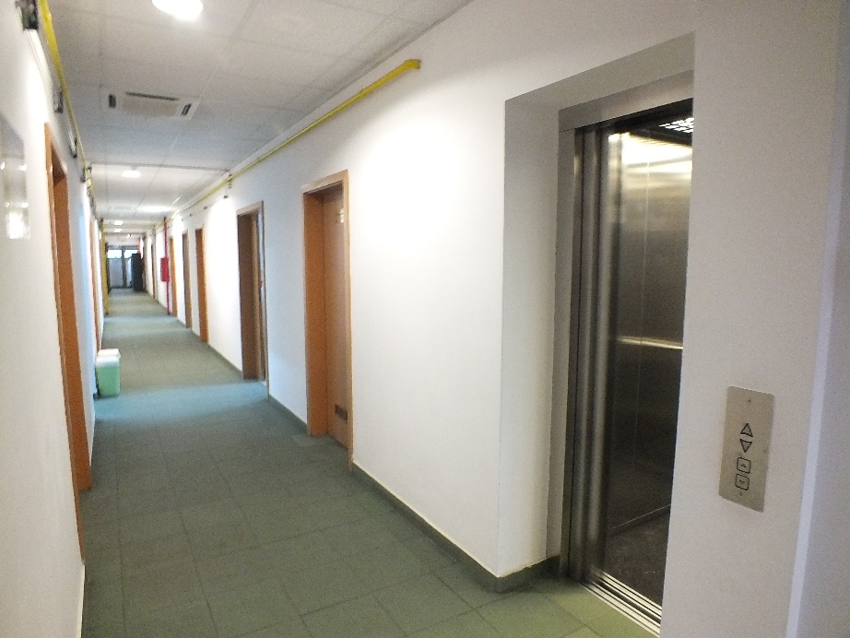
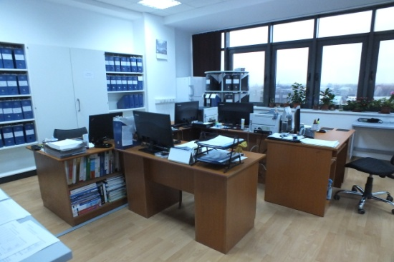
Specific objectives
Setting up 18 new laboratories
(13 within INFRAECO and 5 within MEDIND)

Slide 9
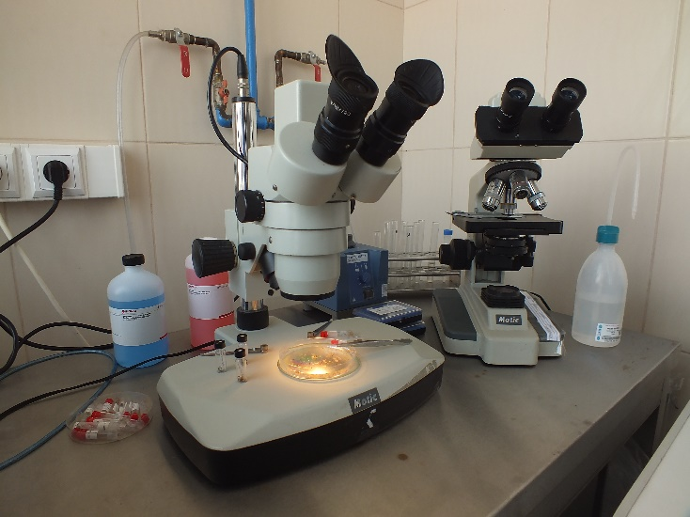
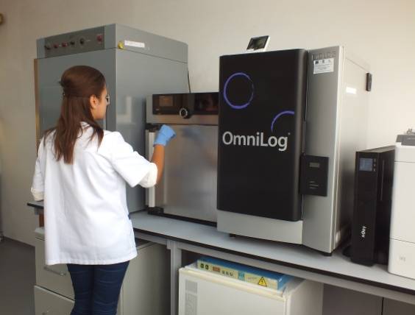
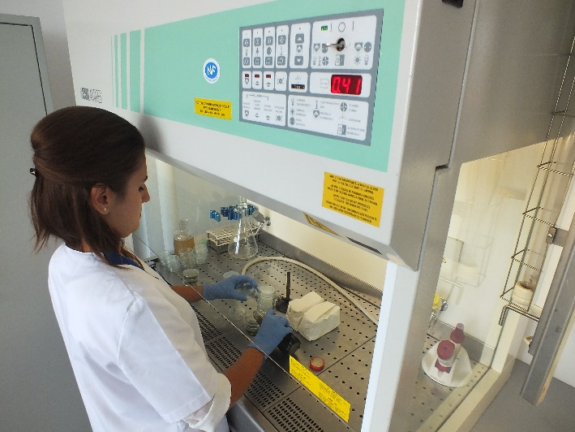
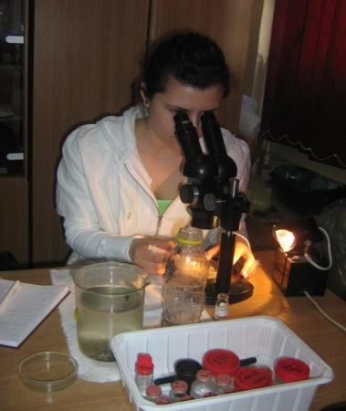
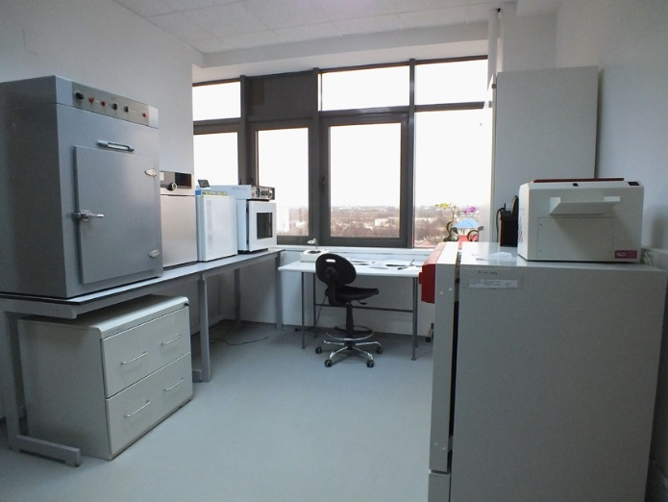
INFRAECO New Laboratories
Pollution Control Department
Laboratory for Evaluation of Ecological Risk
Bacteriological Control Laboratory

Slide 10
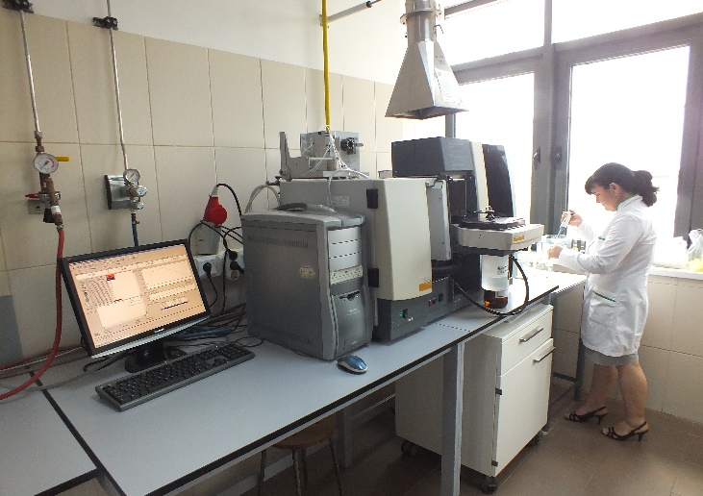
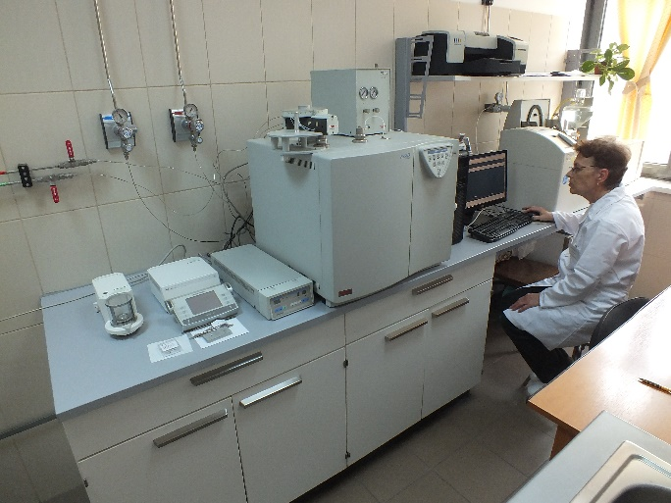
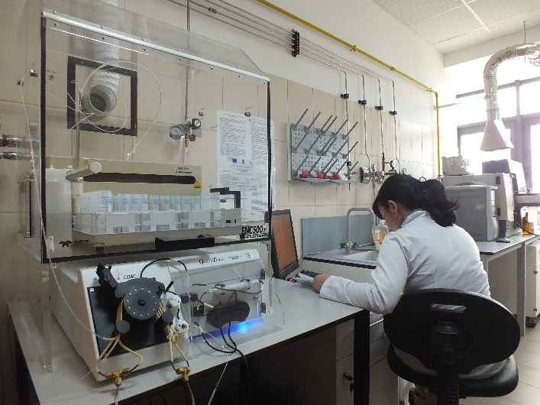
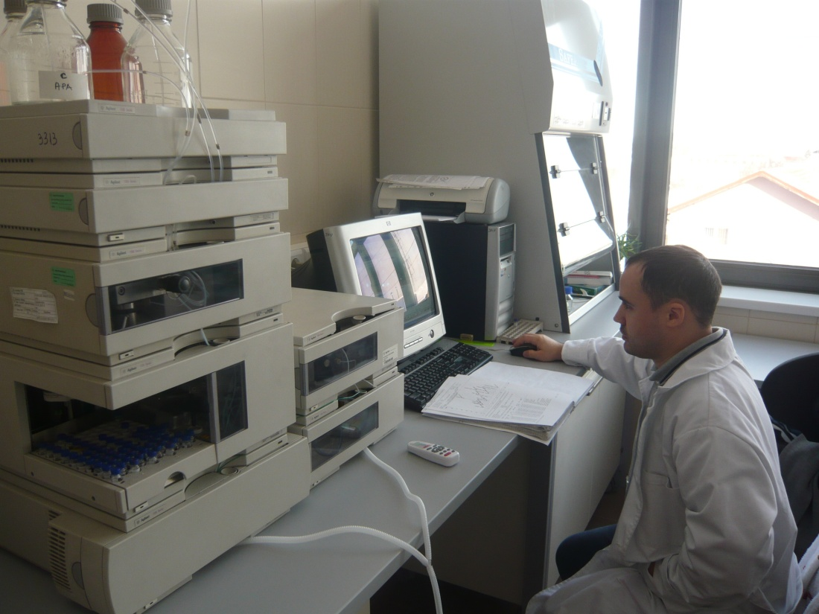
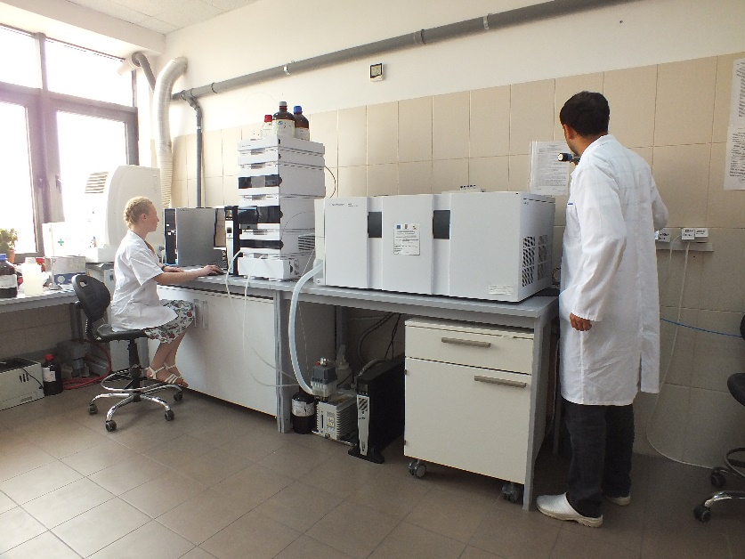
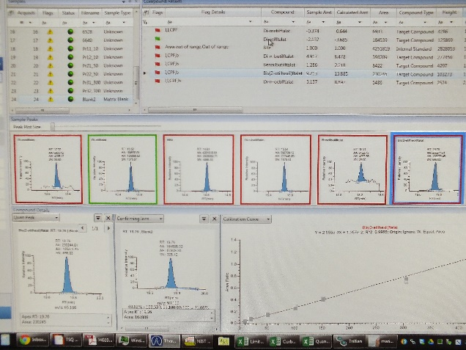
INFRAECO New Laboratories
Pollution Control Department
Assessment – Monitoring Greenhouse Gases
Judicial Environmental Analysis
Characterization / Classification of Liquid and Solid Waste

Slide 11
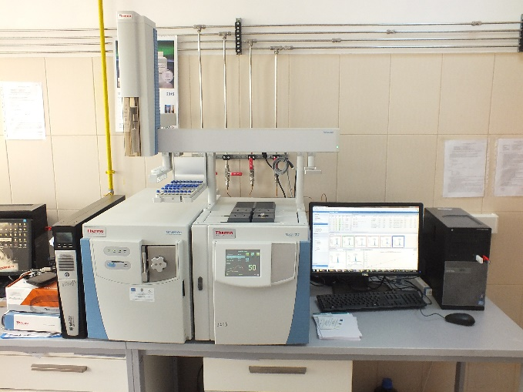
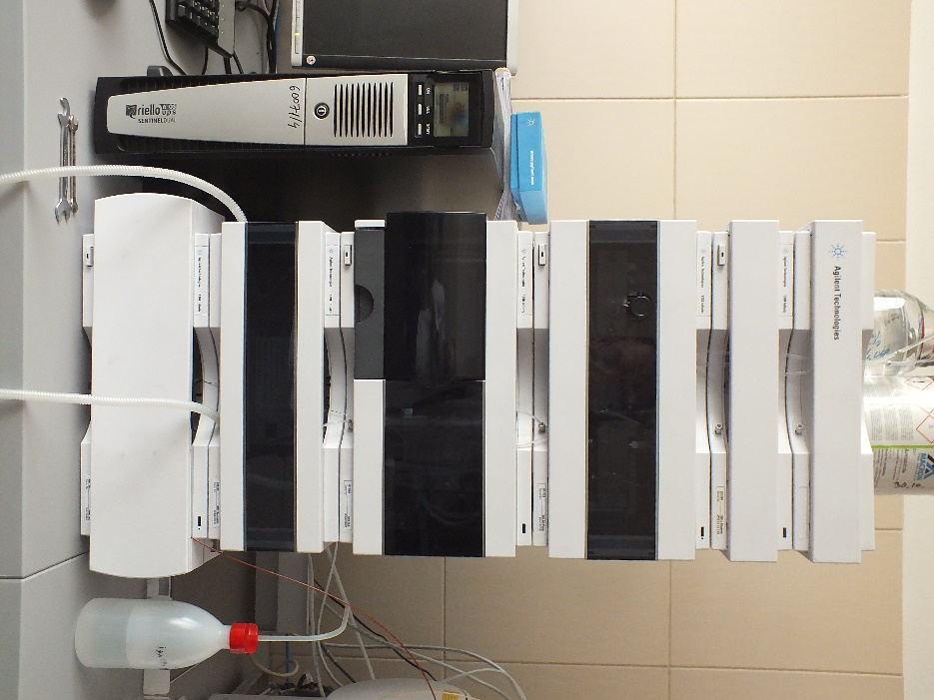
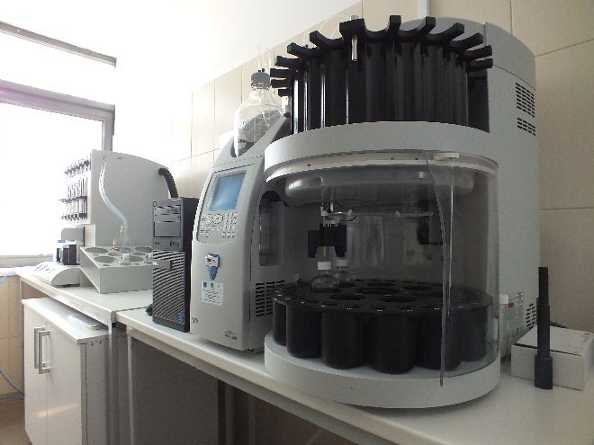
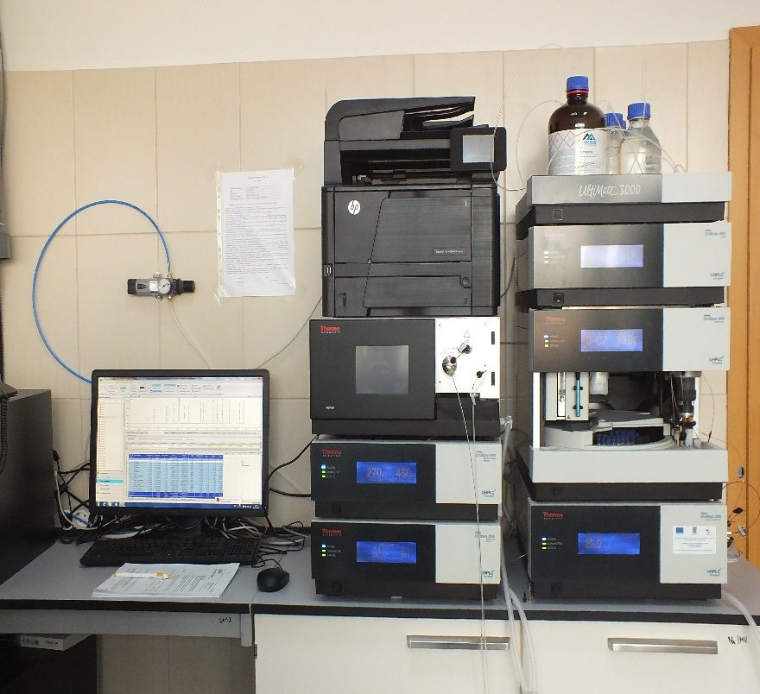
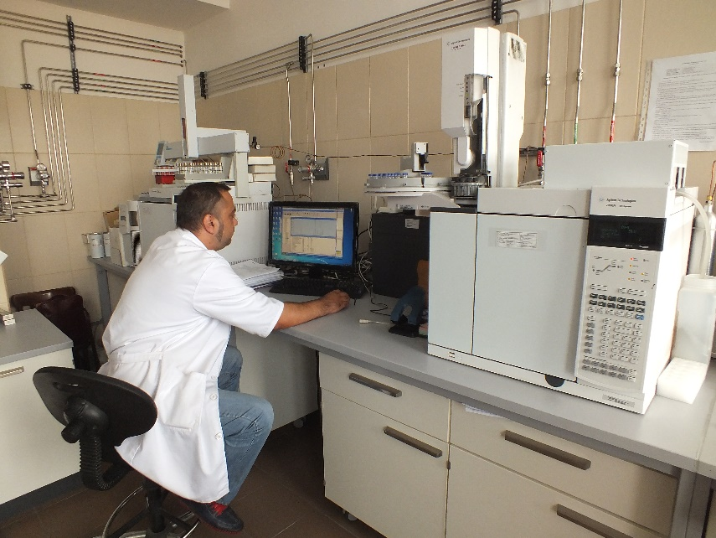
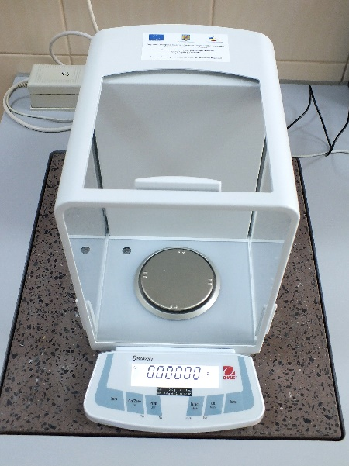

Slide 12
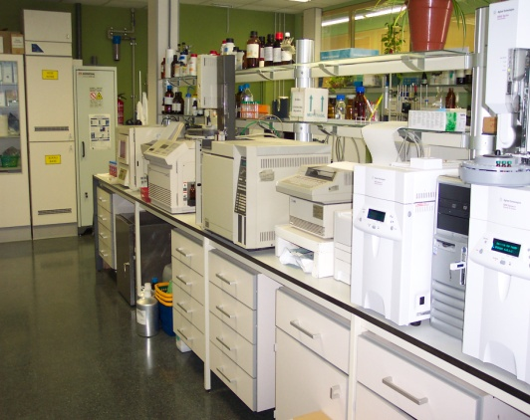
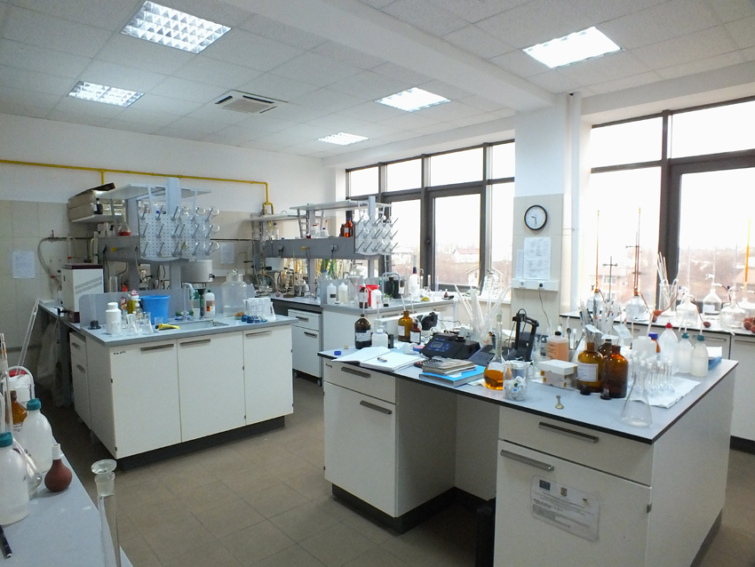
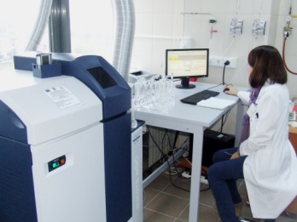
INFRAECO New Laboratories
Environmental Pollution Assessment and Monitoring Department
Process Investigation Laboratory

Slide 13
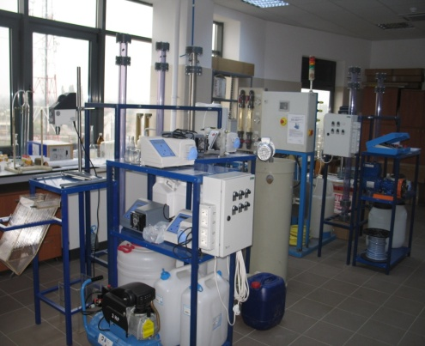
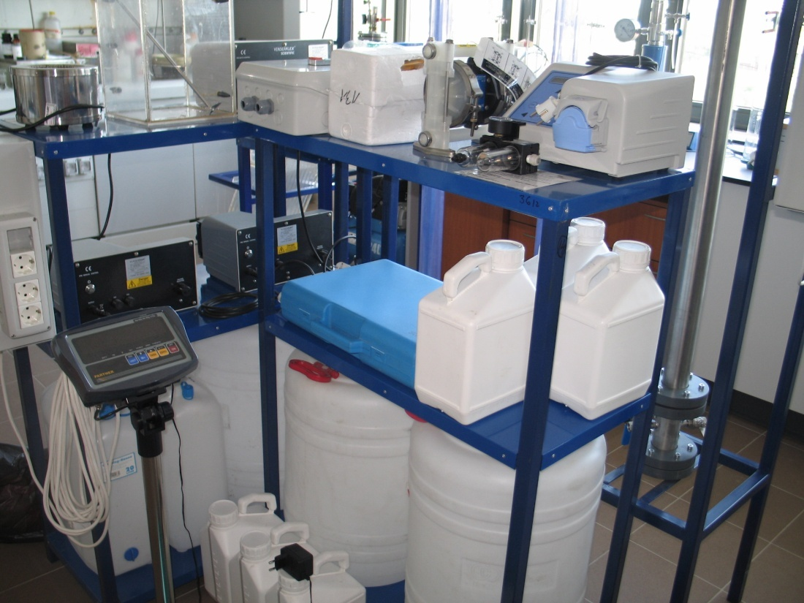
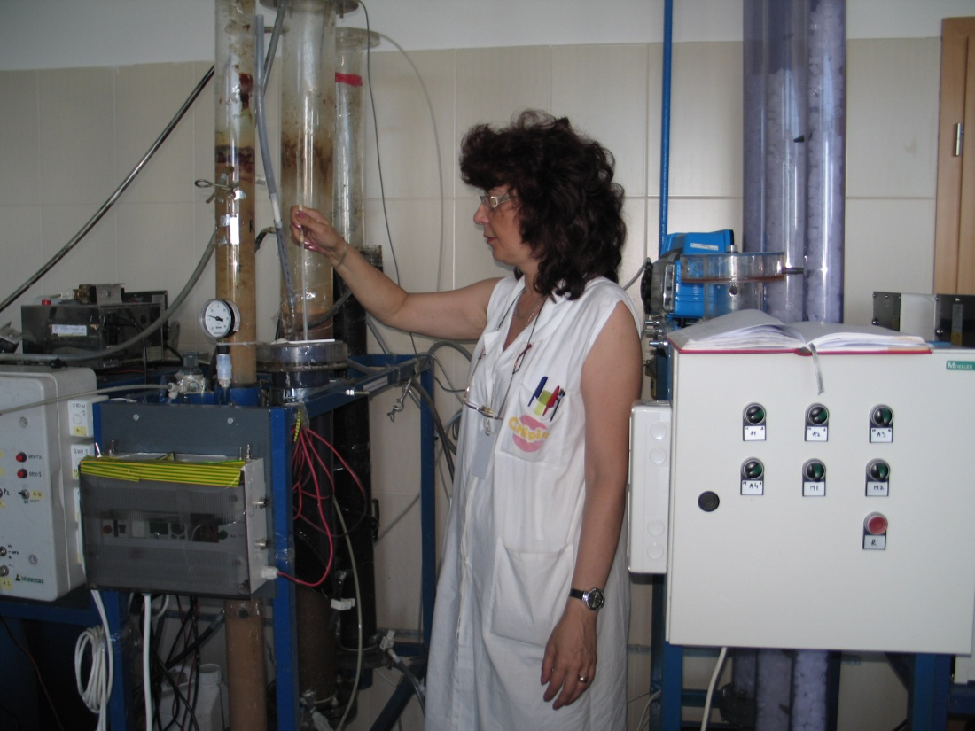
INFRAECO New Laboratories
Environmental Technologies and Technological Transfer Department
Biotechnology Laboratory for Organic Residual Mass Exploitation
Laboratory for Processing Waste / Sludge, Soil Remediation
Process Water Laboratory
Technological Development Compartment

Slide 14
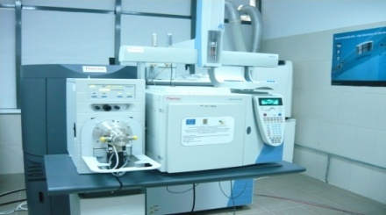
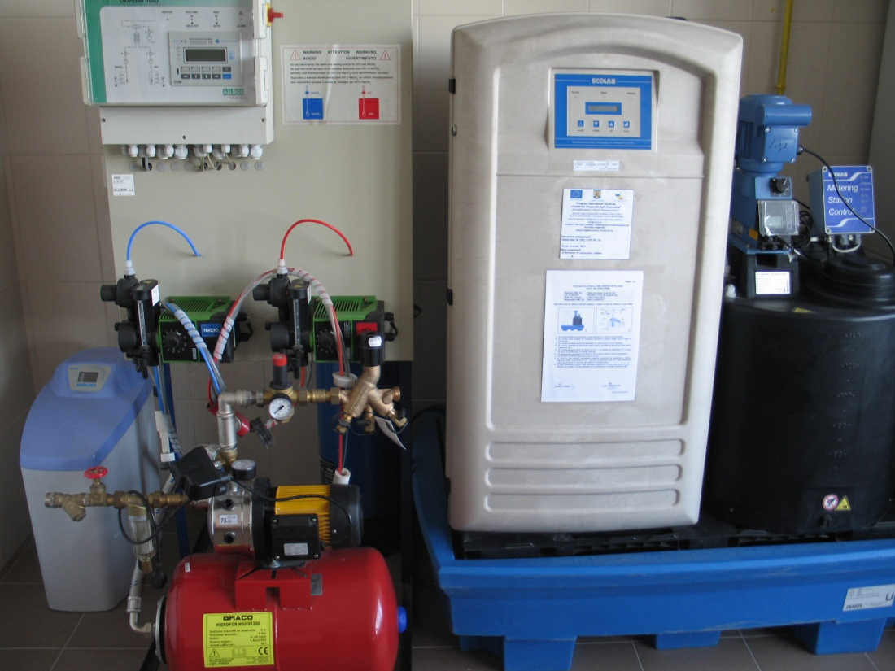
INFRAECO New Laboratories
Environmental Technologies and Technological Transfer Department
Excellence Centre for Green Technologies
Centre for Eco-Efficiency and Sustainable Development

Slide 15
MEDIND New Laboratories
L1 – Molecular Biology Laboratory (LBM)
L2 – Electron Microscopy Laboratory (LME)
L3 – Industrial Waste Pretreatment Laboratory (LPDI)
L4 – Indoor Air Quality Laboratory (LAI)
L5 – Dynamic Olfactometry Laboratory(LOD)

Slide 16
Equipment / software procured within sop iec projects
Name | INFRAECO | MEDIND
Research and development equipment From which>100.000 euro | 70 4 | 71 4
Mobile research equipment | 3 (2 auto-laboratories and 1 boat) | 1 (auto-laboratory for dynamic olfactometry)
Sampling and field measurement equipment | 15 | 8
Laboratory equipments from which>100.000 euro | 22 4 | 60 3
Pilot installations | 12 | 150.040
Cabinets and niches | 18 | 2
Laboratory furniture | yes | yes
Maintenance and fire prevention | yes | -
IT and computers | 31 | 69.815
For research and development | 29 | 5
For increase of administrative capacity | 2 | -
Software | 23 | 2
For research and development | 20 | 2
For increase of administrative capacity | 3 | -

Slide 17
Specific objectives
Development of new research directions: 15 on consecrated institute’s research domains (environmental pollution control, assessment, prevention, reduction and abatement) and 10 according to the new international and national ecological research directions (molecular biology, genetics, electronic microscopy, ecotoxicology, indoor air quality evaluation combined with the smell detection by dynamic olfactometry as well as sludge and industrial waste characterization);
Enhancing the research capacity, consolidation of institute’s position, development of national and international partnerships (13 international projects and 10 R&D collaborations with other research centers)
Development of collaborations with technological networks, stimulation of innovation through transfer of research results to economic environment/market
Diversification of personnel’s qualifications, career development of the research personnel , recruitment/employing of young researchers (16 new jobs)
Institutional development, increase of management effectiveness

Slide 18
New research directions - infraeco
Environmental Pollution Control
Development of new / optimized techniques for hazardous substances pollution (water, air, soil)
Development of new ecotoxicological methods / tests for toxicity assessment of hazardous substances upon soil microorganisms
Elaboration of testing assessment strategies of risks generated by hazardous substances (support for REACH)
Development of methods / techniques for bacteriological control and characterization of water, soil, air, sediments
Modern methodologies for waste characterization / classification
Monitoring / assessment of greenhouse gases in the context of global climate change
Development of an complex system for identification of petroleum products sources – specific methodology for judicial analysis
Elaboration of integrated methodologies / models on assessment of surface water sources pollution status due to the effects of anthropic sources and climatic change
Environmental Pollution Assessment and Monitoring
Impact assessment techniques / methodologies / plans for industrial activities
Evaluation of some ecological risks techniques / methodologies / plans for industrial activities
Environmental Technologies
Development / promotion of innovative technologies / biotechnologies for xenobiotics, nutrients removal, soil remediation, sludge / waste treatment processes
Development of solar environmental technologies
Industrial symbiosis
Development of alternative / passive technologies for mine water treatment
Environmental Management Systems
Elaboration of methodologies for EMAS II and OHSAS, HACCP implementation

Slide 19
New research directions - medind
Development of techniques / methodologies for rapid identification / quantification and evaluation of useful microorganisms
Molecular and enzymatic techniques to provide advanced process control and monitoring of biological diversity and dynamics of microbial activated sludge
Advanced electron microscopy techniques to ensure monitoring of physical-chemical and biological treatment processes
Development of methods and methodologies for assessing indoor air quality of the occupational non-industrial and residential environment
Evaluation of the odour generated by industrial processes using the dynamic olfactometry method
Analytical research to develop pre-treatment techniques, screening and complex methods to characterize different types of industrial wastes in order to fit them according to legislative requirements
Modern and rapid methodologies for simultaneously identification of anaerobic and aerobic microorganisms, potential pathogenic, isolated from environmental samples
Development and implementation of specific methodologies to assess the biodegradability / bioaccumulation / biotransformation of priority hazardous substances, highlighting the recalcitrant metabolites
Ecotoxicological characterization of hazardous substances and xenobiotic emerging micropollutants and integrated risk assessment of aquatic and terrestrial ecosystems
Alternative ways of expressing the value of biodiversity within terrestrial and aquatic ecosystems and ecosystem services

Slide 20
Project’s results
Realization indicators
Result
indicators
Indicator | INFRAECO | MEDIND
Modernized R&D labs | 6 | 4
New R&D labs | 13 | 5
R&D equipment | 70 | 71
R&D equipment > 100.000 euro | 4 | 4
Indicator | INFRAECO | MEDIND
New research directions | 15 | 10
International projects | 10 | 3
New jobs created in R&D | 13 | 3
Other | - | 10 RDI collaborations 3 patents

Slide 21
INFRAECO results
Projects
Public (national / international) and private
Modernized labs
New labs
Equipment
Process software
New research directions
International partnerships
Project’s management & Documents’ management software
Dissemination / promotion
web site
brochure for institute’s promotion
Institutional development

Slide 22
MEDIND results
New national and international partnerships
Better conditions for career develop. of young professionals
Initiation of new research directions
New / modernized labs on developed research directions
Modern / high performance lab / pilot / field equipment
New services
Research projects
More clients
New / modern infrastructure, which assures technical conditions for modern researches and improves institute's public image

Slide 23
Increase of administrative capacity
DEVELOPMENT OF INCD ECOIND RESEARCH INFRASTRUCTURE
Target | Achieved
Integrated system dedicated to data processing in research activities | Primavera based software tailored to institute’s specifics
IT applications, Software | Documents’ management software tailored to institute’s specifics Up-grade of accounting software
Partnerships building | 15 partnerships international projects in progress / completed
Dissemination and publicity for institutional promotion | New web page developed www.incdecoind.ro
WILL HAVE AN EXPECTED MAJOR IMPACT ON:
enhancing the options to reach the top level Romanian research as well as the environmental technological platforms and European networks
raising and strengthening the capacity of the Institute in order to manage complex projects, integrate and stimulate the cooperation with other national and international research institutes and universities
enhancing the institute visibility in the national and international scientific community as well as in the industrial environment
enhancing the transfer of the Institute scientific results such as methods, technics and innovating technologies to the economy/ market
raising the researchers number and personnel structural diversification to cover
all the needs for a competitive and multidisciplinary environmental research

Slide 24
Management team
Management team:
– INFRAECO Project Manager / ECOIND General Manager
Irina Eugenia Lucaciu – INFRAECO Deputy Project Manager / MEDIND Project Manager
Ion Viorel Patroescu – Infrastructure Responsible (INFRAECO&MEDIND)
Gheorghe Batrinescu – Responsible with equipments, installations, intangible assets procurement (MEDIND)
Lucian Alexandru Constantin – Financial management / Information and Publicity responsible (INFRAECO&MEDIND)
Stefan Iliescu – Responsible for monitoring of construction works
Alexandrina Ghita– Public Procurement Responsible
Enlarged project team :
Aurelia Ballo –ECOIND Deputy Manager
Stanca Stoica – Financial Operations Responsible
Cristina Georgeta Zaharia – Public Procurement Responsible
Costel Bumbac – Responsible with new research direction development
At projects implementation participated the head of departments/laboratories, other researchers and specialists, which has the professional and management experience needed for the development of the new research directions.
Margareta Nicolau

Slide 25
You are invited to visit our new infrastructure and laboratories
and collaborate with us!

