Slide 1


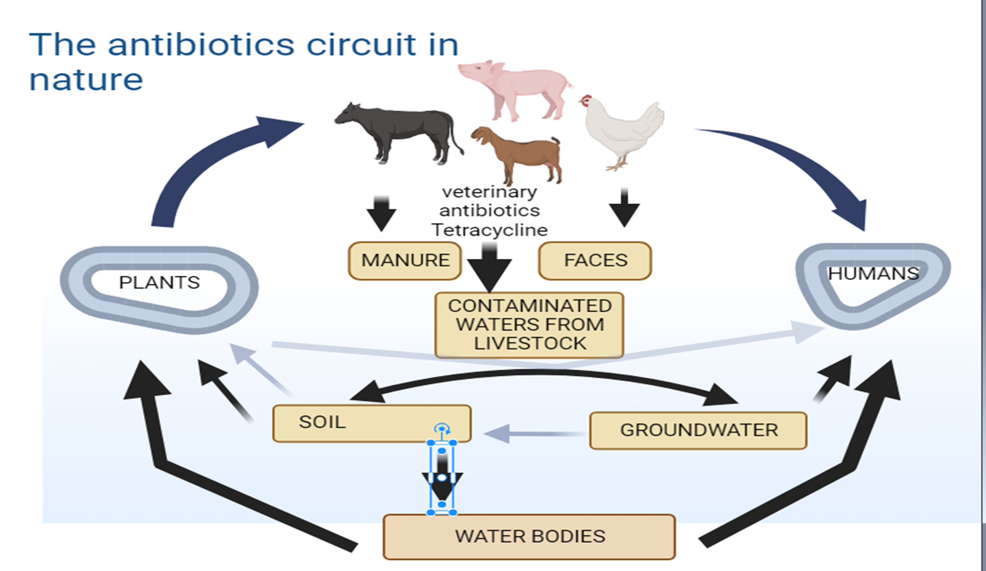
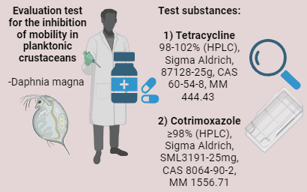
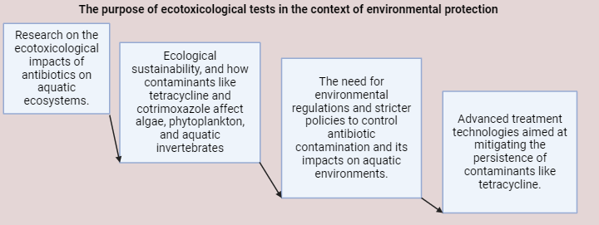
Ecotoxicological Impact of Antibiotics on Aquatic Ecosystems
Laura Feodorov ^{1, 2, #}, Stefania Gheorghe ^{1, #, *}, Anca-Maria Patrascu ¹, Ana Maria Fulgheci ^{1, 3}, Alina Roxana Banciu^{1,}, Mihai Nita-Lazar ¹,*
¹ Control Pollution Department, National Research and Development Institute for Industrial Ecology—ECOIND, Drumul Podu Dambovitei 57–73, Sector 6, 060652 Bucharest, Romania; laura.feodorov@ecoind.ro (L.F.); stefania.gheorghe@incdecoind.ro (S.G.); anca.harabagiu@ecoind.ro (A.M.P); ana.fulgheci@ecoind.ro (A.M.F); alina.banciu@ecoind.ro (A.R.B.); mihai.nita@incdecoind.ro (M.N.L.);
² Faculty of Biotechnology, University of Agronomic Sciences and Veterinary Medicine of Bucharest, 59 Marasti Blvd., district 1, Bucharest, Romania; laura.feodorov@ecoind.ro (L.F.);
³ Faculty of Chemical Engineering and Biotechnologies, National University of Science and Technology Politehnica Bucharest, 1-7 Polizu St., 011061 Bucharest, Romania; ana.fulgheci@ecoind.ro (A.M.F);
* Correspondence author at: National Research and Development Institute for Industrial Ecology—ECOIND, Drumul Podu Dambovitei 57–73, Sector 6, 060652 Bucharest, Romania; Email address: stefania.gheorghe@incdecoind.ro (S.G.); mihai.nita@incdecoind.ro (M.N.L.)
# 1st shared authors: Laura Feodorov, Stefania Gheorghe
Introduction
Materials and methods
Results and Conclusions
Daphnia magna
Tetraciclina | Cotrimoxazol
EC50-48h =57.10 mg/L (29.17-40.09 mg/L) | EC50-48h =44.76 mg/L (26.31- 42 mg/L)
LOEC 12.5 mg/L - 5% efect | LOEC 12.5 mg/L – efect 5%
NOEC 6.25 mg/L – 0% efect | NOEC 6.25 mg/L – efect 0%
EC50 values between 10-100 mg/l were determined, which indicates a harmful effect on Daphnia magna according to the toxicity level classification established by the REACH Regulation.
Future directions
Further Toxicity Testing on Other Species
Mechanistic Studies
Chronic Toxicity Studies
Mitigation Strategies
Risk Assessment
Regulatory Considerations
Synergistic/ Antagonistic Effects
Acknowledgments
This work was carried out through the “Nucleu” Program within the National Research Development and Innovation Plan 2022-2027 with the support of Romanian Ministry of Research, Innovation and Digitalization, contract no. 3N/2022, Project code PN PN 23 22 02 01

