Slide 1

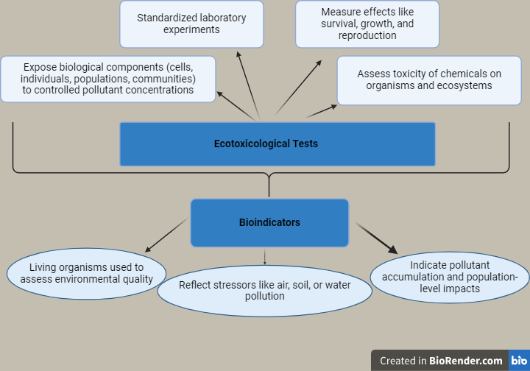
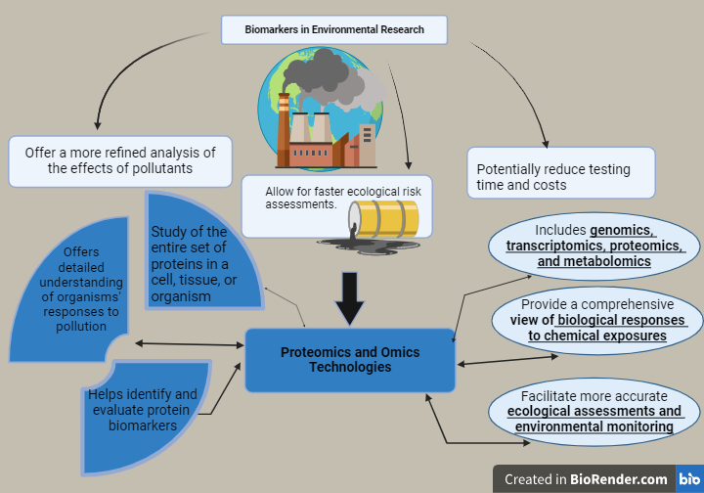
Exploring Current Frontiers of Environmental challenges by Bioindicators and Biomarkers
Laura FEODOROV ^{1, 2}, Mihai NITA-LAZAR ², Calina Petruta CORNEA ¹
¹ University of Agronomic Sciences and Veterinary Medicine of Bucharest, Faculty of Biotechnology,
59 Marasti Blvd, District 1, Bucharest, Romania
² National Research and Development Institute for Industrial Ecology - ECOIND, 57-73 Drumul Podu Dambovitei, District 6, Bucharest, Romania
Keywords: bioindicators, biomarkers, ecotoxicity, biodiversity, anthropogenic stress.
INTRODUCTION
Anthropogenic pollutants from industrial, domestic, and agricultural sources can significantly impact the environment by disrupting the growth and reproduction of various organisms, leading to reduced biodiversity and ecosystem imbalances. Monitoring and assessment using bioindicators and biomarkers play a critical role in identifying pollution sources and measuring their effects on environmental and public health, with international and national agencies providing guidance to mitigate these impacts and promote sustainability.
MATERIALS AND METHODS
A comprehensive literature search covering publications from 1990 to 2024 across Web of Science and Google Scholar was conducted to identify and select 78 key studies related to bioindicators, ecotoxicological tests, and biomarkers in the field of ecotoxicology, focusing on advanced technologies and cellular/molecular levels of analysis.
RESULTS AND DISCUSSIONS
  Challenges and Limitations in Ecotoxicological Testing : Reliability and Cost Issues & Push for Bioindicators and Biomarker
CONCLUSIONS
Transition to Advanced Biomonitoring Approaches
Incorporation of Omics and Systems Biology
Represents a significant shift in ecotoxicological studies.
Provides a more holistic perspective on the effects of pollutants.
Allows for earlier detection of environmental stress.
Expected Outcomes
More effective strategies for environmental management and conservation.
Improved public health protection through faster and more precise assessments of the impact of anthropogenic stressors.
ACKNOWLEDGEMENTS This work was carried out through the “Nucleu” Program within the National Research Development and Innovation Plan 2022-2027 with the support of Romanian Ministry of Research, Innovation and Digitalization, contract no. 3N/2022, Project code PN 23 22 02 01.

