Slide 1
Effects of Modifications of Natural zeolites upon Removal of Manganese from Aqueous Solutions
Ayten ATEŞ
Cumhuriyet University
Department of Chemical Engineering Sivas, Turkey

Slide 2
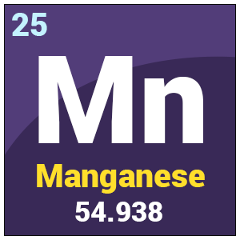
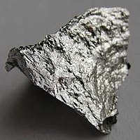
Manganese
Manganese
Manganese is abundance metal in the Earth crust
EPA offers 0.05 mg L⁻¹ for manganese limit in the drinking water
Although it is not clear, manganese may cause damage of the organs.
The valence of manganese is generally Mn(II) and its known minerals are the pyrolusite (MnO₂) and manganese bromide (MnBr₂) minerals, existing in Sivas region of Turkey and they dissolve in the drinking water and exceed the maximum contaminant level.

Slide 3
Removal of heavy metals
Classical technologies
Technologies reported in literature
Chemical precipitation
Ion exchange
Membrane filtration
Coagulation – precipitation
Electrolysis
Liquid- liquid extraction
Ion exchange
Reverse osmosis
Membrane filtration
Adsorption
The adsorption is simple, safe, environmental benign and cheap technology and has a simple operation if chosen suitable adsorbent .
Well known adsorbents :Activated alumina, various metal oxides and hydroxides, Zeolites (Clinoptilolite,chabazite, SZP1, 13X, 5A, Y, Ferrite, ZME, ZH, synthetic mordenite, ZSM-5 and zeolite beta )

Slide 4
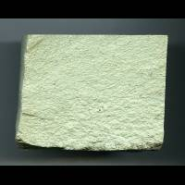
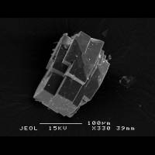
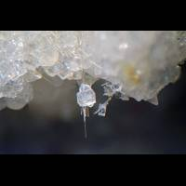
Natural zeolites
Natural zeolites are a ‘Family’ of alumosilicates
The zeolites have crystalline structure characterized by a framework of linked tetrahedra, each consisting of four O atoms surrounding a cation.
The zeolites contain water and extra-framework cations that are commonly exchangeable.
Their channels are large enough to allow the passage of guest species.
They can be hydrated and dehydration occurs a
temperatures mostly below about 400°C, is
largely reversible.
The framework may be interrupted by (OH,F) groups

Slide 5
Natural zeolites as an adsorbent
Having high potential to removal of heavy metals from water
Having low cost
Abundance in the earth
Comparison of natural zeolites with metal oxides for removal of manganese showed that natural zeolites have low sorption capacity.
In order to increase the adsorption capacity of natural zeolites:
To modify of their crystal form,
To change alkali and earth alkali metal content,
To change Si/Al ratio and particle size.
Modifications:
Ion exchange with NH₄NO₃
Treatment with NaOH
Aluminum introduction
Reduction of particle size

Slide 6
Experimental
Material and modification
Characterization
Composition: XRF (PANanalytic)
Crystalinity: XRD (Rigaku SmartLab).
Surface area and porosity (Autosorb 1)
Functional groups : FTIR (Perkin-Elmer Spectrum One)
Particle size: SEM / Particle size analyzer
Mn concentrations : AAS and ICP-MS
Natural zeolite : Bigadic(NZ-B), Manisa- Gördes (NZ-M), Sivas- Demirci (NZ-D) and Sivas – Yavu (NZ-Y)
The particle size: 0.5 mm.
Washed and dried at 120 ºC.
NH₄- form: A twofold exchange with a 0.5 M NH₄NO₃ solution at 80 °C. After washing and drying, the sample was calcined at 500 ºC for 2 h and called as NH₄-NZ.
Na- form : Mixing with sodium hydroxide and water with 1:5:50 mass ratios for 1 h at 90 ºC and then the mixture was filtered and the filtrate was called as Na-NZ.
Al- form:Preparation of aluminum introduced zeolite is based on study of Kemali et al. [Powder Technology ]. The product was called as Al-NZ.
Sorption experiments:
Contact time
Influence of concentration
Influence of pH
Influence of temperature

Slide 7
Chemical composition of NZ-Y
Element | NZ-Y wt.% | NH₄-NZ-Y wt.% | Na-NZ-Y wt.% | Al-NZ-Y wt.%
Al | 15.4 | 17.0 | 11.6 | 19.5
Si | 79.6 | 80.2 | 77.0 | 70.6
Mg | 1.25 | 0.74 | 2.2 | 2.4
Ca | 2.1 | 0.3 | 5.2 | 4.3
K | 0.4 | 0.3 | 0.7 | 0.6
Fe | 0.7 | 0.9 | 1.8 | 1.4
Sr | 3.9 | 0.04 | 0.6 | 0.5
Ti | 0.2 | 0.2 | 0.4 | 0.3
Ba | 0.05 | 0.04 | 0.18 | 0.14
Ce | 0.02 | trace | trace | trace
Zr | 0.01 | 0.01 | 0.04 | 0.04
NH₄⁺ exchange
Decationization
NaOH treatment
Desilication
Dealumination
Aluminum loading
Recrystalization

Slide 8
Chemical composition of natural and modified zeolites
 | NZ-B | Na-NZ-B | Al-NZ-B | NZ-D | Na-NZ-D | Al-NZ-D | NZ-M | Na-NZ-M | Al-NZ-M
Si | 26.5 | 24.7 | 26.0 | 26.7 | 17.4 | 21.3 | 32.4 | 24.7 | 28.2
Al | 5.5 | 4.6 | 5.7 | 5.5 | 6.2 | 9.0 | 5.6 | 6.1 | 8.1
O | 61.4 | 50.6 | 53.3 | 59.1 | 53 | 52.4 | 56.4 | 55.1 | 53.9
K | 2.7 | 1.9 | 5.0 | 2.4 | 1.2 | 2.4 | 2.7 | 2.1 | 1.2
Ca | 2.1 | 6.1 | 3.9 | 3.3 | 3.0 | 6.0 | 0.6 | 1.6 | 1.4
Mg | 0.8 | 1.4 | 1.7 | 2.2 | 2.8 | 3.7 | - | 0.4 | -
Fe | 0.9 | 0.9 | 3.0 | 1.0 | 1.3 | 2.6 | 0.7 | 1.6 | 2.0
Na | - | 9.7 | 1.5 | - | 15.2 | 2.6 | 1.6 | 8.5 | 5.1
Irrespective of composition of natural zeolite, NaOH treatment leads to desilication and dealumination in addition to introduction of Na.
Aluminum introduction into Na-zeolites increases aluminum content of zeolites

Slide 9
XRD
Natural zeolite: Clinoptilolite
Mordenite Quartz and Feldspar
Similar composition with NZ-Y
Disappearance of most phases and increase of HS
Coating of surface with Al

Slide 10
XRD
NaOH treatment and then aluminium loading leads to a noticeable loss of crystallinity due to partial dissolution of clinoptilolite and clay.
Formation of hydroxysodalite phase was observed on zeolites and it remains with aluminium loading.
Feldspar and quartz phases are mostly stabile towards NaOH treatment due to their crystal size and structure.
Aluminium oxide phase is mostly formed on highly desilicated zeolites
The stability of clinoptilolite is strongly related with Si/Al ratio of zeolite

Slide 11
SEM
NaOH treatment and Al loading led to agglomeration and melting of particles
NZ-B has micron-sized aggregates of plate-like particles
NaOH caused thinning of plates and Na-NZ-B consists of thin layer-like crystals.
Aluminium introduction led to partly aggregation of thin layer plates
NZ-D zeolite has irregular surface.
NaOH treatment changed it into flower shape structure via the formation of hydroxysodalite crystals growing at the surface of zeolite. Aaluminium loading rechanged its morphology into thin layer plates.
NZ-M consists of rugged surface.
NaOH treatment led to formation of needle-like and flower shape structures The aluminium introduction resulted in the formation of rod-like structure and hexagonal platy crystals with characteristic dimensions larger than 1μm and also some particle aggregation.

Slide 12
Surface Characteristics
N₂ sorption
Pore size distribution
Sample | S_{BET}ª (m² g⁻¹) | V^{b}_{Total} (cm³g⁻¹) | V^{c}_{Micro} (cm³ g⁻¹) | Dp^{c} (Å)
NZ-Y | 62.4 | 1.4 x10⁻¹ | 2.7 x10⁻² | 94
NH₄-NZ-Y | 83.2 | 0.223 | 2.8 x10⁻² | 107
Na-NZ-Y | 12.9 | 3.7 x10⁻² | 5.1 x10⁻³ | 116
Al-NZ-Y | 37.4 | 2.2 x10⁻¹ | 1.42x10⁻² | 241
ª Multipoint BET method ; ^{b}Volume adsorbed at p/p₀ = 0.99.; ^{c}Micropore volume calculated by DR method

Slide 13
Surface Characteristics
Sample | S_{BET}ª (m² g⁻¹) | V_{Total}^{b}(cm³ g⁻¹) | V_{Micro}^{c} (cm³ g⁻¹) | Dp (Å)
NZ-B | 27.3 | 0.19 | 0.008 | 285
Na-NZ-B | 25.5 | 0.24 | 0.009 | 192
Al-NZ-B | 31.8 | 0.28 | 0.012 | 179
NZ-D | 112 | 0.33 | 0.045 | 119
Na-NZ-D | 3.3 | 0.03 | 0.0006 | 199
Al-NZ-D | 20.6 | 0.10 | 0.007 | 103
NZ-M | 44.8 | 0.22 | 0.012 | 201
Na-NZ | 3.6 | 0.02 | 0.0005 | 109
Al-NZ-M | 13.6 | 0.08 | 0.004 | 127
ª Multipoint BET method ; ^{b}Volume adsorbed at p/p₀ = 0.99.; ^{c}Micropore volume calculated by DR method
NaOH treatment decreases surface area because of desilication and dealumination and crystal loss
Aluminum loading into Na- zeolites increases surface area with recrystalization of structure
Mesopore formation on the zeolites depends on stability of zeolites

Slide 14
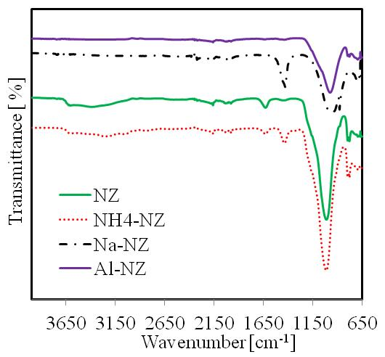
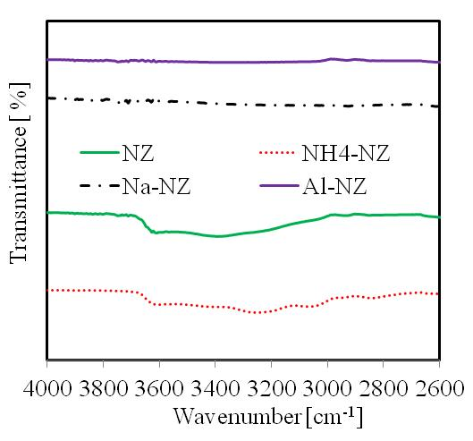
FTIR
Hydrogen bonded Si–OH groups
Proportional with Al content
Si-O(H)-Al
Sample | Ti–O stretching vibration | OH⁻ stretching | OH⁻ bending | Other
NZ-Y | 1011 | 3391 | 1632 | 2161, 694
NH₄-NZ-Y | 1014 | 3250 | 1435, 1631 | 779
Na-NZ-Y | 879 | - | 1429 | 2161, 701
Al-NZ-Y | 974 | - | - | 693

Slide 15
TGA
Ion exchange and aluminum loading into zeolites increase their thermal stability
Manganese adsorption decreases thermal stability of the zeolites

Slide 16
Manganese adsorption
 | NZ-B | Na-NZ-B | Al-NZ-B | NZ-D | Na-NZ-D | Al-NZ-D | NZ-M | Na-NZ-M | Al-NZ-M | NZ-Y | Na-NZ-Y | Al-NZ-Y
q | 34.7 | 19.8 | 14.2 | 23.6 | 26.7 | 34.4 | 28.8 | 10.3 | 16.6 | 6.2 | 165 | 25.1
Mn(II) removal increased for NZ-D and NZ-Y and decreased for NZ-B and NZ-M after NaOH treatment and aluminum loading.
This is most probably related with stability of zeolites; NZ-B and NZ- M are more stabile towards NaOH treatment based on SEM and XRD results and their modification is difficult.

Slide 17
Results and Discussion
Based on XRD results:
The treatment with NH₄NO₃ of NZ hardly changed its composition.
The treatment with NaOH and introduction of aluminium led to significant decrease of clinoptilolite, dolamite and mordenite and insignificant change of feldspar and quartz phases depending on structure of zeolites.
Upon ion exchange with NH₄⁺,
The efficient removal of Sr²⁺ and Ca²⁺
The partial removal of Mg²⁺, Fe³⁺, Ba²⁺ and Ti⁴⁺.
3. The treatment with NaOH :
Significant desilication
Partial dealumination
Insignificant change of almost all cations.
Aluminium introduction increased aluminium content of the sample irrespective of source of zeolites

Slide 18
Results and Discussion
5. Based on TGA results:
Decationisation, dealumination and desilication give rise to a decrease in
the hydrophilic nature of the zeolite.
Mn sorbed zeolite increased its hydrophilic nature based on FTIR results.
6. Based on adsorption-desorption isotherms of N₂ and the pore size distribution results:
Ion exchange increases the surface area and micropore volume
NaOH treatment gives rise to a significant decrease in the surface area
and micropore volume as well as partial collapse of structure ad sintering
Realumination of Na-NZ increases the surface area and micropore
volume.

Slide 19
Results and Discussion
7. Ion exchange, alkali treatment, aluminium introduction changes the manganese sorption capacities of zeolites depending on their stability and reorganisation.

Slide 20
Thanks
FINACAL SUPPORT
Research fund of Cumhuriyet University (CUBAP) (M-657).

