Slide 1


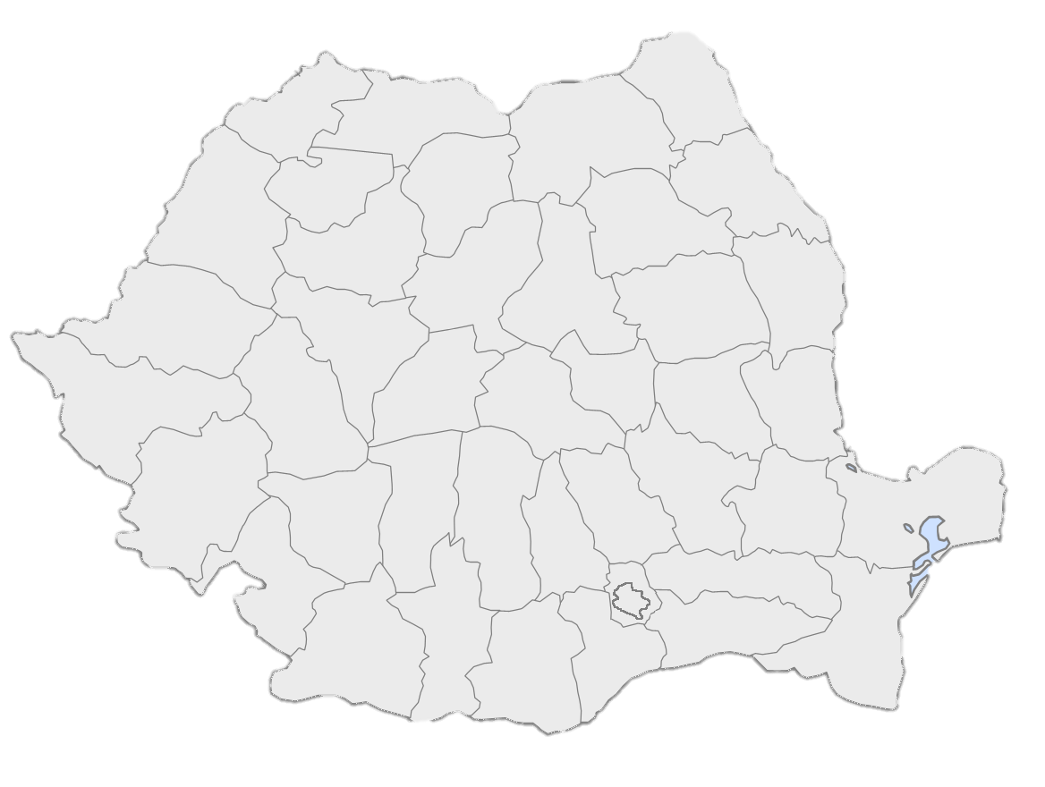
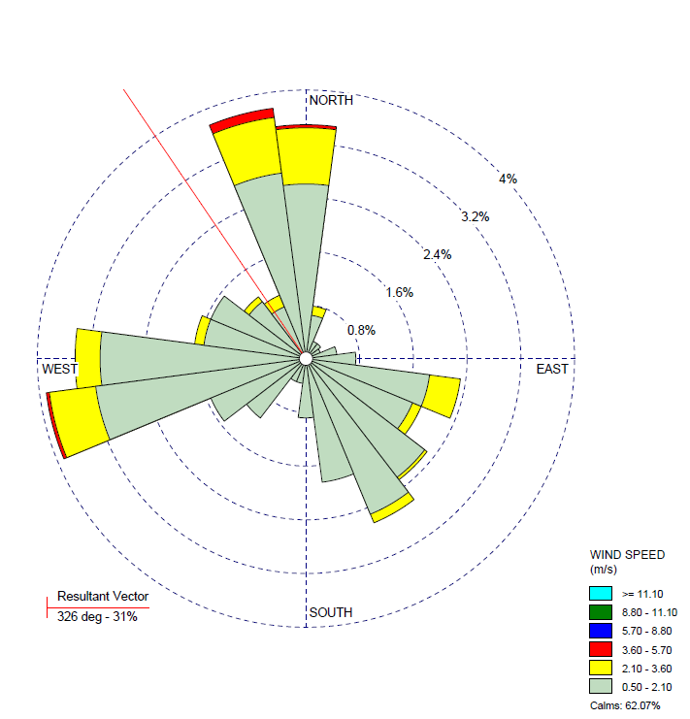
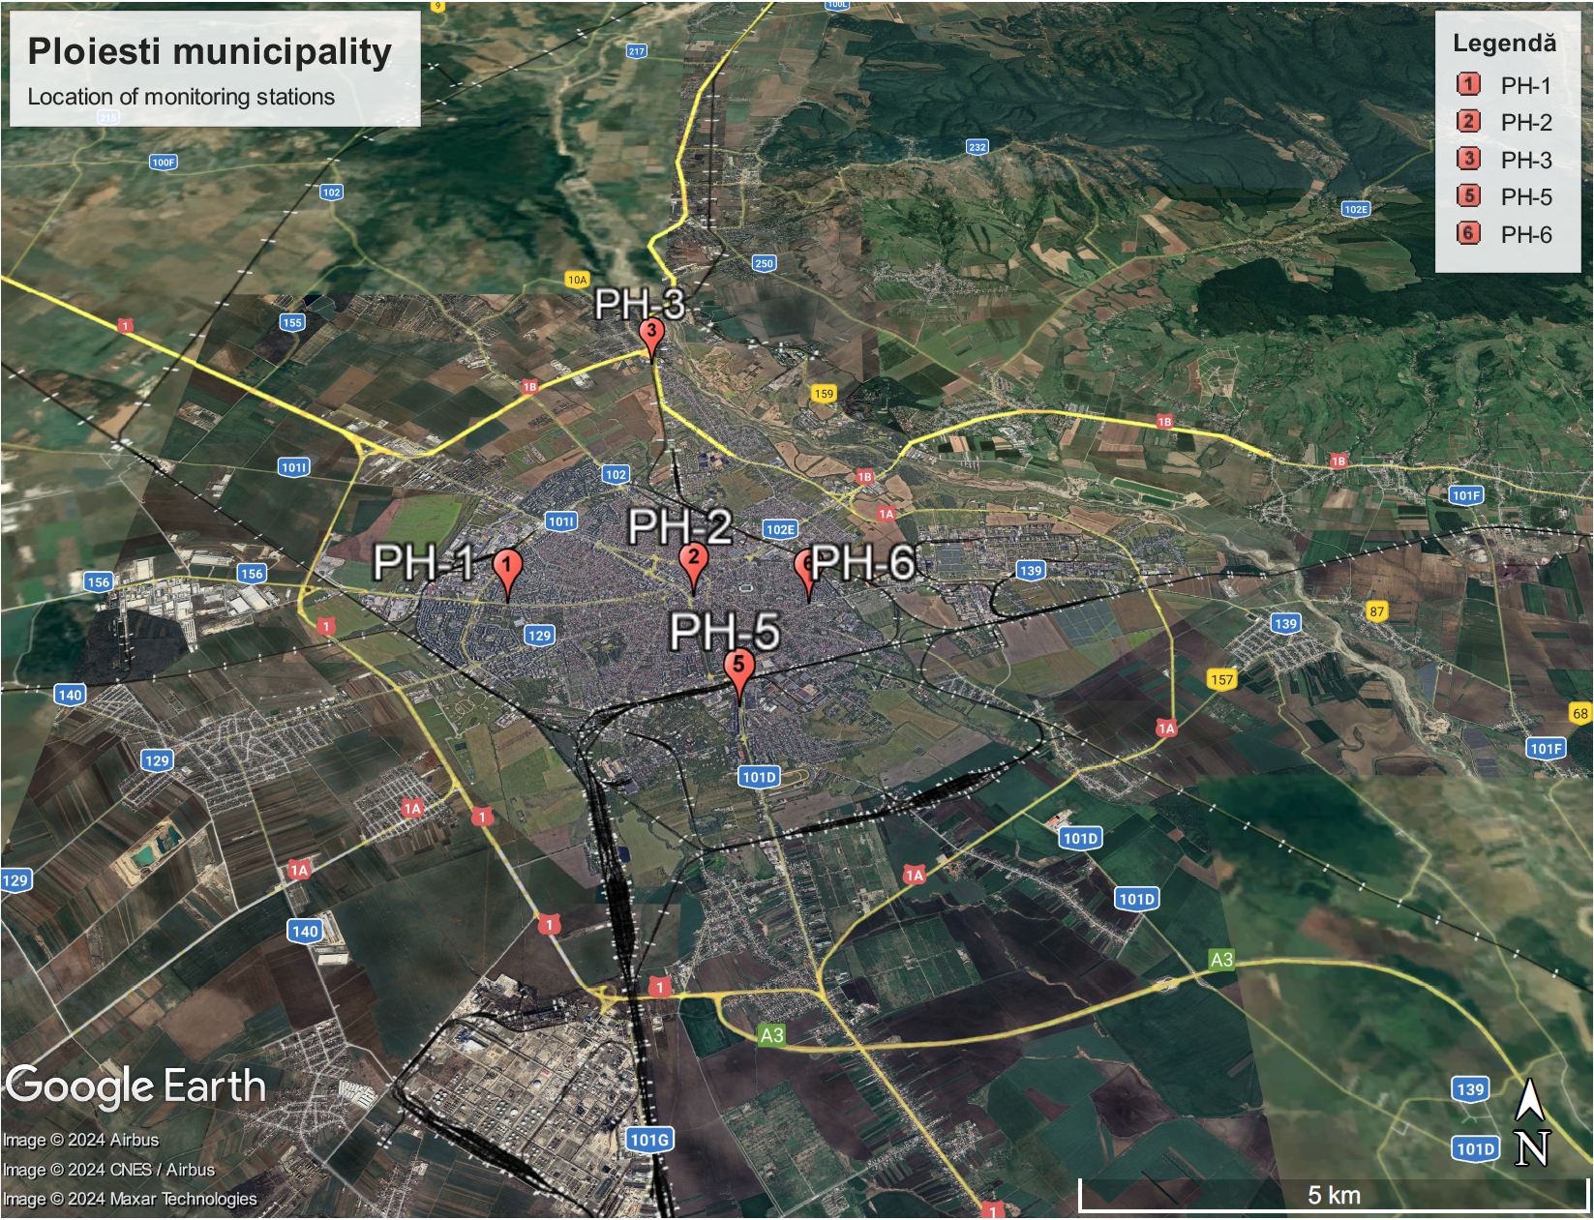




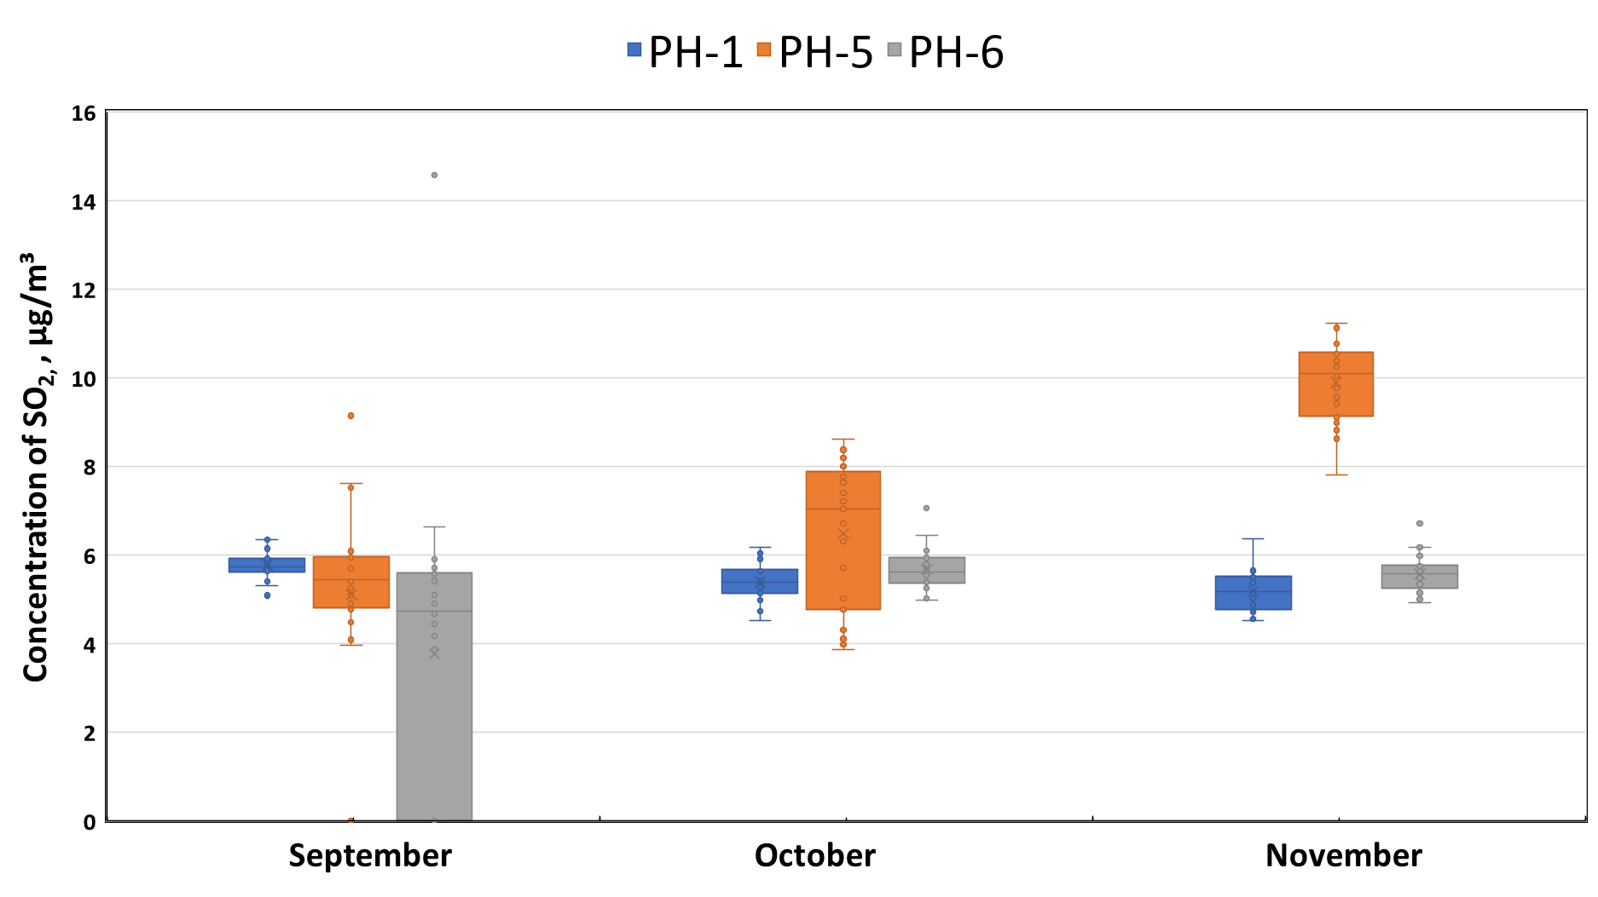
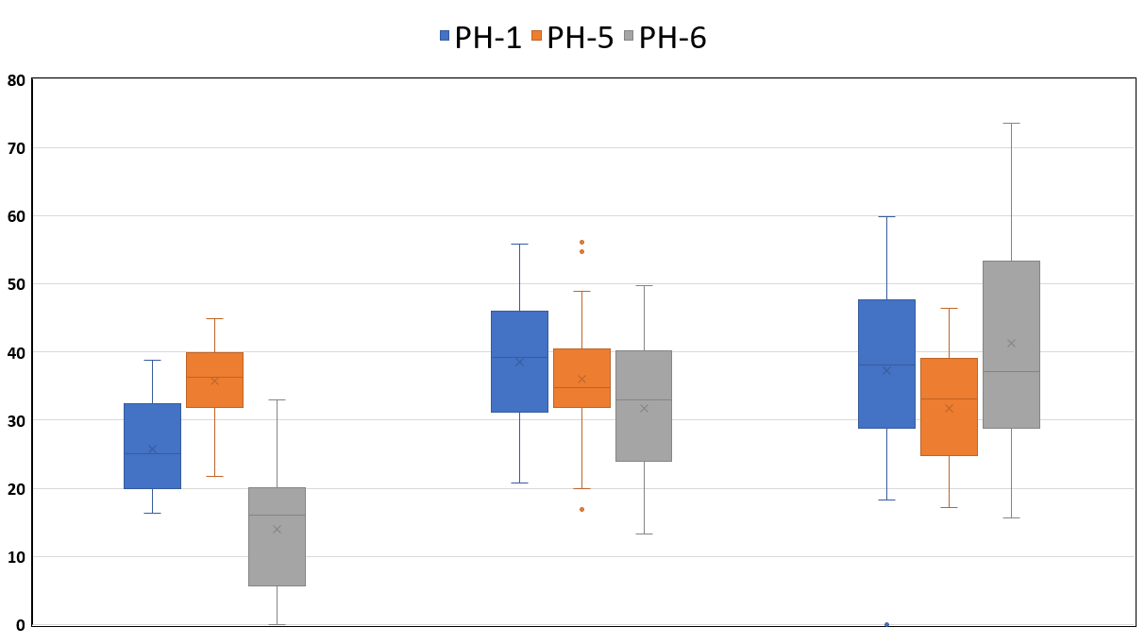

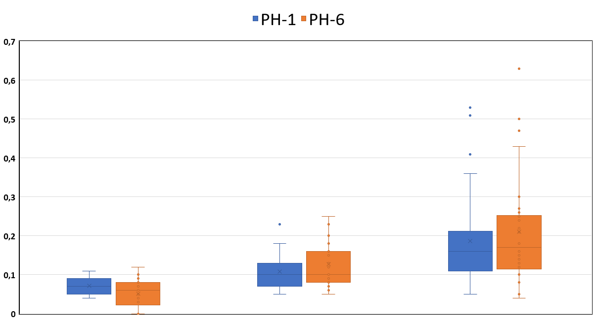
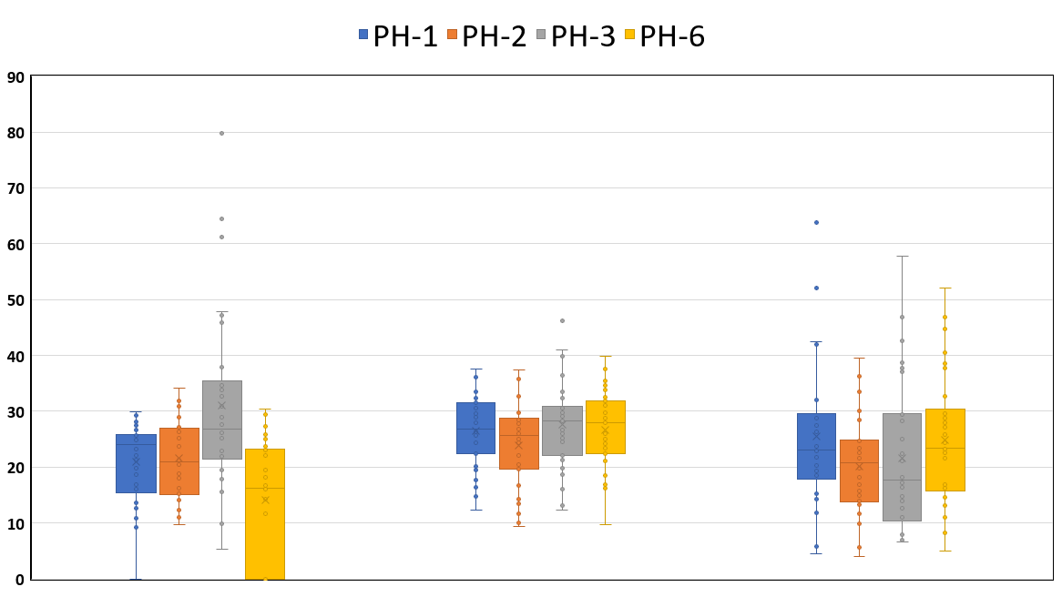
SICHEM
2024
STATISTICAL ANALYSIS OF URBAN AIR QUALITY IN PLOIESTI, ROMANIA DURING AUTUMN
Georgeta O. Popa^{1,2}, Cristian Constantin^{1,2}, Simona M. Calinescu^{1,*}
¹National Research and Development Institute for Industrial Ecology ECOIND, Drumul Podu Dambovitei Street, No. 57-73, ZIP Code 060652, Bucharest, Romania
²Faculty of Chemical Engineering and Biotechnologies, University Politehnica of Bucharest, 1-7, Gheorghe Polizu Street, Sector 1, ZIP Code 011061 Bucharest, Romania
*poluare.aer@incdecoind.ro
Introduction
Introduction
Method of analysis
Air pollutant emissions and weather conditions contribute to urban air quality. In this study, we statistically investigated data collected on urban air pollution using air quality monitoring station measurements. Long-term monitored pollutants were PM₁₀, SO₂, NO₂, CO and meteorological parameters from 01.09.2023-30.11.2023 in Ploiesti, Romania.
Data were processed according to the limit value allowed under the Romanian environmental legislation (LAW no. 104 of 15 June 2011 on ambient air quality). Correlations were made between weather parameters and pollutant concentrates. They were then statistically analyzed. Ploiesti municipality includes 2 stations for monitoring emissions from traffic, 2 background stations and 1 stations for monitoring industrial emissions (Fig. 1).
Ploiesti municipality
Results and discussions
The most significant exceedance is for PM₁₀ with a percentage of 59.54% compared to the permissible limit value (PLV), Fig.2.
Weather data were statistically analyzed with the Aermet View program to eliminate aberrant values and obtain wind distribution over a three-month period, indicating the prevailing „blowing from” from NV and SV, most winds having a speed between 0.5-2.1 m/s and about 62% of the monitored period were characterized by atmospheric calm, and higher intensity winds are present in only 0.2% of the time (Fig. 3).
Fig. 4 shows daily concentrations of pollutants over time as box plots diagrams. The graphical representation illustrates the minimum value, the lower quartile, the upper median quartile and the maximum value. Extreme values are predominantly found in November. For nitrogen dioxide (NO₂), the average concentration decrease in September for the PH-6 station is the highest compared to the other two monitoring stations (55.01%). In the analysis of the concentration of particulate matter for PH-5 with an aerodynamic diameter of 10 micrometers (PM₁₀) we find a slight decrease for October compared to September, after that followed an upward trend for November, with a percentage increase of 37.59%. These fluctuations are due to the density of road traffic, meteorological parameters, vehicle types and industrial emissions.
Figure 1. Localization of air quality monitoring stations in Ploiesti municipality
PLV LAW 104/2011
Figure 3. The wind rose specific to the area and the monitoring period
Figure 2. Daily variation in PM₁₀ concentration
Concentration of NO_{2,} , µg/m³
2023
September October November
2023
Concentration of PM_{10,} , µg/m³
Concentration of CO , mg/m³
September October November
September October November
2023
2023
Figure 4. Statistical summary of the level of air pollution in the form of box plants in September, October, November of CO, NO₂, SO₂ and PM₁₀
Conclusion
The emission of air pollutants is influenced by various factors such as: the chemical changes that occur with their emission in atmospheric air, the interaction with solar radiation, the dispersion in the atmosphere (wind direction, wind speed) and weather.
The variation of emissions in urban areas on several factors, such as: road traffic, vehicle type, fuel used, pollution reduction measures, average speed, traffic congestion degree.
The study highlights the crucial importance of addressing air pollution due to road transport in metropolitan areas in Romania.

