Slide 1


A survey of groundwater nitrate contamination resulted by research of domestic wells from Romania
Călin Cătălinaª, Madjar Roxana Maria^{b}, Scăețeanu Vasile Gina^{b*}, Oprescu Emilia-Elenaª
ªPetroleum-Gas University of Ploieşti, Romania
^{b}University of Agronomic Sciences and Veterinary Medicine Bucharest, Romania

Slide 2
Our study presents a general approach concerning nitrate levels in well water collected from different areas located in Romania
Săhăteni
(Buzău County)
Matca
(Galati County)
Clinceni
(Ilfov County)
Măneciu-Ungureni (Prahova County)
Fântânele village
(Prahova County)

Slide 3
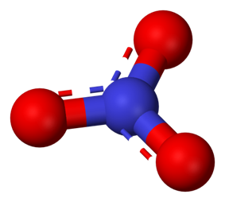

Almost all inorganic nitrate salts are soluble in water at standard temperature and pressure
Nitrates are mainly produced for use as fertilizers in agriculture because of their high solubility and biodegradability
The main nitrate fertilizers are ammonium, sodium, potassium, and calcium salts
The use of nitrates in food preservation is controversial

Slide 4
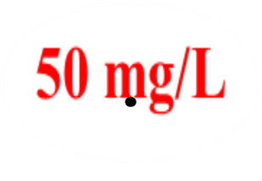

Nitrates and their concentration in waters are a global concern and the reduction of nitrate pollution is a trend that more and more countries are implementing
Nitrate pollution occurs mainly in areas where intensive farming is practiced and where nitrogen fertilizers are frequently applied
Within the European Union, the threshold for nitrate in drinking water is 50 mg / L.

Slide 5
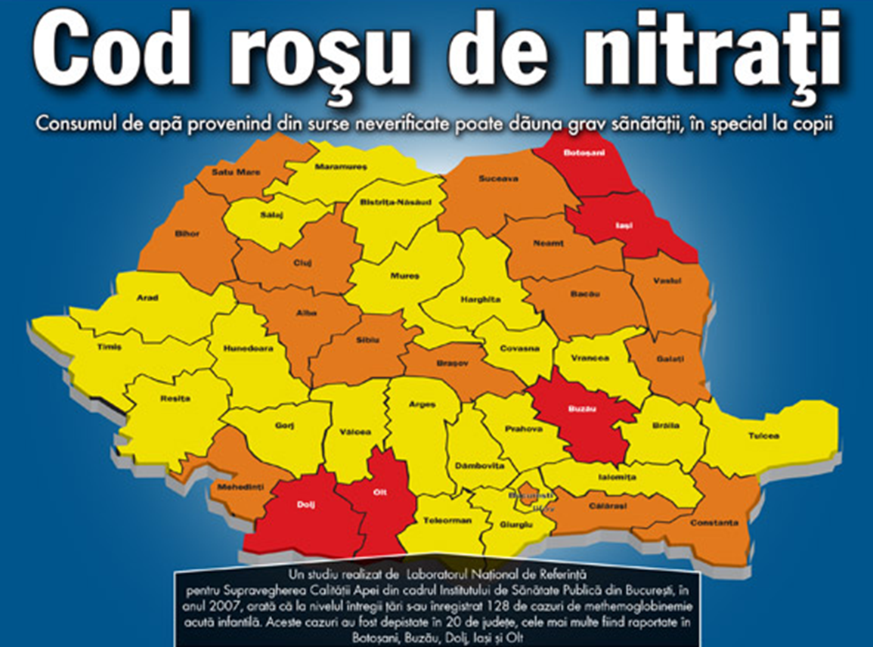

Slide 6
Sampling Well | S1 | S2 | S3 | S4 | S5 | S6 | Average
W1 | 8.32 | 10.32 | 14.87 | 5.45 | 5.88 | 6.35 | 8.53
W2 | 22.71 | 28.33 | 25.32 | 18.37 | 19.45 | 15.33 | 21.58
W3 | 52.65 | 68.32 | 50.73 | 46.66 | 40.75 | 33.45 | 48.76
W4 | 43.08 | 55.34 | 48.32 | 34.48 | 38.32 | 30.18 | 41.62
W5 | 45.69 | 40.33 | 53.28 | 58.64 | 50.64 | 46.78 | 49.22
W6 | 35.42 | 43.97 | 38.54 | 22.98 | 26.87 | 25.64 | 32.23
W7 | 35.09 | 38.22 | 42.76 | 25.43 | 24.88 | 21.35 | 31.28
MAL* | 50 mg/L
bold numbers represent samples with nitrate levels above MAL
Regarding nitrate, violations of the parametric value (50 mg/L) imposed by European and Romanian legislation were detected for 7 water samples (16.66% from 42 water samples). Nitrate content, as average, present the following variation W1<W2<W7<W6<W4<W3<W5.

Slide 7

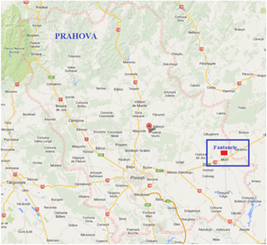
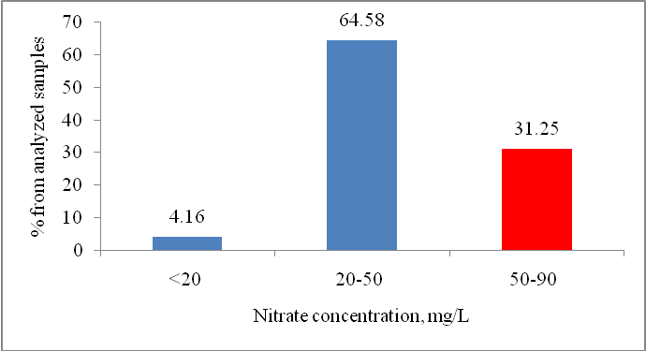
NITRATE MONITORING IN PRIVATE WELLS FROM PRAHOVA DISTRICT FANTANELE
Analysis of 48 water samples collected from 4 wells at different sampling moments, from Fântânele village, Prahova County indicated that 31.25% of samples contain nitrate above 50 mg/L, the highest found value being 87.09 mg/L

Slide 8
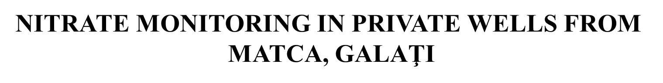
7 samples from Matca have high levels of nitrate between 149 mg/L and 452 mg/L

Slide 9
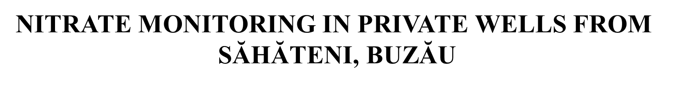

Slide 10
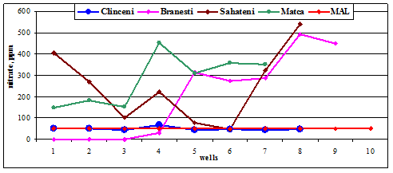
COMPARATIVE DATA REGARDING NITRATE CONTENTS IN WELLS OF THE FOUR VILLAGES
Analyzing the results, it can be concluded that, excepting samples from Clinceni village, almost all water samples exceed the maximum admitted level (MAL = 50 ppm) and endanger human health.

Slide 11
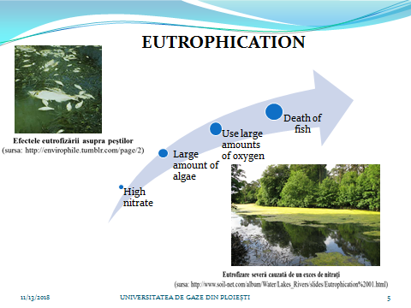

Slide 12
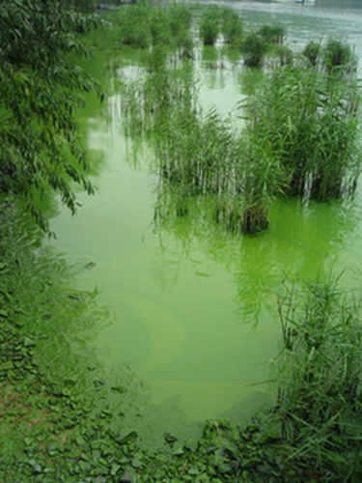
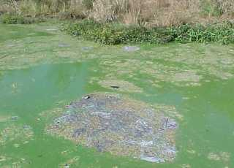
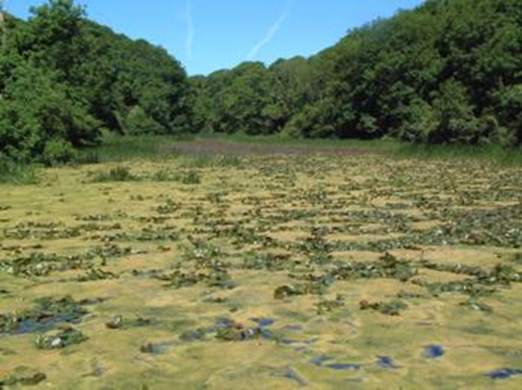
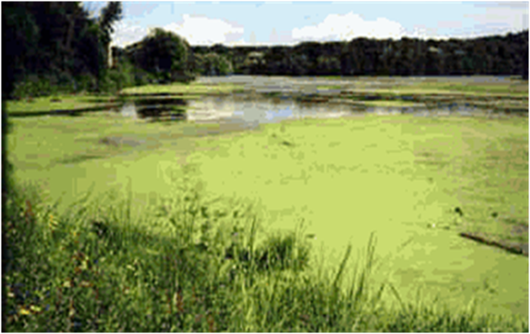
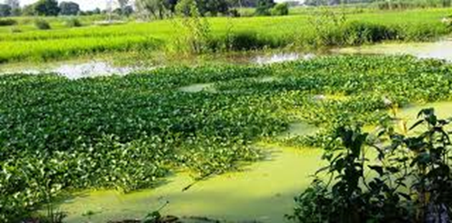

Slide 13
HEALTH EFFECTS

Slide 14
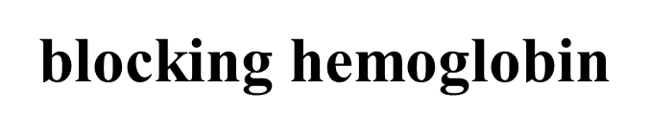
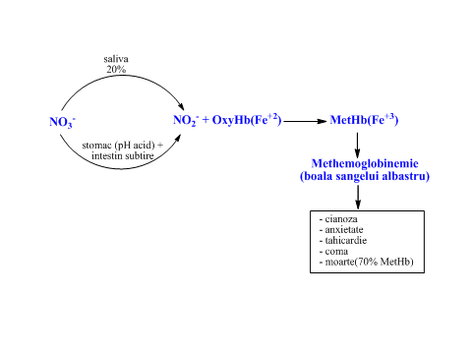
HEALTH EFFECTS

Slide 15
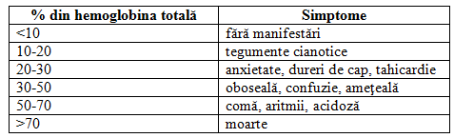
Manifestations of nitrate intoxication as % of blocked hemoglobin
Normal blood
Blocked hemoglobin
J.A.Cortazzo, A.D.Lichtman - Methemoglobinemia - a review and recommendations for management. Journal of Cardiothoracic and Vascular Anesthesia, 2013.

Slide 16
Treatment of methemoglobinemia
An intravenous dose of 1-2 mg / kg as a 1% solution of methylene blue
Before treatment
After treatment
A. El-Husseini, N.Azarov - Is threshold for treatment of methemoglobinemia the same for all? A case report and literature review. merican Journal of Emergency Medicine, 28, 748e5-748e10, 2010

Slide 17
The methaemoglobinemia recorded in Romania during 2005-2009
89
241
an 2005
106
an 2006
an 2007
an 2008
an 2009
128
243
A.Tudor, C.Staicu - Methemoglobinemia acută infantilă generată de apa de fântână în anul 2009, raport naţional

Slide 18
A.Tudor, C.Staicu - Methemoglobinemia acută infantilă generată de apa de fântână în anul 2009, raport naţional

Slide 19
Removing nitrates from water
DISTILLATION
REVERSE OSMOSIS
ION EXCHANGE RESINS

Slide 20
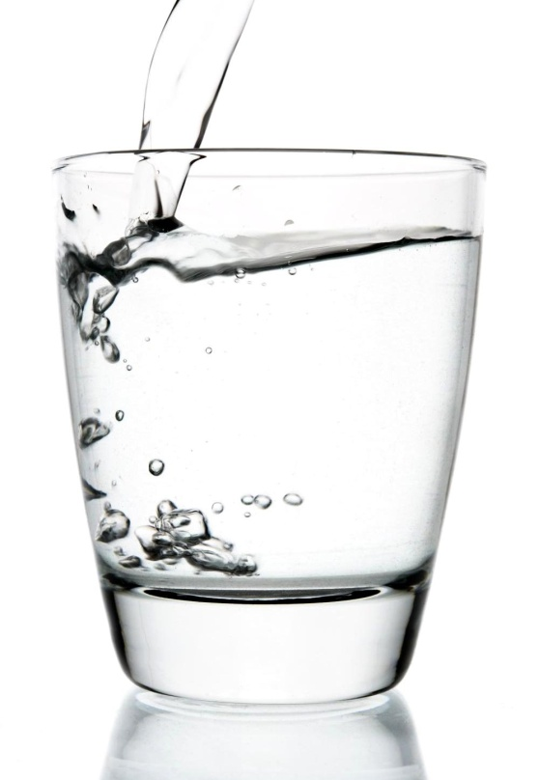
”Apa este singura băutură pentru un om înţelept.”
(Henry David Thoreau)

