Slide 1
Stability of zinc oxide samples prepared with sol- gel method in supercritical water
Ayten ATEŞ
Cumhuriyet University, Engineering Faculty, Department of Chemical Engineering, Sivas, 58140, TURKEY
^{3rd} International Colloquium Energy and Environmental Protection

Slide 2
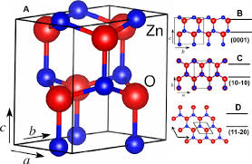
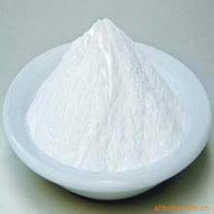
Zinc Oxide (ZnO)
a white crystalline oxide of zinc
Structure
Hexagonal, wurtzite crystal structure
Outstanding optical and electrical properties
Uses
Optoelectric transducers,
Chemical and gas sensors,
Photocatalyst etc.
Morphologies
wires, flowers, rods, tubes, sheets, ribbons, plates, dumbbell, disks and springs
Synthesis routes
Sol–gel method
Hydrothermal and solvothermal synthesis from ambient temperature and pressure up to supercritical conditions
Chemical vapor deposition (CVD)
Thermal evaporation
Spray pyrolysis

Slide 3
Use of supercritical water (SCW) with heterogeneous catalyst in biomass gasification has following advantages:
The control of phase behavior via elimination of gas- liquid and liquid- liquid mass transfer resistances,
Enhanced diffusion rate in reactions controlled by interface diffusion (fluid/particle),
Enhanced heat transfer,
Easy removal of products,
Improvement of catalyst’s lifetime by dissolution of deactivating hydrocarbons,
Improvement of solvent using a co-solvent and increased pressure.

Slide 4
Effect of supercritical water (SCW) on heterogeneous catalyst
The stability and mechanical strength of the catalysts cannot be remained in SCW as the solid- solid transformations of the conventional catalysts.
The structural change such as the aggregation of solid catalysts, phase transformation and dissolution of solid can occur in SCW.
The degree of the structural change:
The composition of catalysts
Preparation method of catalysts
Operation conditions in the reactor.
The crystalline phase of zinc oxide strongly affects its structural, textural, and thereby catalytic properties in SCW

Slide 5
Experimental Method
Sol-gel synthesis of ZnO
Characterization
Precursor: Zinc acetate dehydrate
Chemical: Ethylene glycol, n-propyl alcohol, and glycerol, triethylene amine
Preperation: Precursor, zinc acetate dehydrate, was dissolved in ethylene glycol at 150 ºC for 15 min at 400 rpm. The gel was formed during aging. The gel was dissolved in glycerol and n- propanol was added to solution. After gel formation, tri ethylene amine was added to the gel and the solvent was removed by rotary evaporator at 90 ºC under vacuum. Gel was dried at 80 ºC and calcined at 350 ºC and 900 ºC.
Temperature-Programmed Reduction (TPR)
Temperature-Programmed Oxidation (TPO)
Crystalinity: XRD (Rigaku SmartLab).
Surface area and porosity (Autosorb 1)
Functional groups : FTIR (Perkin-Elmer Spectrum One)
Particle size: SEM / Particle size analyzer

Slide 6
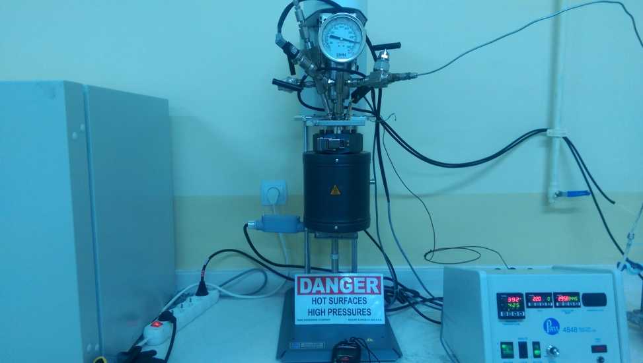
Reaction
Reactor: Batch reactor (Parr 4591) (volume of 100 cm³).
Mixture: 55 g/L of formaldehyde and 40 g (0.52 g/cm³) of solution ;
ZnO catalyst: 1.0 g
Reaction time and temperature: 30 min and 400 ºC
Gas and liquid samples were analyzed by using an on-line GC and HPLC, respectively

Slide 7
RESULTS AND DISCUSSION

Slide 8
XRD
ZnO has hexagonal crystal structure and its crystal structure maintains after SCW gasification, but its crystal size is getting bigger based on SEM results

Slide 9
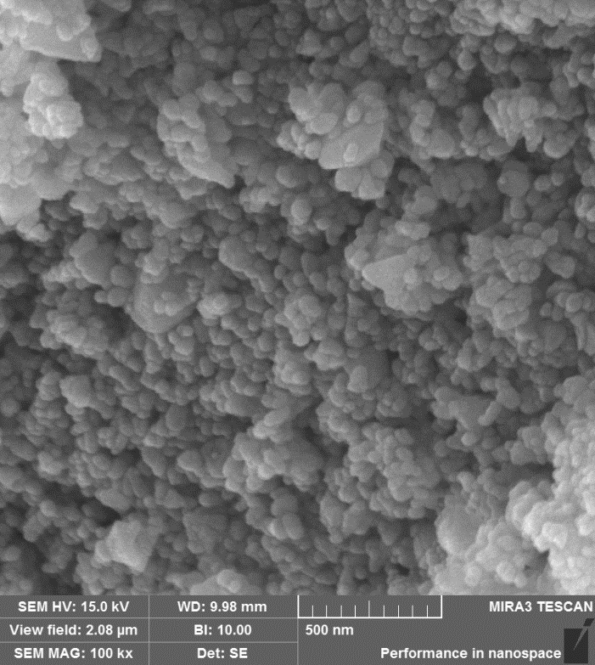
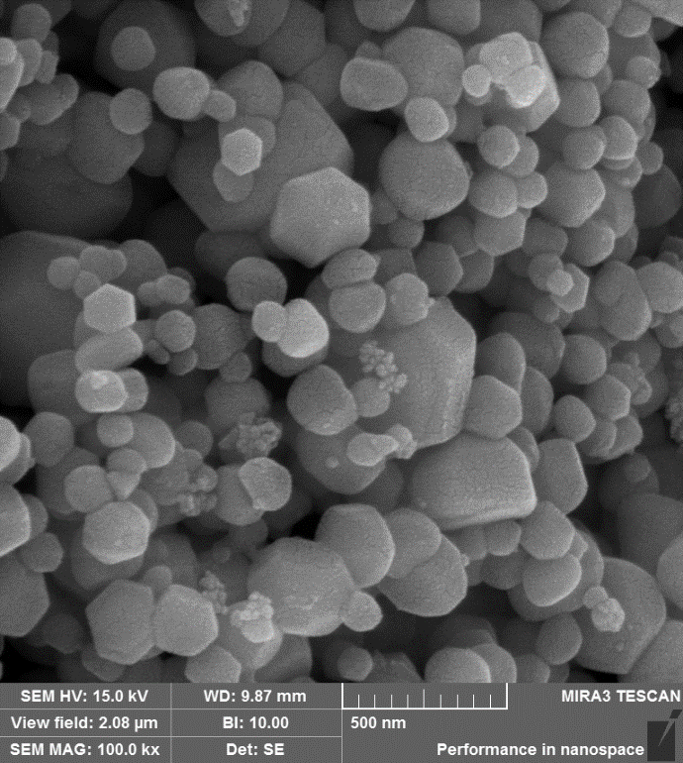
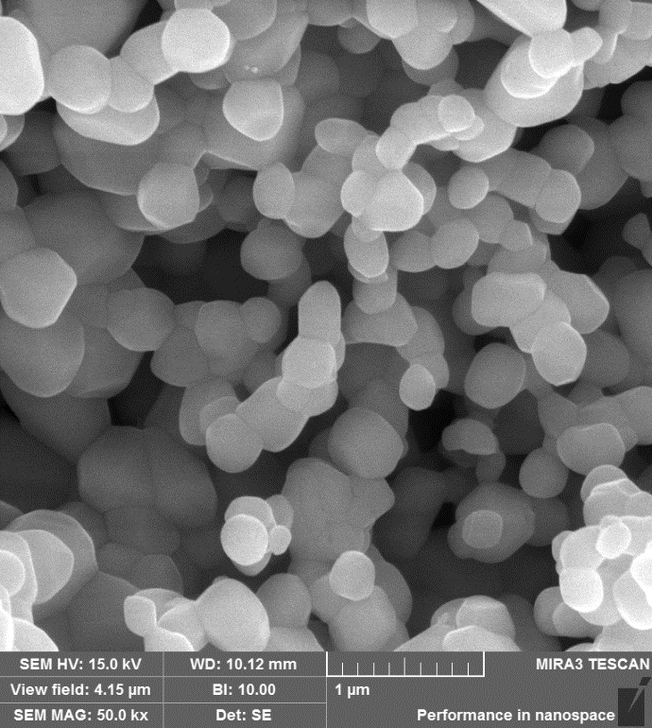
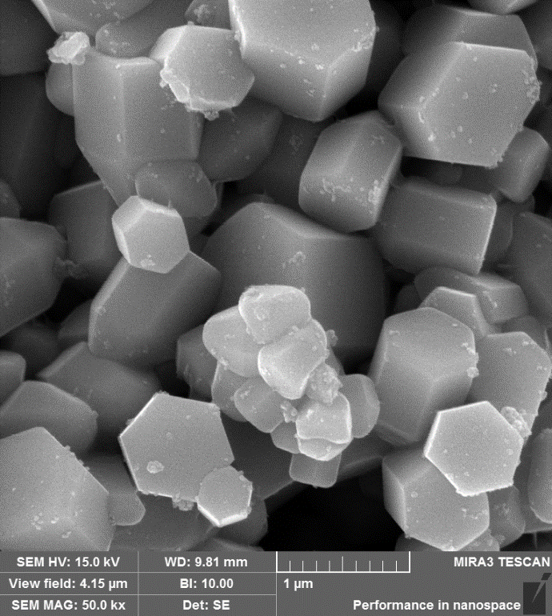
SEM RESULTS
ZnO calcined at 350 ºC
has nano- sized particles
ZnO-350
ZnO-350SCW
ZnO calcined at 900 ºC
has mikro- sized particles
SCW gasification leads to
particle growing at both
calcination temperature
ZnO-900
ZnO-900-SCW

Slide 10
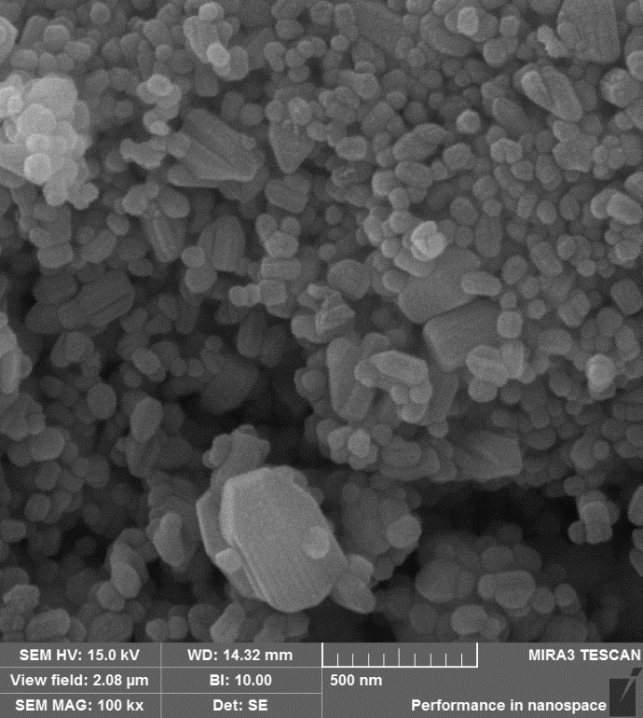
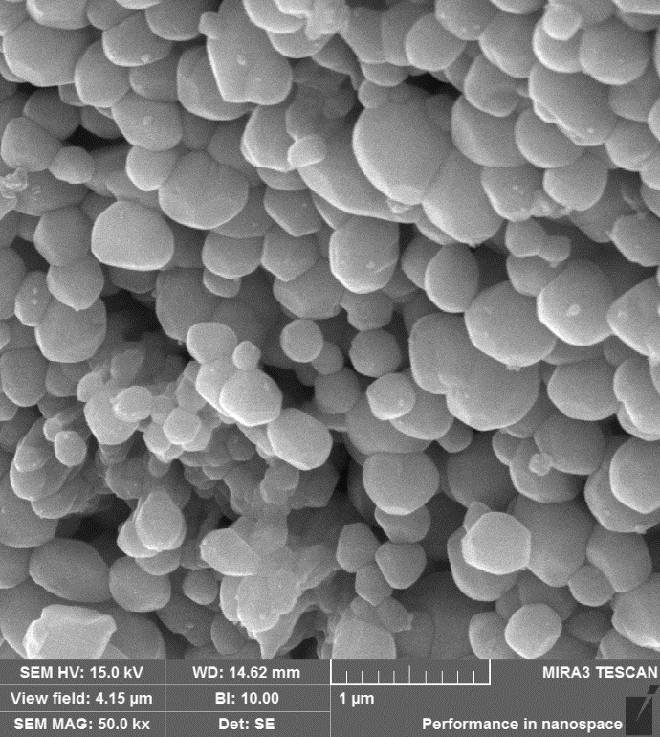
SEM RESULTS
SCW leads to agglomeration of
ZnO irrespective of calcination temperature
ZnO-350
ZnO-350- HT
ZnO-900
ZnO-900- HT

Slide 11
Surface area and pore size distribution
Sample | S_{BET}ª (m²g⁻ ¹) | V_{Total}^{b} (cm³ g⁻ ¹) | V_{micro} (cm³ g⁻ ¹) | Dp (Å) ^{c}
ZnO-Commercial | 9.7 | 0.04 | - | 167.0
ZnO-SJ-350 | 30.7 | 0.18 | 0.01 | 121.9
ZnO-SJ-350-HT | 21.5 | 0.16 | 0.006 | 151.0
ZnO-SJ-350-SCW | 11.65 | 0.10 | 0.003 | 176.8
ZnO-SJ-900 | 26.8 | 0.12 | - | 295
ZnO-SJ-900-HT | 20.5 | 0.06 | 0.006 | 54.1
ZnO-SJ-900-SCW | 9.94 | 0.10 | 0.003 | 203.1
Surface area of ZnO synthesized with sol- gel is higher than commercial ZnO
The reaction of formaldehyde on ZnO decreased surface area due to agglomeration of crystal
ª Multipoint BET; ^{b} Adsorbed volume at P/Pº = 0.99’da; ^{c} DR

Slide 12
ZETA Results
SCW gasification and SCW affect significantly the zeta potential of ZnO
Hydrothermal treatment (HT) in SCW affects significantly the zeta potential
of ZnO

Slide 13
TGA Results
Coke amount
ZnO calcined at high temperature (900 ºC) is more stabile than that at low temperature
due to its higher crystal size based on SEM and XRD results
Coking is less in the presence of ZnO- 350 than that of ZnO-900

Slide 14
Activity Results
Table 1. Gas and liquid product distribution of formaldehyde on ZnO
Sample | mcat (g) | CH₂O (%) | m_{Total} (g) | T (ºC) | t (min) | CO₂ | H₂ | CO | O₂ | CH₄ | C_{CH2O} (g/L) | C_{CH3OH} (mol/L) | C_{HCOOH} (mol/L) | %X | pH
Homogenous | - | 20 | 40 | 400 | 30 | 45.68 | 37.83 | 11.76 | 3.64 | 1.08 | 17.40 | 5.64 | 0.83 | 91.0 | 2.88
ZnO-350 | 1.0 | 20 | 40 | 400 | 30 | 43.24 | 53.84 | 1.80 | 0.65 | 0.42 | 14.90 | 3.58 | 0.74 | 92.6 | 2.45
ZnO-350-R | 1.0 | 20 | 40 | 400 | 30 | 41.54 | 54.68 | 1.48 | 1.85 | 0.39 | 3.10 | 5.81 | 0.22 | 98.4 | 3.01
ZnO-900 | 1.0 | 20 | 40 | 400 | 30 | 35.25 | 57.28 | 3.82 | 3.19 | 0.46 | 8.79 | 5.38 | 0.56 | 95.6 | 2.27
% 10 Formaldehyde-pH=3.20; % 15 Formaldehyde pH=2.58; % 20 Formaldehyde-pH=2.45
For 30 min, the highest H₂ percentage is detected on ZnO-900 and highest CO₂ percentage is observed on ZnO- 350. Increasing particle size increases hydrogen formation of ZnO.

Slide 15
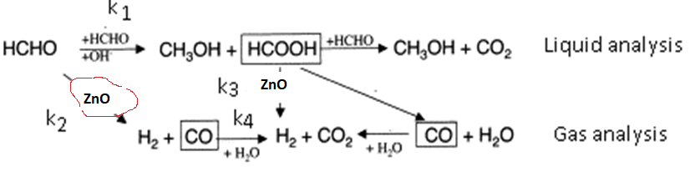
Decomposition mechanism of formaldehyde
The presence of ZnO changes decomposition mechanism of CH₂O and enhanced hydrogen formation

Slide 16
Results and Discussion
Based on XRD pattern:
ZnO has hexagonal phase composition irrespective of calcination temperature
SCW and SCW gasification do not affect ZnO’s phase composition
Increasing calcination temperature of ZnO :
increasing stability based on XRD patterns
decreasing surface area and porosity
increasing crystal size

Slide 17
Presence of ZnO
changes decomposition mechanism of formaldehyde
enhances hydrogen formation
increases formaldehyde conversion

Slide 18
THANKS
FINANCIAL SUPPORT
The Scientific and Technological Research Council of Turkey (TUBITAK) (213 M398) and Cumhuriyet University Research Fund (M742).

