Slide 1

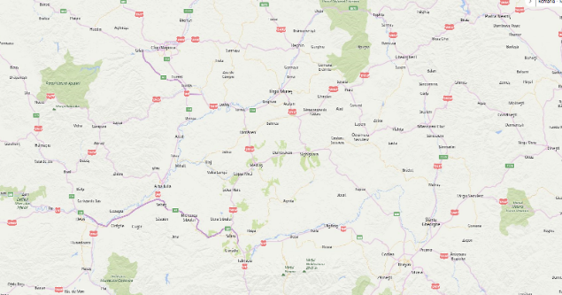
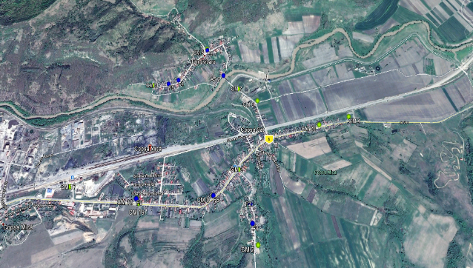
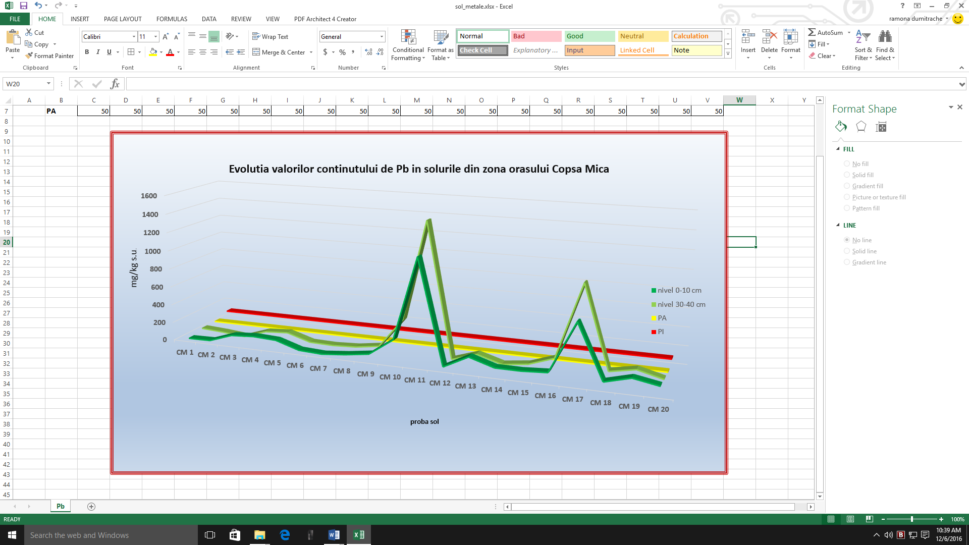
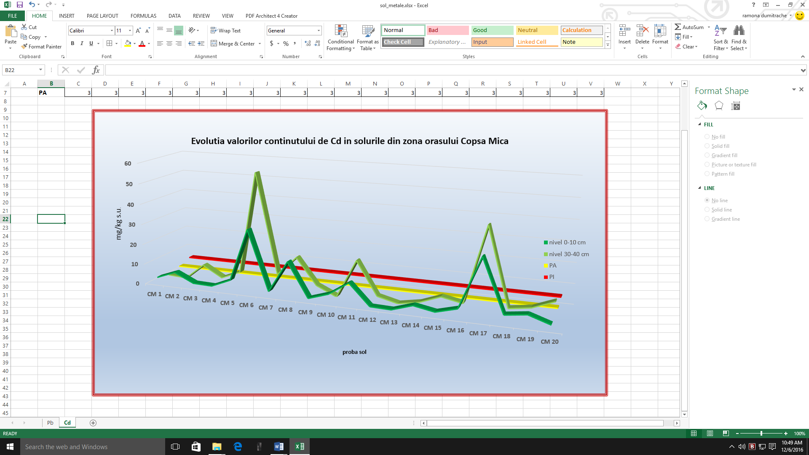
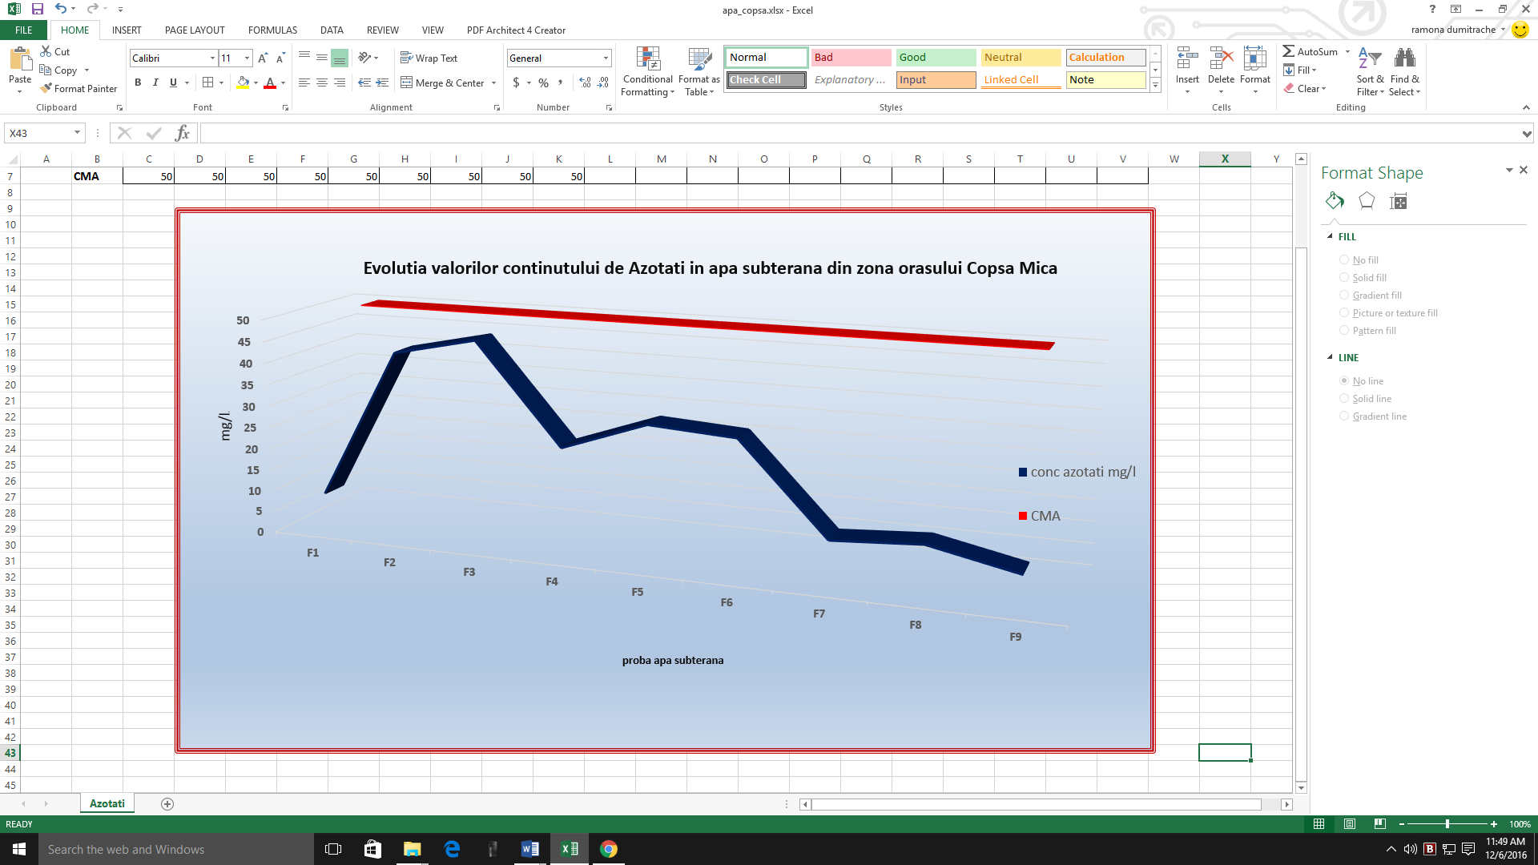
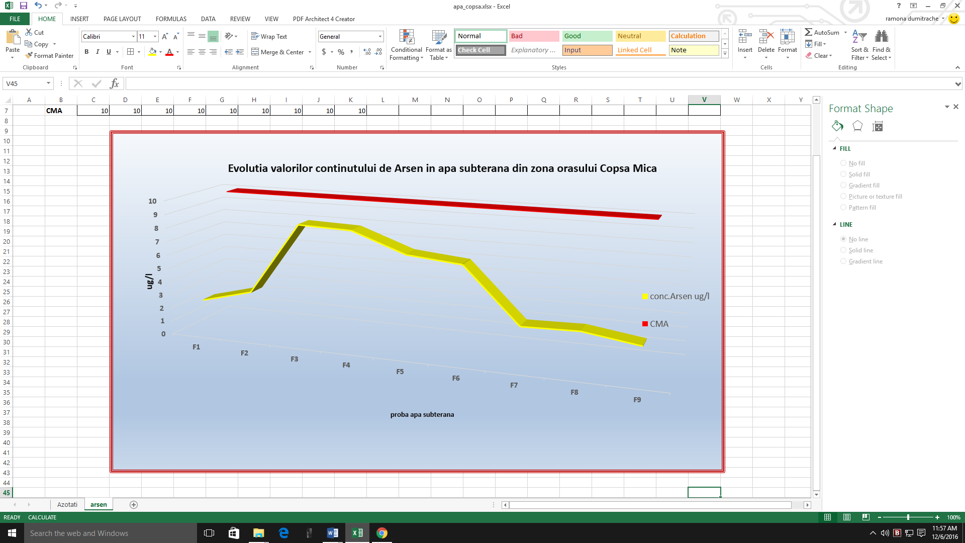
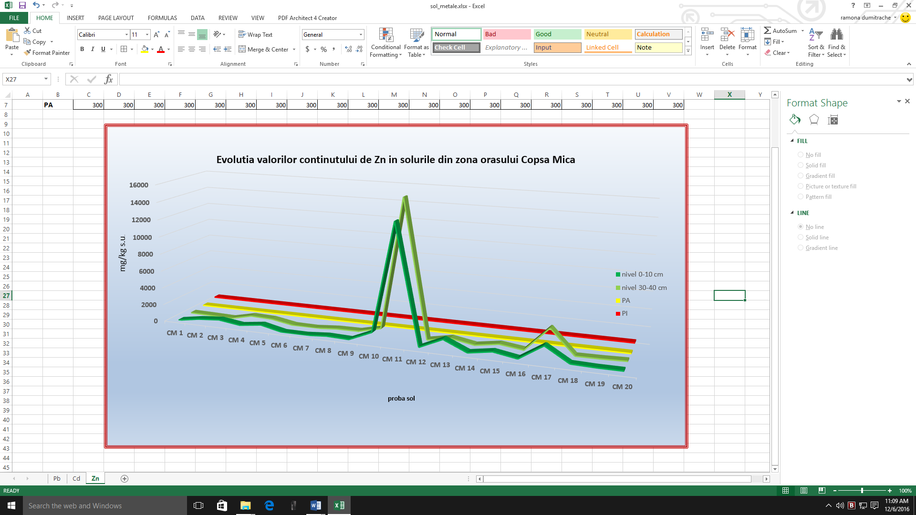
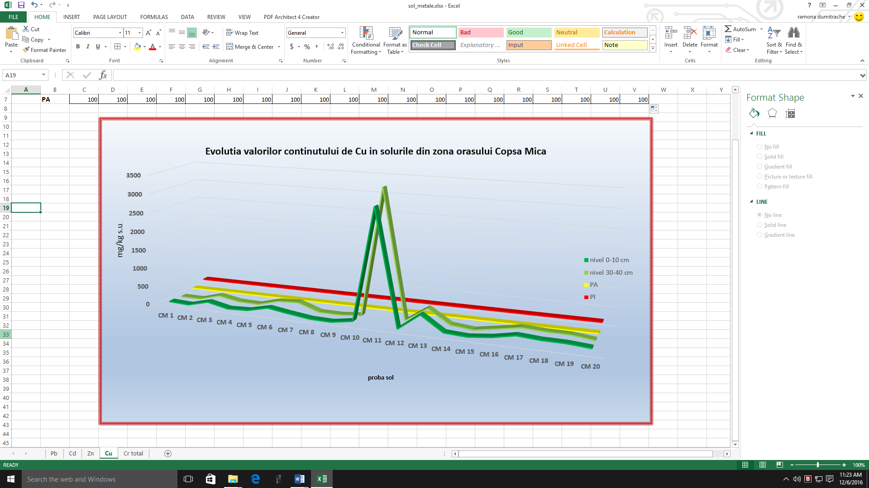
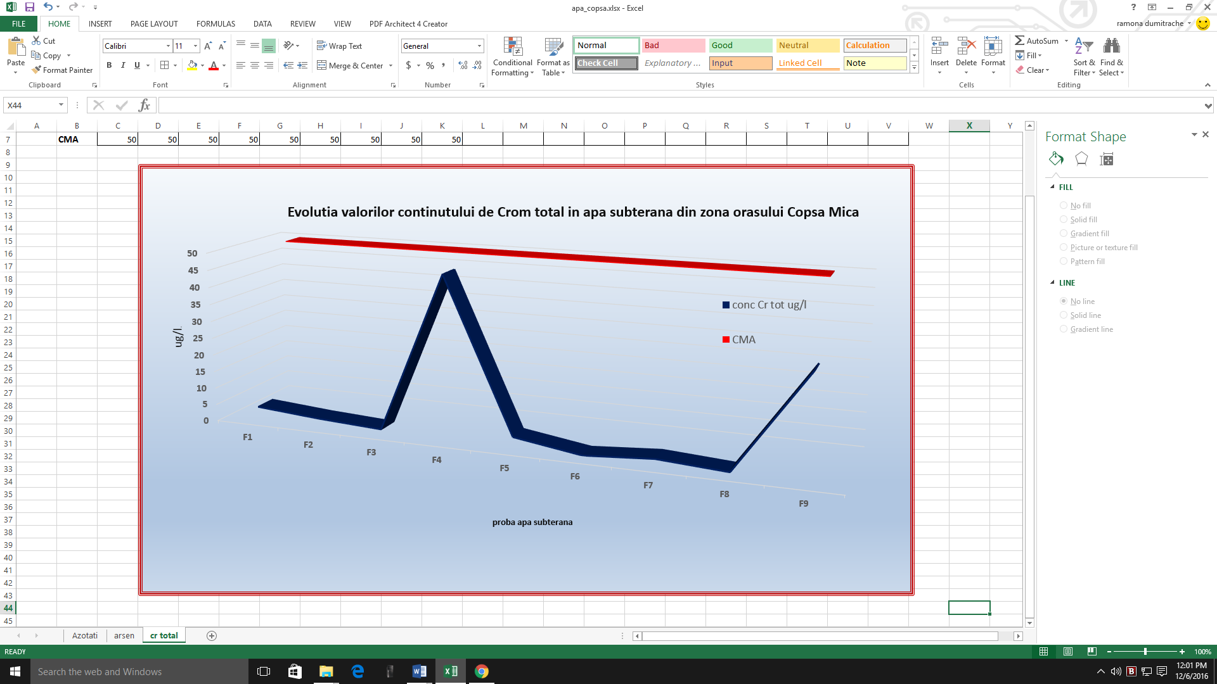
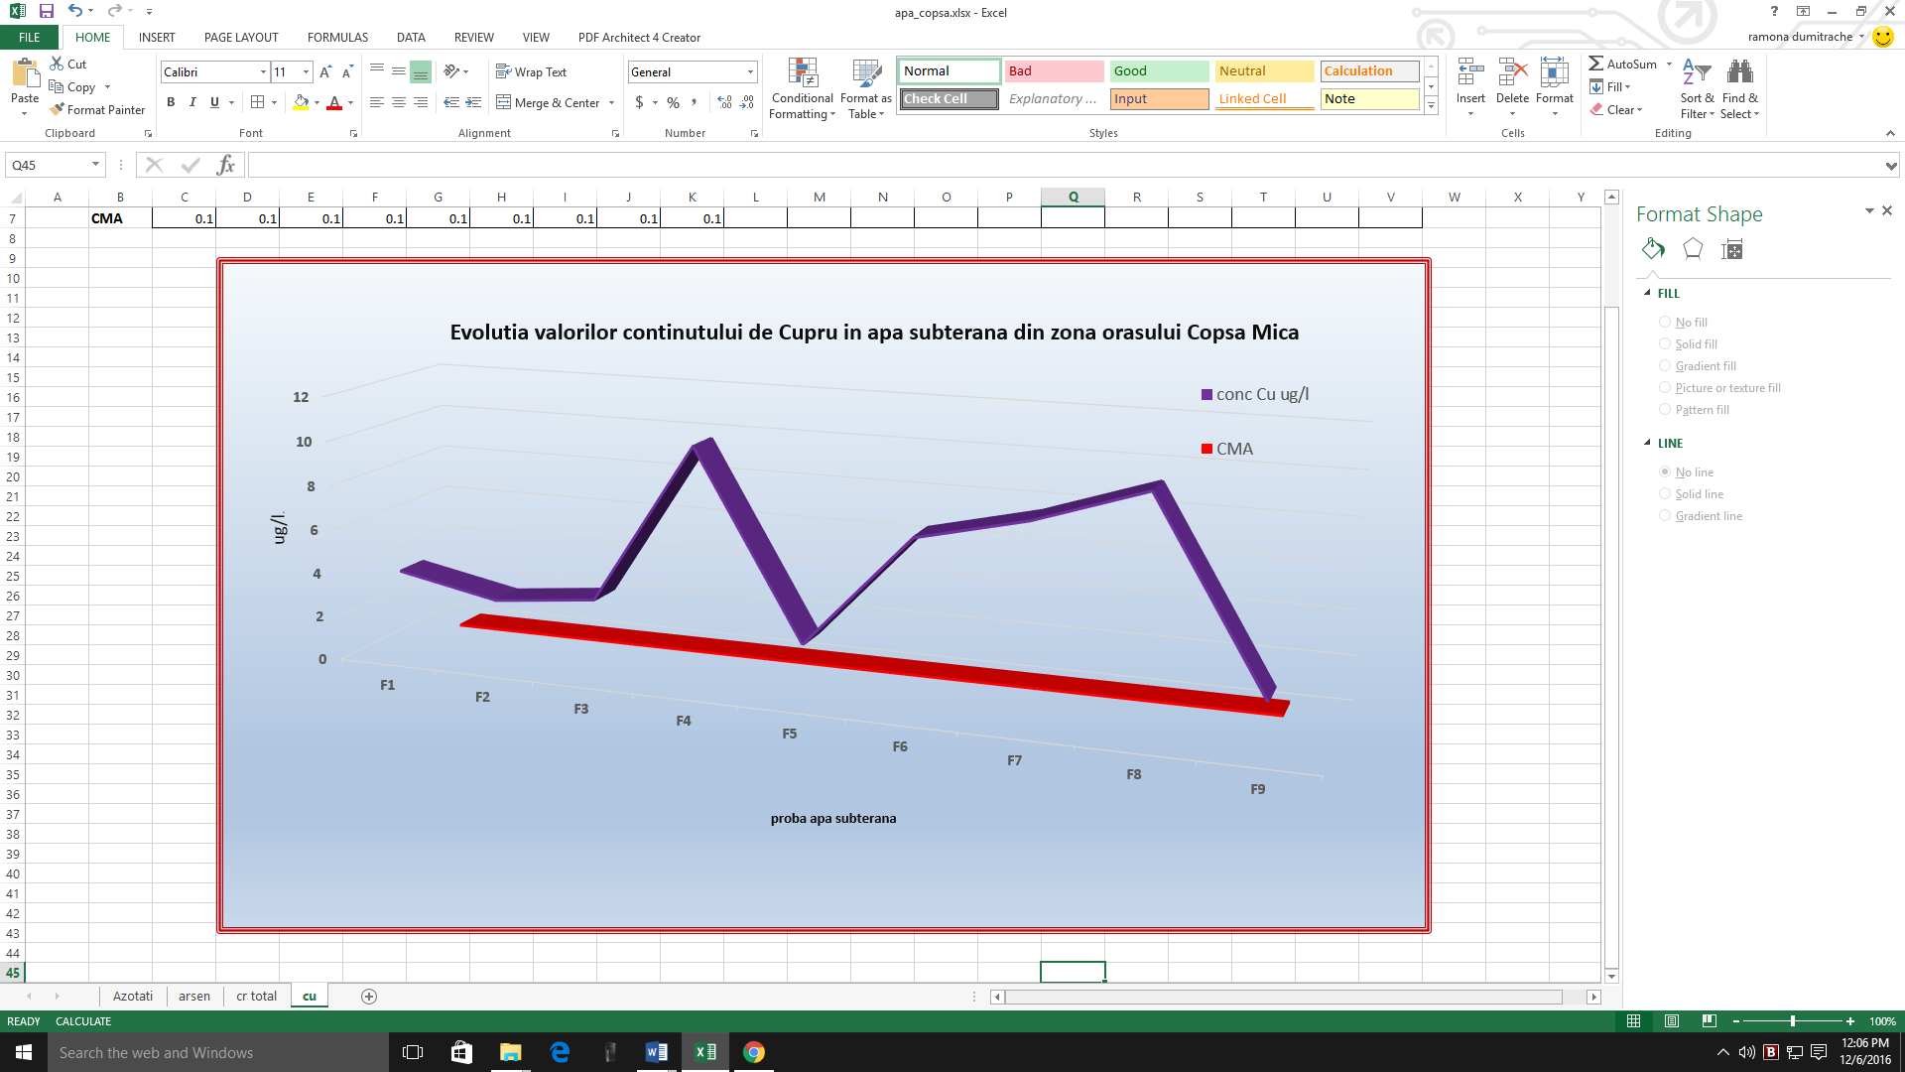
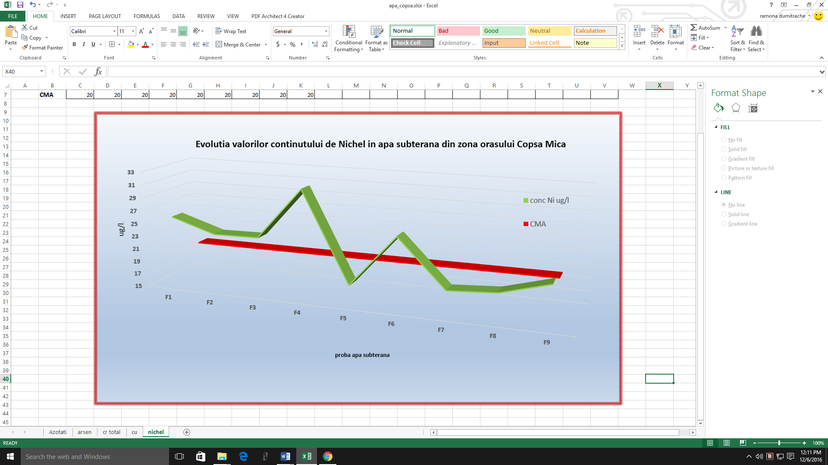
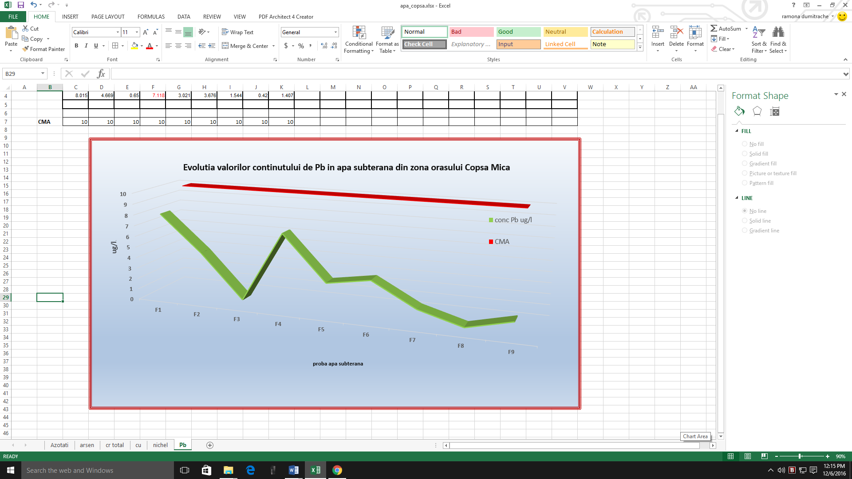
ASSESSMENT OF THE ENVIRONMENTAL ASPECTS IN A CITY AREA AFFECTED BY HISTORICAL POLLUTION
Bogdan Stanescu, Lidia Kim, Carol Lehr, Elena Stanescu
National Research and Development Institute for Industrial Ecology ECOIND Bucharest, 71– 73 Drumul Podu Dambovitei Street, code 060652, Bucharest, Romania, evmt@incdecoind.ro
Introduction
Industrial polllution has been and continues to be a major factor causing the degradation of the environment. Copsa Mica city is located in the North-West of Sibiu County, at the confluence of the Tirnava Mare river with Visa. Crossed by DN14, the city is located 43 km from the county seat, 12 km from Medias and 33 km from Blaj on DN 14B. The city is bordered by Bazna commune and resort, to the North-East by Tirnava commune and Medias municipality, by the commune of Valea-Viilor to the East, by the Axente Sever commune to the South and the Micasasa commune to the West. The city is located in the depression corridor of the Tarnava Mare River, surrounded by hills (Figure 1).
The city of Copsa Mica is well known for the historical pollution induced by the industrial activities carried out in the area (over 60 years) which is attributed to gaseous emissions containing sulphur dioxide and atmospheric particulates containing heavy metals, mainly Cd, Pb and Zn.
The ecological importance of the presence of heavy metals in urban soils is closely related to human health due to their high ecological transference reported as an indicator of urban environmental quality. Recent studies underline the importance of the correlation between the state of terrestrial ecosystems and groundwater, considering that one of the basic principles in this field is based on groundwater protection policy against pollution and deterioration, as included in EU Water Framework Directive 2000/60 EC and Directive 2006/118/EC.
STUDY AREA
2. Materials and methods
Figure 1 . Study area – Copsa Mica
The soil quality survey in Copsa Mica consisted of sampling soil from an experimental field with an extended spatial distribution throughout Copsa Mica and
beyond its limits to a distance of about 6 km. A total of 20 soil samples were taken from depths of 0-10 cm and 30-40 cm, resulting in a total of 40 soil samples. Hand-operated soil sampling equipment produced by the Eijkelkamp company was used. The GPS tracking equipment used is a Garmin portable GPS receiver, the GPSmap 60CSx. The location distribution of the sampling points is shown in Figure. 2.For each soil sample, the following quality indicators: pH, humus, sulphates, phenols and heavy metals (Pb, total Cr, Cu, Zn, Fe, Cd, Mn, Ni, As).
The investigation of the groundwater quality in Copsa Mica consisted in the sampling activities according to of the distribution of fountains throughout the city of Copsa Mica and 2 distribution points (named "Cismea" 1 and 2). A total of 9 groundwater samples were taken, with the reference that for points F7 and F8 the underground water is captured, stored and pumped into two distribution points, locally identified as "Cismea".For each water sample, the following quality indicators: pH, nitrates, conductivity, sulfates, phenols, oxidation and heavy metals (Total Chromium, As, Ni, Cu, Zn, Cd, Fe, Pb, Mn, Ni) were analyzed in the NR&DI ECOIND laboratories using the standardized test methods.
3. Results and Discussion
Figure 2 . Map of the sampling points
Interpretation of the results of the laboratory tests made for the 40 soil samples taken from Copsa Mica, Sibiu county was done by comparison to the reference values of the "Order 756/1997 for the approval of the Regulation regarding the environmental pollution assessment", with the subsequent modifications and completions, respectively the reference values for chemical soil traces in soil for sensitive land use. Sensitive use is defined by Article 8 paragraph a) from the above mentioned regulation:
"Sensitive land use is represented by their use for residential and recreational areas, for agricultural purposes, as protected areas or restricted sanitary areas as well as the areas of land forecasted for such uses in the future.”
The evolutions of some relevant quality indicators for the industrial activities carried out in the area of Copsa Mica are graphically presented below:
With regard to the underground water, significant exceedances of the maximum admissible concentrations were registered for copper (all samples taken) and nickel (6 samples out of 9), while for the other analysed pollutants the values ​​were below the CMA values.
This shows that the underground water supply in the analysed area is not affected by the pollution identified in the case of soils, and under these conditions the groundwater can be considered much better in qualitative terms.
Interpretation of the results of the tests performed for the two samples of surface water taken from the area of ​​Copsa Mica, respectively from the Visa and Tarnava Mare River, was made by reference to the values ​​of the Order no.161 of 16.02.2006
approving the Norms for surface water quality classification to determine the ecological status of water bodies.
Analysing the obtained results, it is obvious that both water bodies analysed correspond to a "very good" ecological status, with one exception, respectively the "Ni" quality indicator whose values ​​impose the "good" ecological status.
Figure 3. “Lead” content in soils samples from Copsa Mica
Figure 4. “Cadmium” content in soils samples from Copsa Mica
Figure 7. “Nitrates” content in underground samples from Copsa Mica
Figure 8. “Arsenic” content in underground water samples from Copsa Mica
Figure 5. “Zinc” content in soils samples from Copsa Mica
Figure 6. “Copper” content in soils samples from Copsa Mica
Figure 9. “Total Chromium” content in underground water samples from Copsa Mica
Figure 10. “Copper” content in undreground water samples from Copsa Mica
There are a number of negative aspects regarding the soil quality, which mainly consist in the frequent exceeding of the intervention threshold. An extremely unfavourable situation was recorded at sample “CM 11”, located near DN14B, at approx. 700m in the South direction of the dumps of SC Sometra SA, which is the potential source of pollution with heavy metals. A general conclusion for the soil environmental component can be formulated as follows: the soil is still affected by the residual pollution of historical nature, induced by the industrial activities carried out in the area that had a significant impact on the environment.
The groundwater quality investigations, respectively 9 groundwater samples taken from the Copsa Mica area led to results that were interpreted by comparison with the reference values of Law 458 (r1) of 08.07.2002.
Figure 11. “Nickel” content in undreground water samples from Copsa Mica
Figure 12. “Lead” content in underground water samples from Copsa Mica
4. Conclusions
The project aimed to investigate the quality of the environmental components of soil and water (surface and underground water) in the Copsa Mica, a small city, known for the historical pollution recorded over several decades.
Specific soil and water quality investigations were conducted in 2016 in order to highlight the evolution and dynamics of environmental issues in a highly anthropic and polluted area (historical pollution). The experimental field will be used to highlight dynamic evolution starting from the baseline identified in 2016.
The conduct of several investigative campaigns within the proposed experimental field will create clear premises for obtaining a solid database regarding the quality of the environmental components and the evolution and dynamics of the environmental aspects for Copsa Mica, as the activities are in progress in 2017.
Acknowledgements
The project PN 16 25 02 10 is funded under the „Program Nucleu”, in period 2016-2017, conducted by the Ministry of Research and Innovation from Romania.
International Symposium “Environment and Industry” SIMI 2017, Bucharest, Romania, 28-29 September 2017

