Slide 1

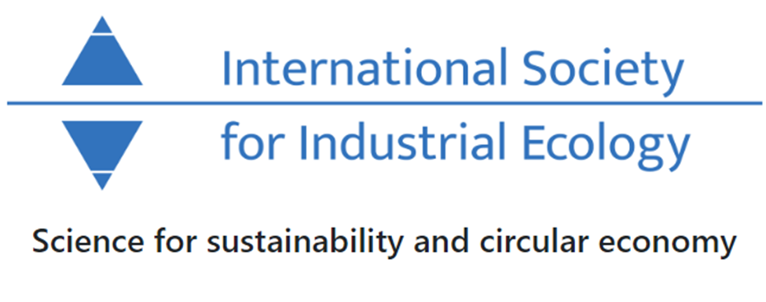



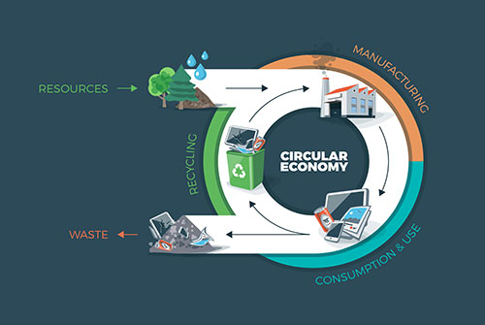
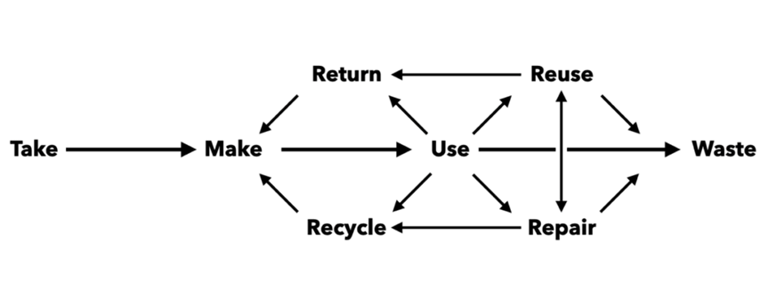
GREEN REVOLUTION and Circular Economy
moDELS and practices
Andreea COZEA*, Gheorghe-Cosmin MANEA**
* 1 National Research and Development Institute for Industrial Ecology INCD ECOIND, 57-73 Drumul Podu Dambovitei Street, postal code 060652, Bucharest, Romania, 2 GLEARN & RESEARCH, Adress: 201 Fullwell Avenue, Ilford, Essex, United Kingdom, postal code IG5 0RA, andreea.cozea@yahoo.com
** 1The Bucharest University of Economic Studies-E.A.I., Tache Ionescu Street, postal code 52632, Bucharest, Romania, 2 GLEARN & RESEARCH, Adress: 201 Fullwell Avenue, Ilford, Essex, United Kingdom, postal code IG5 0RA, maneacosmin37@gmail.com
Introduction
Climate change, biodiversity loss and the degradation of soil, air and water resources endanger our lives. Therefore, everyone's interest must be focused on a green and sustainable economy, and research and innovation must ensure the transition to a circular economy.
The changes must be considered related to the greening aspect such as: sustainable agriculture, carbon-free buildings and transport system, the transition to a clean energy, energy efficient transportation, and smart cities. The future is based on the green transition to renewable energy, accompanied by the adoption of the circular economy model.
In this sense, this study aims to follow the context of the framework necessary for the implementation of initiatives associated with the circular economy that will lead to a green transition, in general, with increasing resource efficiency, and recovering gaps at the state level.
The circular economy is an model that is regenerative by intention and design and aims to improve resources’ performance and fight the volatility that climate change might bring to businesses.
A circular economy model aims to close the gap between the production and the natural ecosystems’ cycles – on which humans ultimately depend upon.
Principles and model
The circular economy model
The circular economy must be not one single vertically-integrated action.
Companies are like dots along the circle, forming a network between suppliers and customers called a value chain. This network can either be organized as a straight line between natural resources and landfills (linear economy) or creating a perpetual cycle of value with zero waste (circular economy).
EU aims to transition to a circular economy to make Europe cleaner and more competitive.
The model will be sustained by three principles of the circular economy:
1. Keeping products and materials in use
That means focusing on sustainability, reuse, re-manufacturing and recycling to keep products, components and materials circulating in the economy.
2. Elimination of waste and pollution
This includes emissions of greenhouse gases and hazardous substances, air, soil and water pollution, as well as structural losses such as traffic congestion.
3. Regeneration and renewal of natural systems
A circular economy avoids the use of non-renewable resources and conserves or enhances renewable ones, for example by returning valuable nutrients to the soil to support regeneration or by using renewable energy instead of fossil fuel-based energy.
Implications at national and international level
Through the study, an inventory of existing best practices was made at European and national level for the implementation of the circular economy (e.g. industrial symbiosis).
The promotion of thematic initiatives in this area actively could contributes to the development of norms/standards, methodologies on the different types of waste, but also on the specialization of the workforce.
Regarding the green economy area, Romania has implemented a series at the national level of relevant normative acts for this field, which achieve synergies with the circular economy.
In terms of the tools needed to facilitate the implementation of the circular economy and the green one in Romania, the following tools were approached in the last years: investment projects (84.31%), public education (88.24%), research projects (60.78%), green public procurement (52.94%).
Conclusion
The circular economy does not apply to a single field of activity or resources, it can be extended to the level of all sectors of activity through different types of synergies, which can generate positive cumulative effects by association.
Acknowledgements
This study was accomplishing through the GLEARN & RESEARCH funds; the authors would like to thank all those who contributed to this study.

