Slide 1
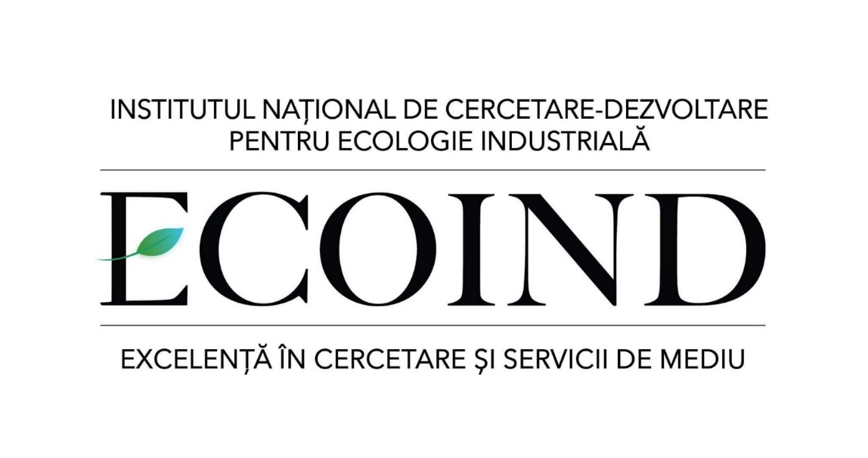
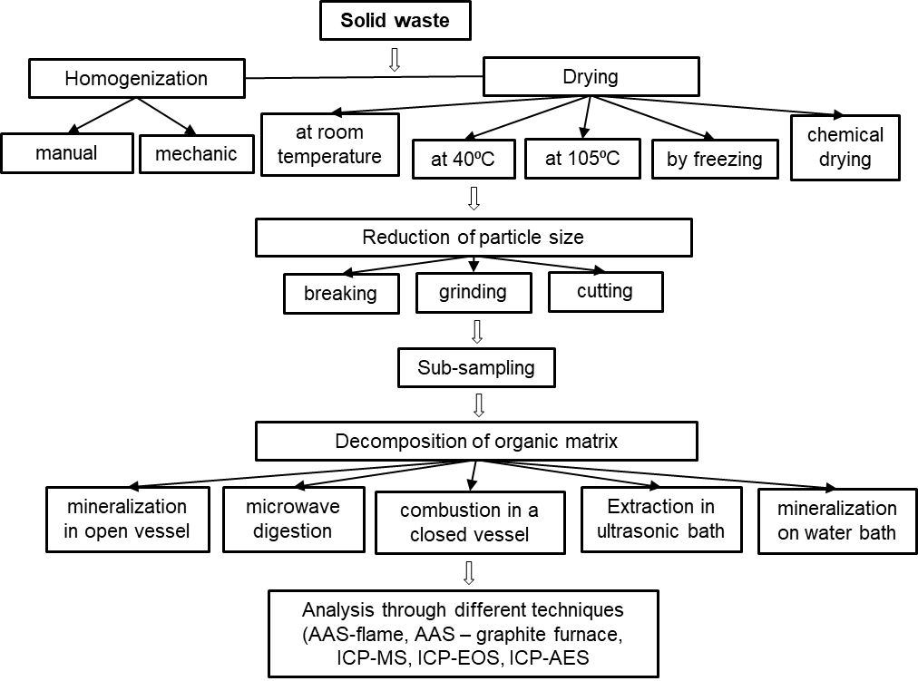
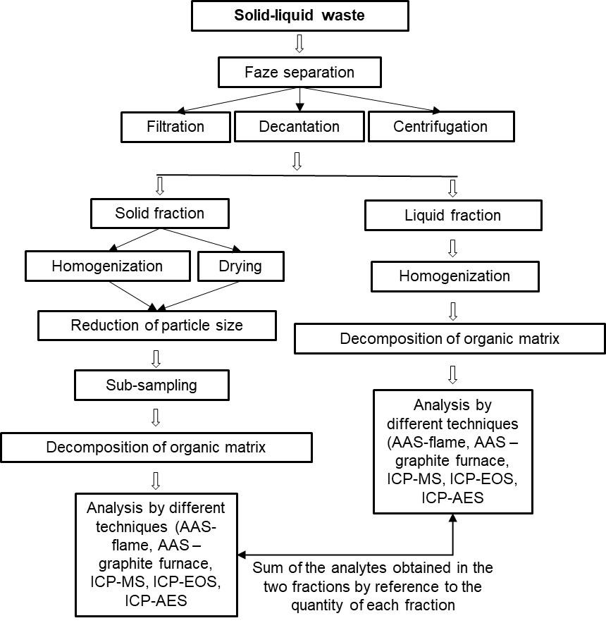
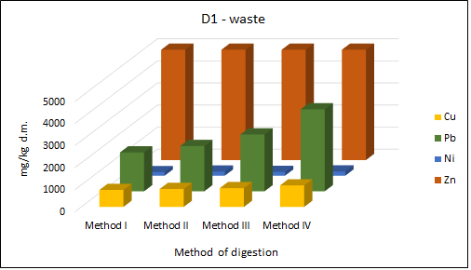
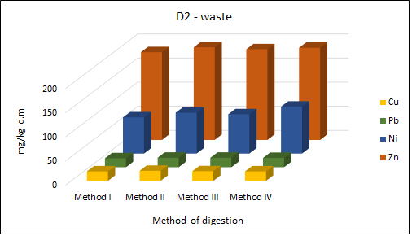
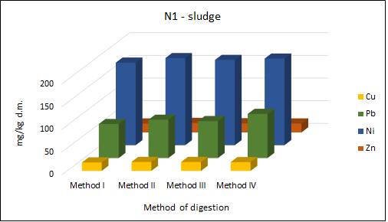
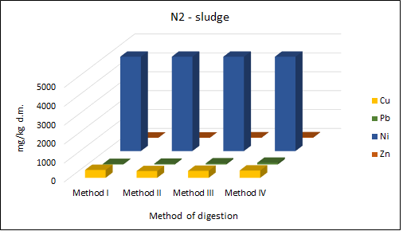
EXPERIMENTAL MODELS OF CHARACTERIZATION AND ANALYSIS
OF INDUSTRIAL WASTE
Lidia Kim, Alina-Maria Muresan, Adriana Cuciureanu, Doina Guta, Madalina Arama, Nicolae Ionut Cristea, Violeta Dediu
National Research and Development Institute for Industrial Ecology – ECOIND Bucharest
Drumul Podu Dambovitei St. 71– 73, 060652, Bucharest, Romania
Introduction
It is well known that pollution of the natural environment with heavy metals is a universal problem because these metals are not biodegradable and many of them have toxic effects on living organisms and implicitly on human health¹. Knowing the waste composition is extremely important because based on it and depending on the waste nature and the hazardous substances content, the environmental contamination degree could be highlighted²⁻⁴. Also, knowing waste composition is important from a managerial point of, which consists in collecting, transporting, capitalizing and waste disposal activities, as well as in terms of recycling, reuse or treatment. In the present paper we report, a series of experimental characterization and analysis models that can be applied to industrial waste samples in order to determine the heavy metals within them. These experimental models were tested on a series of wastes coming from processing and finishing activities of metal surfaces and other materials. The obtained results proved that the proposed experimental models are suitable for analysis of different types of industrial wastes samples.
Materials and methods
In Figure 1 and Figure 2, are given two models of preparation and characterization applicable on solid waste and solid-liquid mixture.
The models were applied to four wastes:
N1 - Soil and filter cakes containing dangerous substances,
waste code 11 01 09 * - from nickel and chrome plating processes;
N2 - Soil and filter cakes containing dangerous substances,
waste code 11 01 09 * - from electrochemical milling processes of metal parts using salt baths;
D1 - Powder coating waste - from the brake pad manufacturing industry;
D2 - Paint waste - from cleaning or mixing colors
Results and Discussion
Figure 1. Solid waste characterization
Figure 2. Solid-liquid waste
characterization
In figure 3-6 are presented the results obtained for all types of sample waste that were analyzed.
In table bellow are presented methods of mineralization by using different acids concentrations, and they were used separately or in mixture, according to EPA 3052.
Methods of mineralization | Analyte | Analytical technique | Procedure
Method I. HNO₃ | Cu, Zn, Ni, Pb | AAS | 0.5 g of the sample is introduced into the digestion cell. Add 10 mL of HNO₃ (65%).
Method II. HNO₃ + HCl | Cu, Zn, Ni, Pb | AAS | 0.5 g of the sample is introduced into the digestion cell. Add 3 mL HNO₃ (65%) + 7 mL HCl 37% (v/v).
Method III. HNO₃ + H₂O₂ | Cu, Zn, Ni, Pb | AAS | 0.5 g of the sample is introduced into the digestion cell. Add 6 mL HNO₃ (65%) + 4 mL H₂O₂ (30%) (v/v).
Method IV. HNO₃ + H₂O₂ +HCl | Cu, Zn, Ni, Pb | AAS | 0.5 g of the sample is introduced into the digestion cell. Add 4 mL HNO₃ (65%) + 4 mL H₂O₂ (30%) + 2 mL HCl (37%) (v/v/v).
After complete digestion, the solutions were filtered through blue strip filter paper (porosity 3μ), and filled up to volume of 50 mL and were read on AAS, the calibration curve of 0.1-0.5 mg/L.
Figure 3. Experimental results for waste D1
Figure 4. Experimental results for waste D2
Figure 5. Experimental results for sludge N1
Figure 6. Experimental results for sludge N2
Comparative study on heavy metals composition in waste samples
Conclusions
Waste sample | Metal | Values
 |  | XRF technique (mg/kg d.m.) | AAS technique - Method IV (mg/kg d.m.)
N1 | Zn | 217 | 136
 | Ni | 30057 | 27224
 | Cu | 235 | 180
 | Pb | 174 | 157
N2 | Zn | 33.7 | 24.4
 | Ni | 5653 | 5117
 | Cu | 444 | 387
 | Pb | 106 | 89.3
D1 | Zn | 85767 | 82000
 | Ni | 197 | 189
 | Cu | 1117 | 975
 | Pb | 4343 | 3713
D2 | Zn | 207 | 191
 | Ni | 112 | 97.2
 | Cu | 21.8 | 19.6
 | Pb | 24.8 | 19.3
From the obtained results it is found that even if there are no very high concentration differences between the 4 analyzed wastes (N1, N2, D1, D2), the highest concentrations were obtained by applying mineralization method IV. Metal concentrations obtained through this method were also verified using XRF analysis technique (X-ray fluorescence spectrometry), in which the sample is analyzed in a solid state. The results obtained by the two techniques (AAS and XRF) are comparative and they highlight the fact that the models applied in samples preparation of are suitable for the characterization and analysis of these categories of wastes.
Acknowledgements
This paper is based on the analysis methods developed in the project PN 16 25 01 07 (Development and implementation of methods for analysis and characterization of industrial wastes), being funded by Romanian National Authority for Scientific Research.
References:
Zeng, X, Xu, X, Boezen, HM & Huo, X 2016, 'Children with health impairments by heavy metals in an e-waste recycling area', Chemosphere, vol. 148, pp. 408-415.
Arama, MG & Kim, L 2016, 'Using waste hierarchy concept for optimizing the management of the waste disposal amount and implicitly of the possible ecological risk', International Symposium “The Environment and The Industry”, National Research and Development Institute for Industrial Ecology, Bucharest, pp. 66-72.
Guta, D, Batrinescu, G & Cuciureanu, A 2013, 'Determining the dangerousness of waste', International Symposium “The Environment and The Industry”, National Research and Development Institute for Industrial Ecology, Bucharest, pp. 243-252.
Haţegan, R-M 2013, 'Monitorizarea metalelor prioritare/prioritar periculoase prin tehnici spectrale moderne în managementul deşeurilor', PhD thesis, Babes-Bolyai University.
The 20th International Symposium “Environment and Industry” SIMI 2017, Bucharest, Romania, 28-29 September 2017

