Slide 1
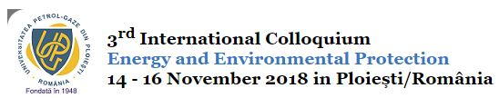
The Waste Characterization for a Spent Adsorbent Used for Hydrogen Sulfide Removal from Natural Gas
PhD Student:
Eng. Mihai-Stefan PETRACHE

Slide 2
INTRODUCTION (1)
The actual status related waste management for our country has the following features:
Increasing of waste quantity generated, hazardous and non-hazardous;
Best available technique applied on EU level are not applied in our country. Waste disposal is the most use alternative instead of recovery;
The potential to prevent waste generation is not fully utilized;
Waste management operations generates hazardous emissions into the air, water and soil.

Slide 3
INTRODUCTION (2)
The objectiv of this study is to caracterize the waste resulted from the hydrogen sulfide removal from natural gas process
In order to comply with legal requirements for the quality of the natural gas, it was needed to adopt a technical solution in order to remove the impurities, in this case hydrogen sulfide. H₂S
Process flow for the analyzed facility
Natural Gas from Wells
Heating
Biphasic separation
H₂S removal
Dehydratation
Condensation of C₅₊ Hydrocarbons
Gas pipeline

Slide 4
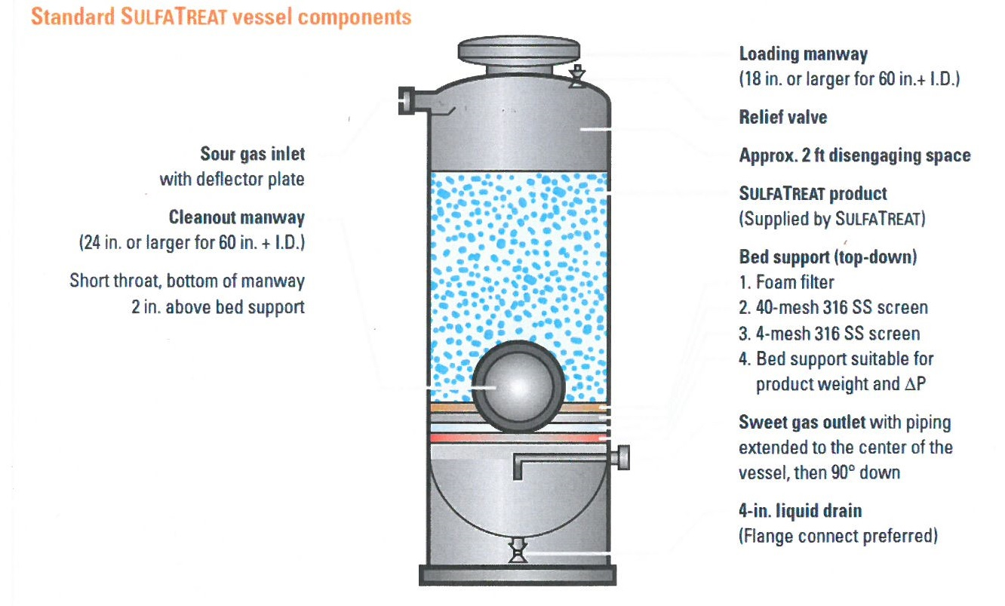
HYDROGEN SULPHIDE REMOVAL PROCESS (1)

Slide 5
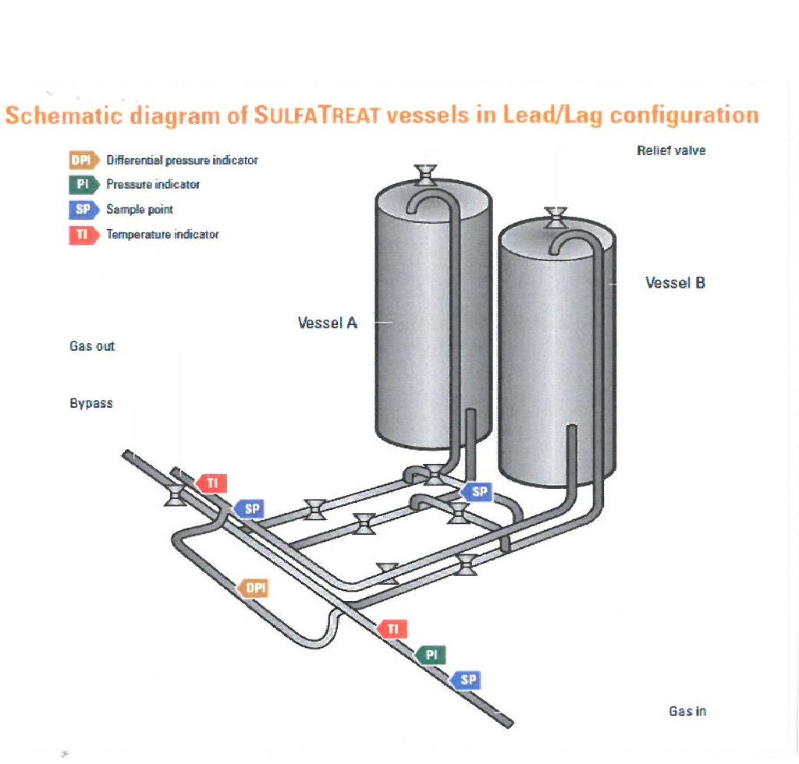
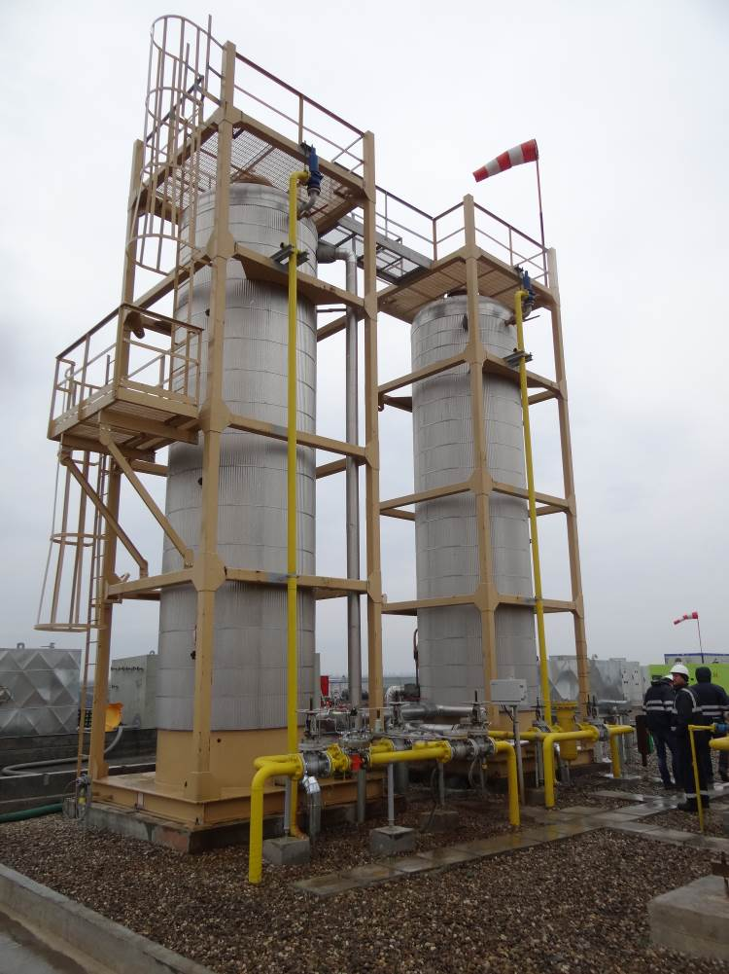
HYDROGEN SULPHIDE REMOVAL PROCESS (2)

Slide 6
ADSORBENT USED
Safety Data Sheet
According to EU Regulation no 1272/2008 the material is not clasified as hazardous
Iron oxides
Quartz (SiO2)
The material is an adsorbent: activated alumina on which iron oxides are deposited.

Slide 7
THE CHEMICAL REACTION INSIDE THE VESSELS
Metal oxide blend reacts with hydrogen sulfide to produce metal sulfides and water
M_{x}O_{y} + H₂S → MS + H₂O
Iron oxides react with hydrogen sulfide which it retains as iron sulfides
Both products, iron oxides and iron sulfides, are chemicals with very low solubility in water
The adsorbent can retain impurities from natural gas, most important from healthy and environmental point of view are hazardous heavy metals

Slide 8
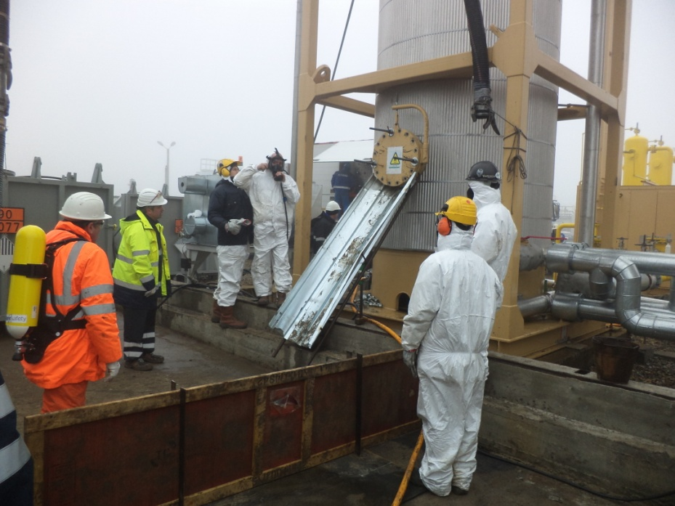
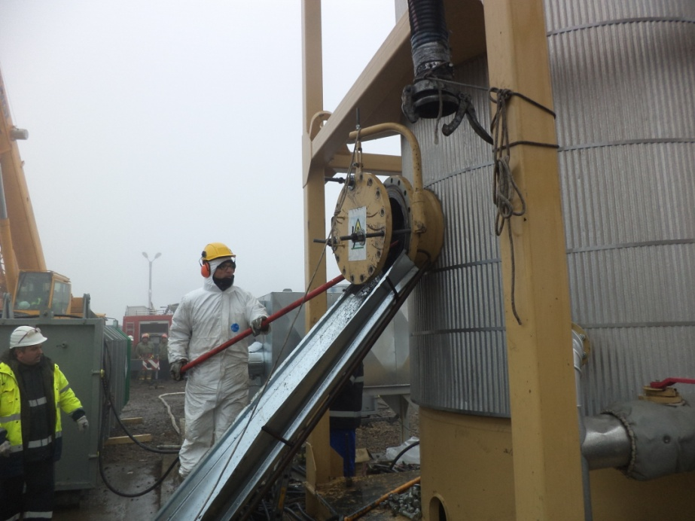
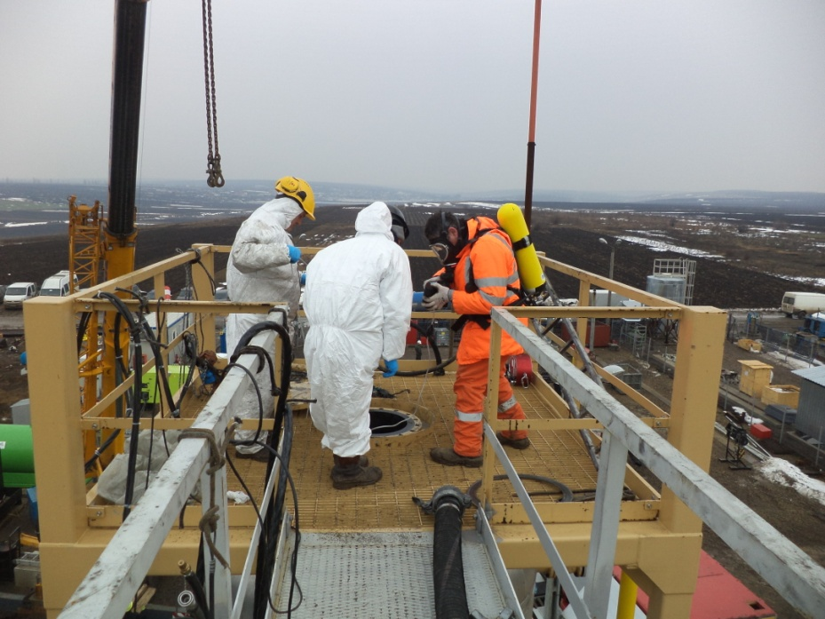
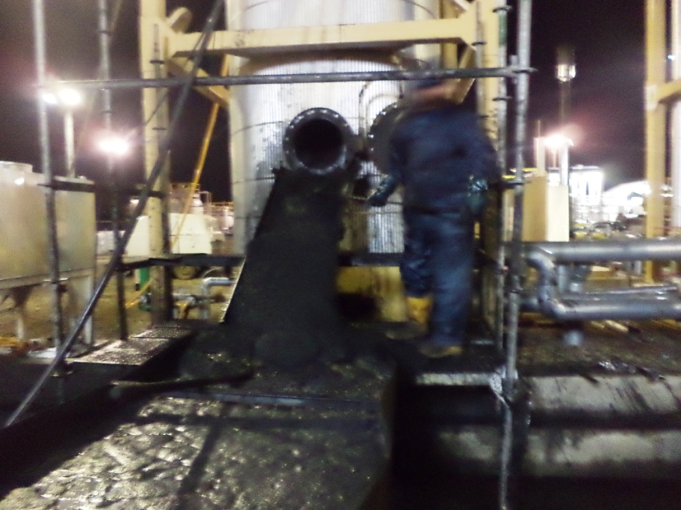
OPERATION OF EMPTYING THE VESSELS

Slide 9
RESULTS OF PHYSICO-CHEMICAL ANALYZES (1)
Description of the waste:
Phase: solid
Color: black-gray
Smell: persistent gasoline
Physico-chemical indicators:
Indicator | Measurement Unit | Value
pH | - | 5,51

Slide 10
RESULTS OF PHYSICO-CHEMICAL ANALYZES (2)
Indicator | Value, mg/kg dry substance | Value, % dry substance
Arsenic | 52 | 0,0052
Barium | 18 | 0,0018
Cadmium | <1 | <0,0001
Chromium (IV) | 1,13 | 0,00011
Iron | 35300 | 3,53
Mercury | <0,3 | <0,00003
Nickel | 813 | 0,081
Lead | 143 | 0,014
Selenium | <0,3 | <0,00003
Zinc | 144 | 0,014

Slide 11
LIST OF WASTE (1)
LIST OF WASTE
01 | Wastes resulting from exploration, mining, quarrying, physical and chemical treatment of minerals
02 | Wastes from agriculture, horticulture, aquaculture, forestry, hunting and fishing, food preparation and processing
03 | Wastes from wood processing and the production of panels and furniture, pulp, paper and cardboard
04 | Wastes from the leather, fur and textile industries
05 | Wastes from petroleum refining, natural gas purification and pyrolytic treatment of coal
06 | Wastes from inorganic chemical processes
07 | Wastes from organic chemical processes
08 | Wastes from the manufacture, formulation, supply and use (MFSU) of coatings (paints, varnishes and vitreous enamels), adhesives, sealants and printing inks
09 | Wastes from the photographic industry
10 | Wastes from thermal processes

Slide 12
LIST OF WASTE (2)
LIST OF WASTE
11 | Wastes from chemical surface treatment and coating of metals and other materials; non-ferrous hydro-metallurgy
12 | Wastes from shaping and physical and mechanical surface treatment of metals and plastics
13 | Oil wastes and wastes of liquid fuels (except edible oils, 05 and 12)
14 | Waste organic solvents, refrigerants and propellants (except 07 and 08)
15 | Waste packaging; absorbents, wiping cloths, filter materials and protective clothing not otherwise specified
16 | Wastes not otherwise specified in the list
17 | Construction and demolition wastes (including excavated soil from contaminated sites)
18 | Wastes from human or animal health care and/or related research (except kitchen and restaurant wastes not arising from immediate health care)
19 | Wastes from waste management facilities, off-site waste water treatment plants and the preparation of water intended for human consumption and water for industrial use
20 | Municipal wastes (household waste and similar commercial, industrial and institutional wastes) including separately collected fractions

Slide 13
PROPERTIES OF WASTE WHICH RENDER IT HAZARDOUS (1)
HP1 | “Explosive:” | waste which is capable by chemical reaction of producing gas at such a temperature and pressure and at such a speed as to cause damage to the surroundings. Pyrotechnic waste, explosive organic peroxide waste and explosive self-reactive waste is included.
HP2 | “Oxidising:” | waste which may, generally by providing oxygen, cause or contribute to the combustion of other materials.
HP3 | “Flammable:”
HP4 | “Irritant — skin irritation and eye damage:” | waste which on application can cause skin irritation or damage to the eye.
HP5 | “Specific Target Organ Toxicity (STOT)/Aspiration Toxicity:” | waste which can cause specific target organ toxicity either from a single or repeated exposure, or which cause acute toxic effects following aspiration.
HP6 | “Acute Toxicity:” | waste which can cause acute toxic effects following oral or dermal administration, or inhalation exposure.
HP7 | “Carcinogenic:” | waste which induces cancer or increases its incidence.

Slide 14
PROPERTIES OF WASTE WHICH RENDER IT HAZARDOUS (2)
HP8 | “Corrosive:” | waste which on application can cause skin corrosion.
HP9 | “Infectious:” | waste containing viable micro-organisms or their toxins which are known or reliably believed to cause disease in man or other living organisms.
HP10 | “Toxic for reproduction:” | waste which has adverse effects on sexual function and fertility in adult males and females, as well as developmental toxicity in the offspring.
HP11 | “Mutagenic:” | waste which may cause a mutation, that is a permanent change in the amount or structure of the genetic material in a cell.
HP12 | “Release of an acute toxic gas:” | waste which releases acute toxic gases (Acute Tox. 1, 2 or 3) in contact with water or an acid.
HP13 | “Sensitising:” | waste which contains one or more substances known to cause sensitising effects to the skin or the respiratory organs.
HP14 | “Ecotoxic:” | waste which presents or may present immediate or delayed risks for one or more sectors of the environment.
HP15 | “Waste capable of exhibiting a hazardous property listed above not directly displayed by the original waste”.

Slide 15
DEFINING THE WASTE CODE (1)
Step 1: Identifying the source who generate the waste in Chapters 01 to 12 or 17 to 20
05 | Wastes from petroleum refining, natural gas purification and pyrolytic treatment of coal
06 | Wastes from inorganic chemical processes
Step 2: Identifying the subchapters according with the performed activity
05 07 | wastes from natural gas purification and transportation
06 03 | wastes from the MFSU of salts and their solutions and metallic oxides
06 06 | wastes from the MFSU of sulfur chemicals, sulfur chemical processes and desulfurisation processes

Slide 16
DEFINING THE WASTE CODE (2)
Step 3: Identifying the appropriate six-digit code of the waste (excluding codes ending with 99 of these chapters)
05 07 02 | wastes containing sulfur
06 03 15* | metallic oxides containing heavy metals
06 03 16 | metallic oxides other than those mentioned in 06 03 15
06 06 02* | wastes containing hazardous sulfides
06 02 03 | wastes containing sulfides other than those mentioned in 06 06 02
Step 4: Define the characteristic of the waste:
Hazardous
or
Non-hazardous

Slide 17
DEFINING THE WASTE CODE (3)
The waste sample present a significant concentration of nickel, comparing with initial concentration of the adsorbent
The waste sample contain iron oxides compounds, which can produce self-heating up to ignition phenomena.
Self-heating phenomena was noticed for this waste starting discharging from the desulphurization vessel.
The waste was tested with flame in order to identify the potential flammability and the result was positive, most likely due to the traces of gasoline.

Slide 18
DEFINING THE WASTE CODE (3)
Take into consideration the results of physico-chemical analysis and available information, by applying the principle of precaution, the waste subject of this study is hazardous, with next properties:
HP3 Flammable
Hazard statement:
H228 Flammable solid
H252 Self heating, in large quantities may catch fire
HP7 Carcinogenic
Hazard statement:
H350i May cause cancer by inhalation
HP15 Waste capable of exhibiting a hazardous property listed above not directly displayed by the original waste

Slide 19


DEFINING THE WASTE CODE (4)
Proposed codes for this waste are:
06 03 15* metallic oxides containing heavy metals
06 06 02* wastes containing hazardous sulfides
Labeling elements are:

Slide 20
CONCLUSIONS
Based on waste hierarchy,
1st option for this waste is to be used as an alternative raw material for cement industry;
2nd option is to treat in order to be disposed in landfills.
Recommendation for temporary storage and transport:
Avoid exposure to high temperature and oxygen;
Cooling system in order to maintain a constant temperature;
Ensuring a low oxygen content atmosphere;
Use of not so big containers, in order to avoid storage of a big quantity;
Comply with legal compliance for hazardous waste transport

Slide 21
THANK YOU!

