Slide 1


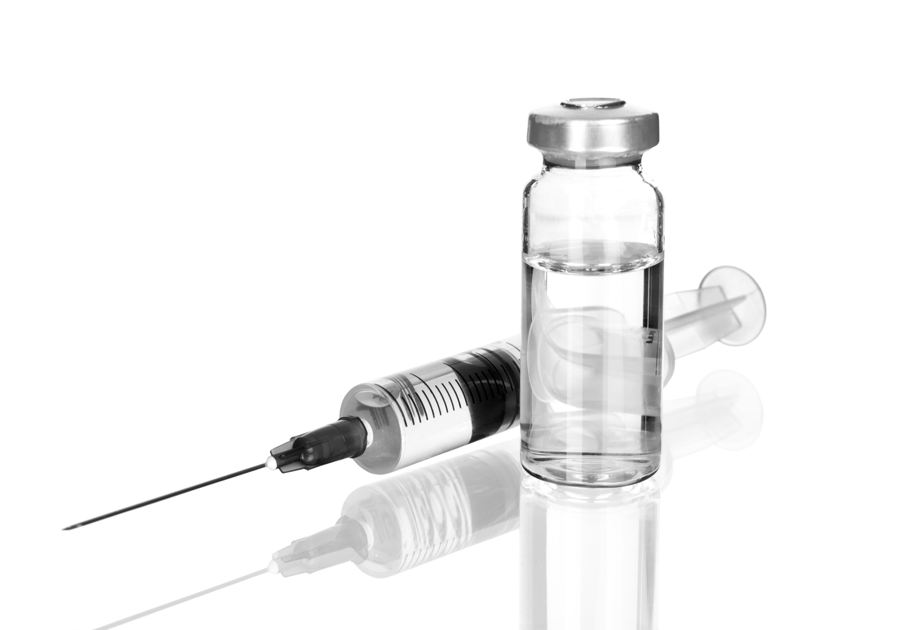
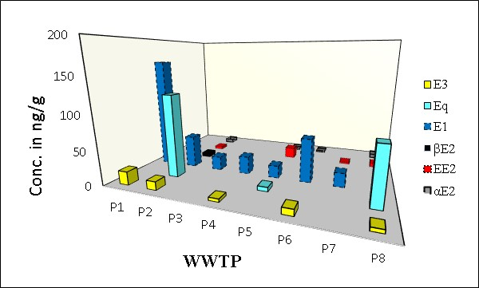
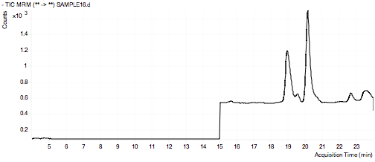
DETERMINATION OF ESTROGENIC STEROIDS IN SEWAGE SLUDGE SAMPLES FROM EIGHT DOMESTIC WASTEWATER TREATMENT PLANTS
Jana Petre, Toma Galaon, Vasile Ion Iancu, Marcela Niculescu
INCD ECOIND, Department of Pollution Control, Bucharest, Romania
INTRODUCTION Estrogenic steroids are chemicals that have the ability to interfere with the normal function of the endocrine systems of humans and animals. Their pathway to the environment is mainly through wastewater effluents from municipal treatment plants, hospital effluents and from livestock activities. WWTPs wastewater effluents are discharged into the river while the sludges, resulted during biological and chemical processes, that contain a large variety of substances including estrogens are used as fertilizer
The purpose of this study was the determination of six natural and synthetic estrogens estrone (E1), 17α-estradiol (αE2), 17β-estradiol (βE2), estriol (E3), 17α-ethinylestradiol (EE2) and equiline (Eq) in sewage sludges collected from eight selected wastewater treatment plants (WWTPs) which can be found in some cities in the south-east of Romania. To achieve this goal, a method consisting of ultrasonic extraction and silica gel cleanup followed by LC-MS/MS analysis was optimized.
EXPERIMENTAL
RESULTS
E1 occurred in 90 % of sludge samples in concentrations from 18.3 to 164.4 ng/g d.w.; E3 was detected in 60 5 of samples with a mediane of 9.1 ng/g d.w.
βE2 was quantified only in one sample at level of 5.9 ng/g d.w.; EE2 was found in 4 samples ranging from 2.7 to 16.1 ng/g d.w.
Sample collection
The sewage sludge grab samples were collected in May 2016 from eight domestic wastewater treatment plants in Brăila, Buzău and Calarași Counties.
Sludge samples were first lyophilized for 24 hours, crushed and homogenized by a mortar and pestle, sieved (particle size <100μm) and stored in glass bottles at -20 °C until they were analysed.
LC-MS instrumentation and method performance
Agilent 1260 LC (binary pump, autosampler, column thermostat) coupled to an Agilent 6410 Triple Quadrupole Mass Spectrometer
Column: Zorbax Eclipse Plus C18 150 x 2.1 mm, 3.5 µm (20°C);
Flow-rate 0.25 mL/min; 25 µL injection
Mobile phase: 0.01% NH4OH/MeOH = 90/10 (v/v), gradient 0-52.5% MeOH 0-10’, 52.5-62.5% MeOH 10-14’, 52.5% MeOH 14-20’
MS Source: ESI(-); MS detection: Multiple Reaction Monitoring
Sample extraction and cleanup
SPE done using automated system AutoTrace 280Thermo Scientific Dionex; Oasis HLB cartridges (500 mg/6mL);
Steps. Extraction: 0.5 g freeze-dried sludge is extracted with binary mixture: MeOH/acetone (5:2,v/v); centrifugation at 3000 rpm for 20 min Purification: elution was done with 2 x 2 mL MeOH at a flow rate of 5 mL/min. Concentration: with a gentle stream of N₂ (45°C); reconstitution to 1 mL with a binary methanol-water mixture (50:50, v/v).; labeled internal standard ¹³C₂-EE2 was added.
Results in ng/g (d.w.) of sewage sludge samples analyzed
Intra-day and inter-day precision, recoveries and detection and quantification limits of estrogens in sludge samples by HPLC-MS/MS (100 ng/g)
Compound | Precision |  | Overall method recoveryª | LOD^{b} (ng/g) | LOQ^{b} (ng/g)
 | Intra-day (ng/g) ª | Inter-day (ng/g) ª
E3 | 11.7± 0.8 | 10.6 ± 1.7 | 84.5 ± 10 | 1.18 | 3.95
Eq | 122.9 ± 6.7 | 120.9 ± 14.5 | 84.1 ± 8 | 0.07 | 0.24
E1 | 49.6 ± 1.4 | 50.5 ± 4.6 | 86.6 ± 13 | 0.39 | 1.31
βE2 | 5,3 ± 0,5 | 5.7 ± 0.8 | 71.3 ± 7 | 0.73 | 2.43
EE2 | 3.9 ± 0.2 | 4.2 ± 1.0 | 91.0 ± 8 | 0.54 | 1.79
αE2 | 5.5 ± 0.6 | 6.5 ± 1.2 | 104.1 ± 14 | 1,05 | 3.49
MRM chromatogram obtained by HPLC-MS/MS of sewage sludge collected from WWTP1: Estriol (19.6 ng/g d.w.) and Estrone (164.4 ng/g d.w.)
CONCLUSIONS
A sensitive method was applied to the analysis of eight sludge samples from different municipal WWTPs. The concentrations of detected residual estrogenic steroids in sludge samples varied greatly from 2.7 ng/g d.w. to 164.4 ng/g d.w. The most frequently detected compounds were Estrone and Estriol, with the latter having the highest concentrations.
ªMean (%) ± standard deviation (%) (n =3, replicate samples at the same time)
^{b}LOD, method limit of detection; LOQ, method limit of quantification
ACKNOWLEDGEMENTS
The authors gratefully acknowledge the financial support offered by The National Research Program “Nucleu” through Project PN 16-25.01.06.

