Slide 1

ECOLIB, library of National R&D Institute for Industrial Ecology, an on-line tool for environmental topics area
Gabriela Geanina Vasile¹, Ionut Radu Popescu², Theodor Iamandi², Lidia Kim¹, Calin Maxim¹, Catalina Stoica¹, Ioana Ionescu¹, Olga Tiron¹, Stefania Gheorghe¹ , Marius Simion¹
¹National Research and Development Institute for Industrial Ecology ECOIND, 71-73
Drumul Podul Dambovitei Street, code 060652, Bucharest, Romania, gabriela.vasile@incdecoind.ro
²MBM Software, 31 Slobozia Street, district 4, Bucharest, Romania, ionut.popescu@mbmsoftware.com

Slide 2

INTRODUCTION
The repository was structured, by the MBM Software IT specialists, in communities and collections according to the main research activities developed by the scientists from National Research and Development Institute for Industrial Ecology.
The included documents are: articles published in national and international journals, doctoral theses (only abstract), conference papers, short description of the projects developed from 2006 till present, patents, Power Point presentations.
An entire community is reserved to SIMI Proceedings.
Easy to find, to search, to download.
www.dspace.incdecoind.ro
International Symposium Environment and Industry, 28-29 September 2017

Slide 3
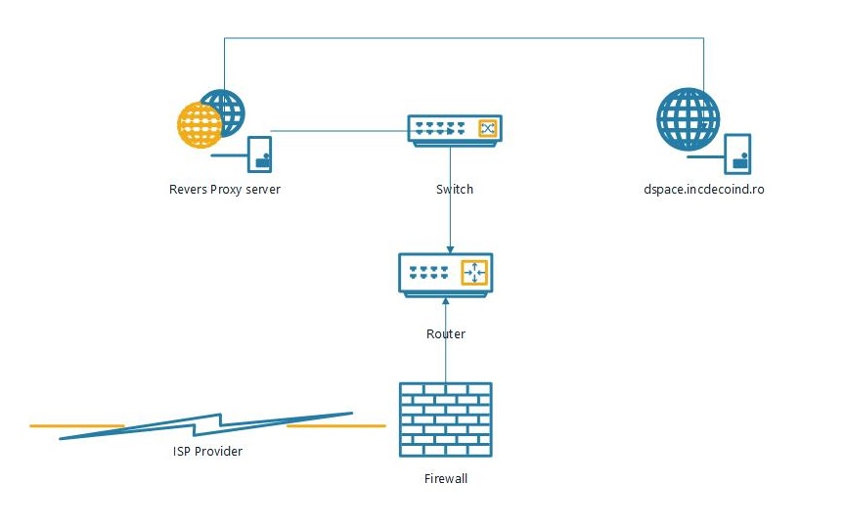
Infrastructure Server Dell, model PowerEdge T130; CPU: Intel(R) Xeon(R) CPU E3-1230 v5 @ 3.40GHz; Memory: 8Gb; HDD: 1x1Tb; OS: VMware vSphare 6 Hypervisor. Software DSpace software was used for implementation of Institutional Repository because was compatible with various metadata standards and inter-operability protocols, uses only one programming language, complete documentation is available on-line for free and various communities that can provide technical support are available. The version of the used DSpace application is 5.5.
Figure 1. ECOLIB Repository access scheme

Slide 4
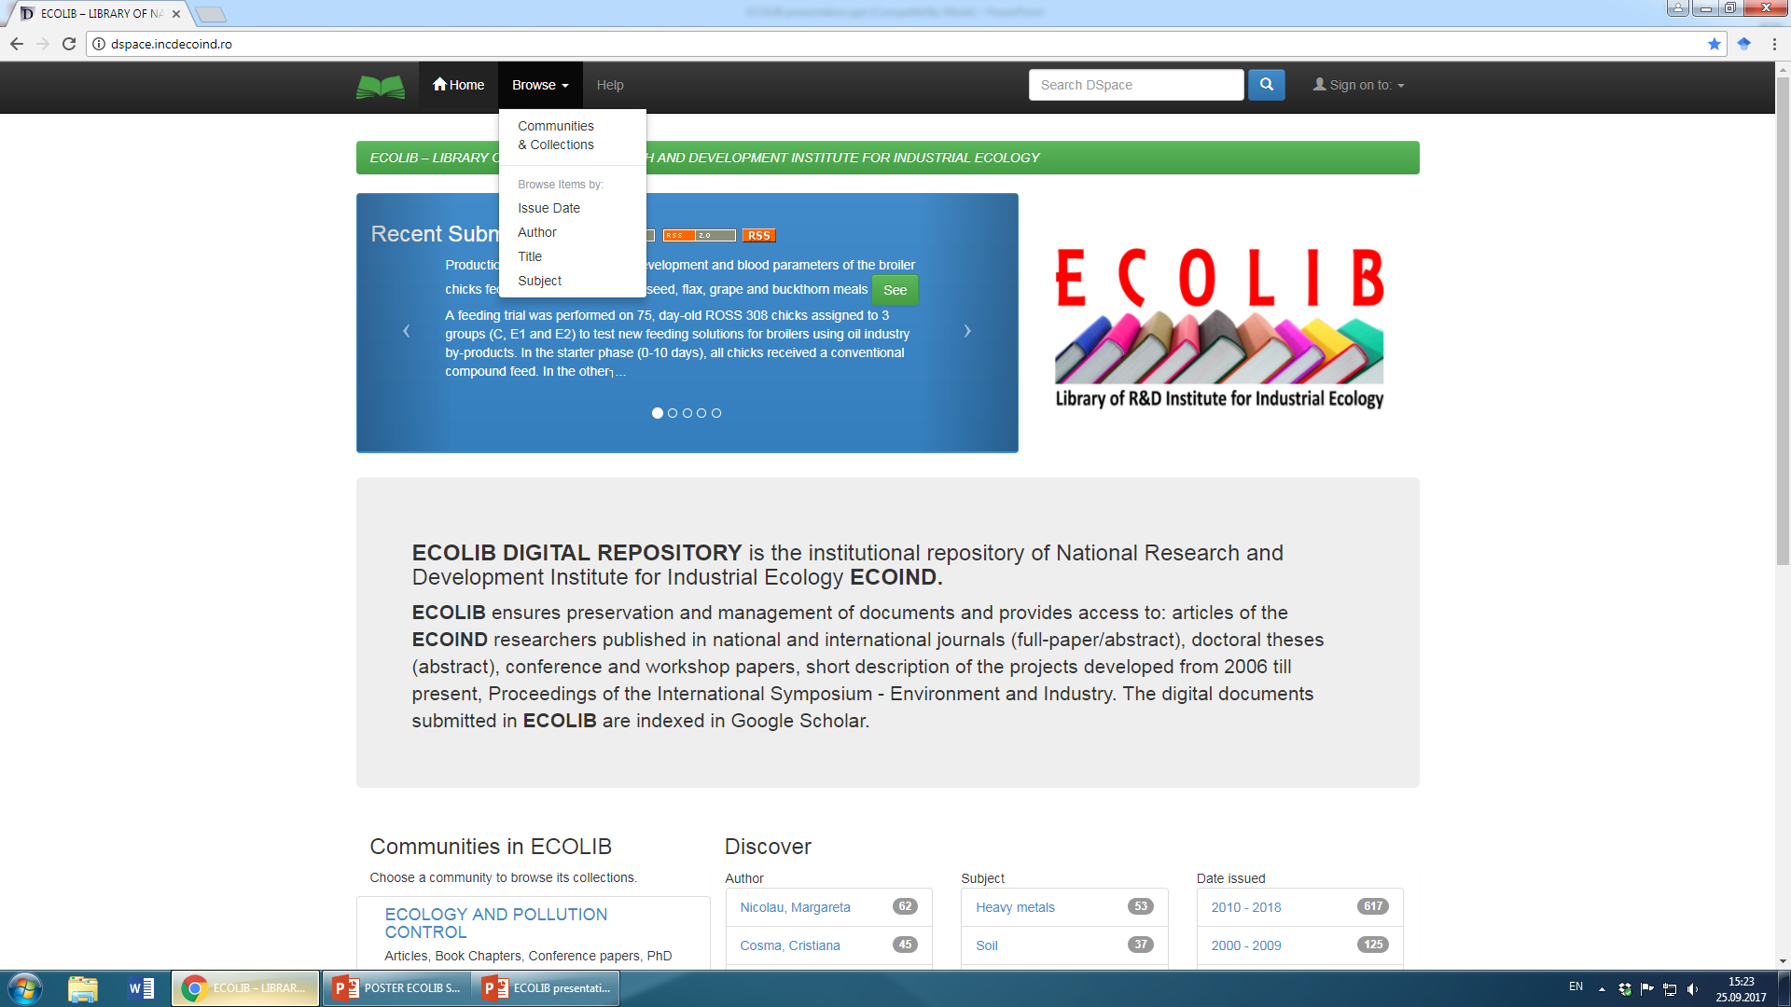
www.dspace.incdecoind.ro
The search in the repository is performed using one of the following options: issue date, author name, title of the document, subject (keywords). Access to the full-text of the resources is either open access or restricted, in accordance with the document publication policy.

Slide 5
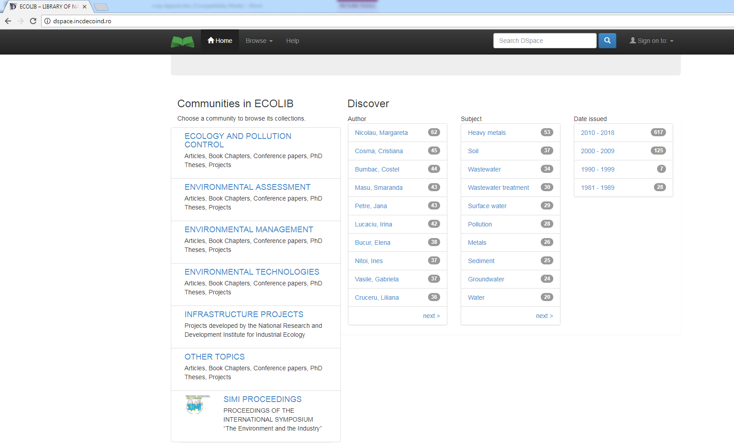
www.dspace.incdecoind.ro
In the repository are included more than 800 documents, are listed 850 author names and 1750 subjects.

Slide 6
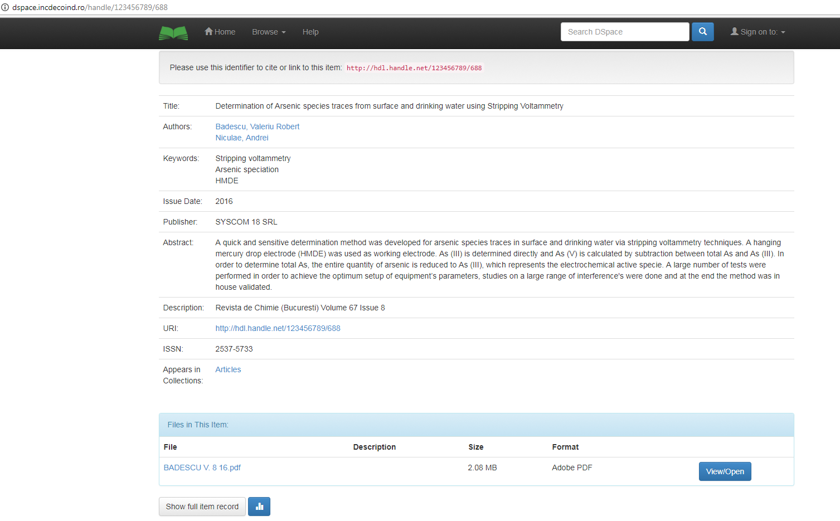
www.dspace.incdecoind.ro
The metadata recorded for each document are: document title, authors, keywords, publisher, abstract, publication title, year, volume, number, other identification data for publication (e.g. ISSN, ISBN), article DOI. A specific button is available to download the article.

Slide 7
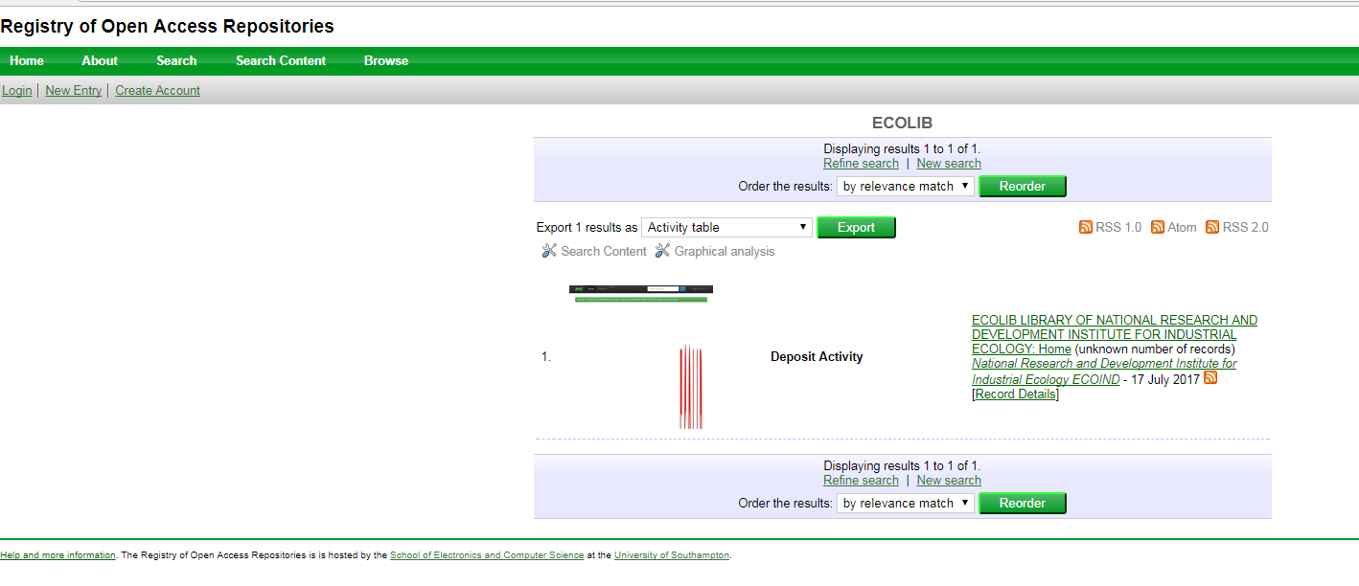
INDEXING
http://roar.eprints.org
Starting with July 2017 ECOLIB is indexed in Registry of Open Access Repositories (ROAR). ROAR is hosted at the University of Southampton, UK, being part of the Eprints.org network.

Slide 8

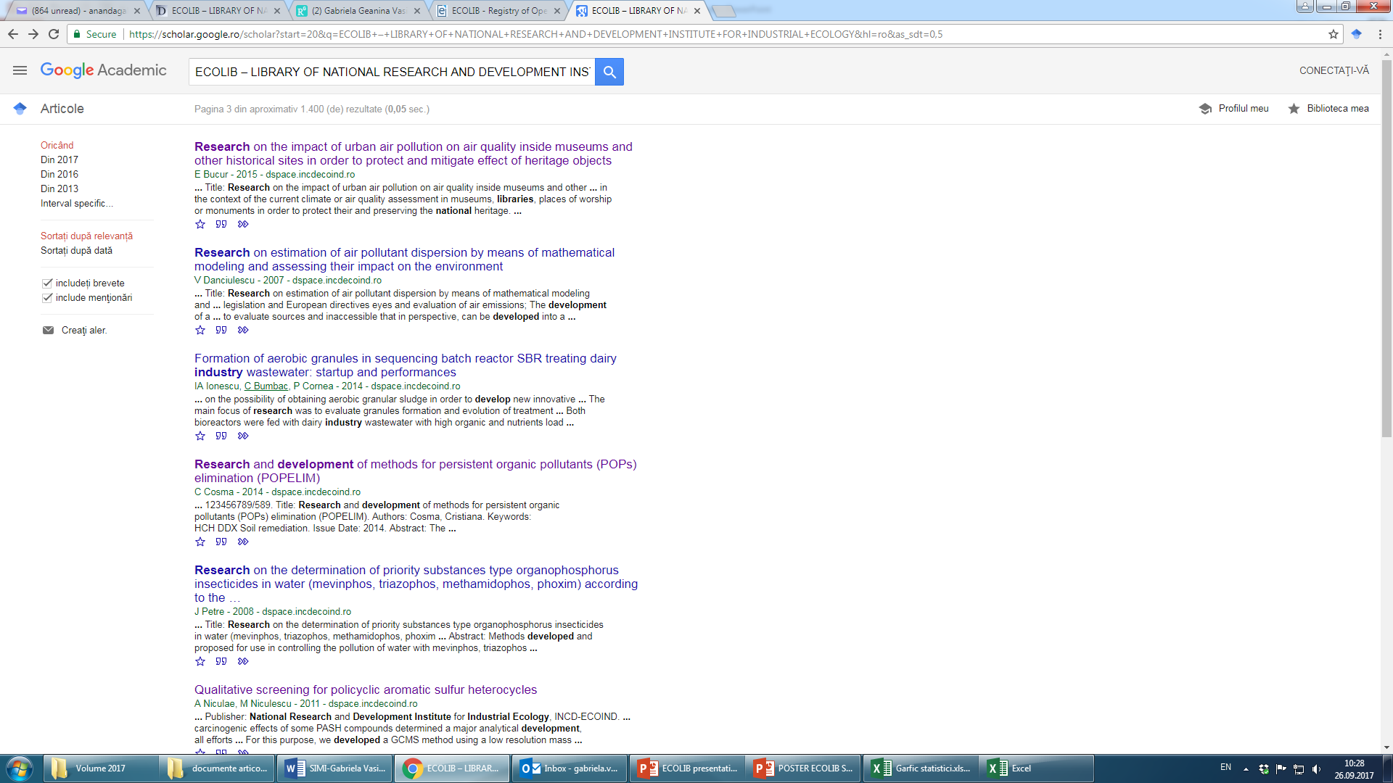
INDEXING
https://scholar.google.ro
Starting with June 2017, ECOLIB Library is indexed in Google Scholar. Thus, the citations of the digital documents submitted in ECOLIB can be counted.

Slide 9
STATISTICS
In March and April this year the repository was under construction, in the process of adding documents, so the viewers were only ECOIND scientists. Starting with end of April, ECOLIB was launched on-line. The number of visitors was low (arround 100), until July 2017 when the number increased four times, mainly do to the indexation in Google Scholar at the end of June. The visitors come from Romania, Hungary, EU and China, the top cities are Bucharest, Cluj, Iasi, Szeged, Hangzhou, Fuzhou, Nanjing.

Slide 10

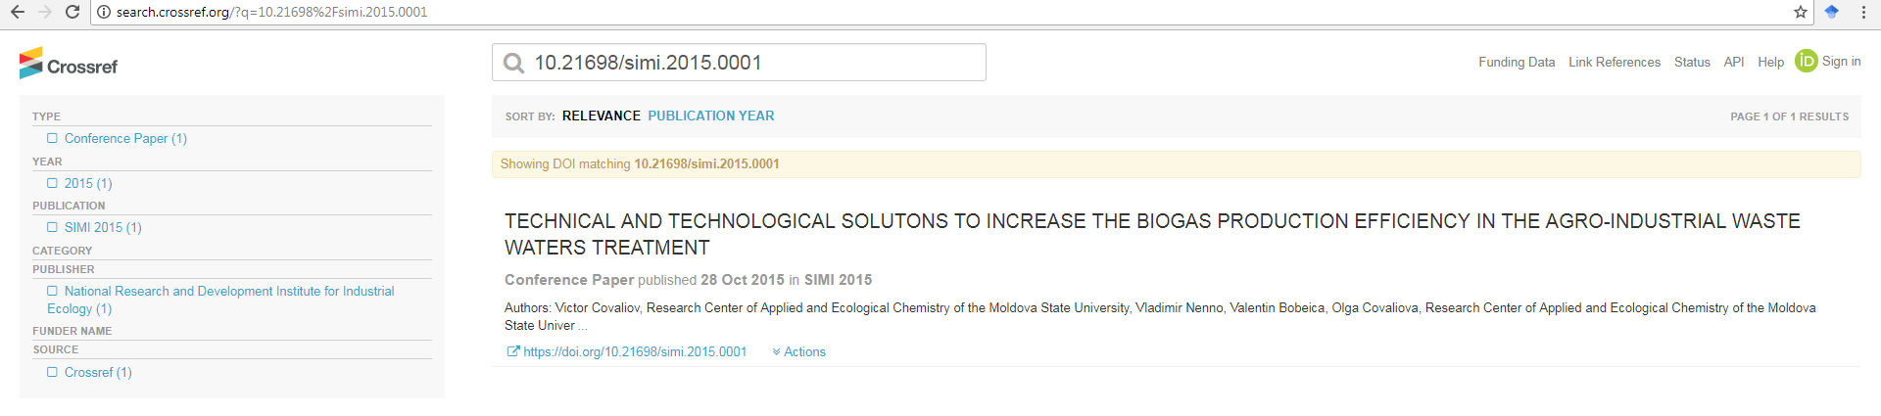
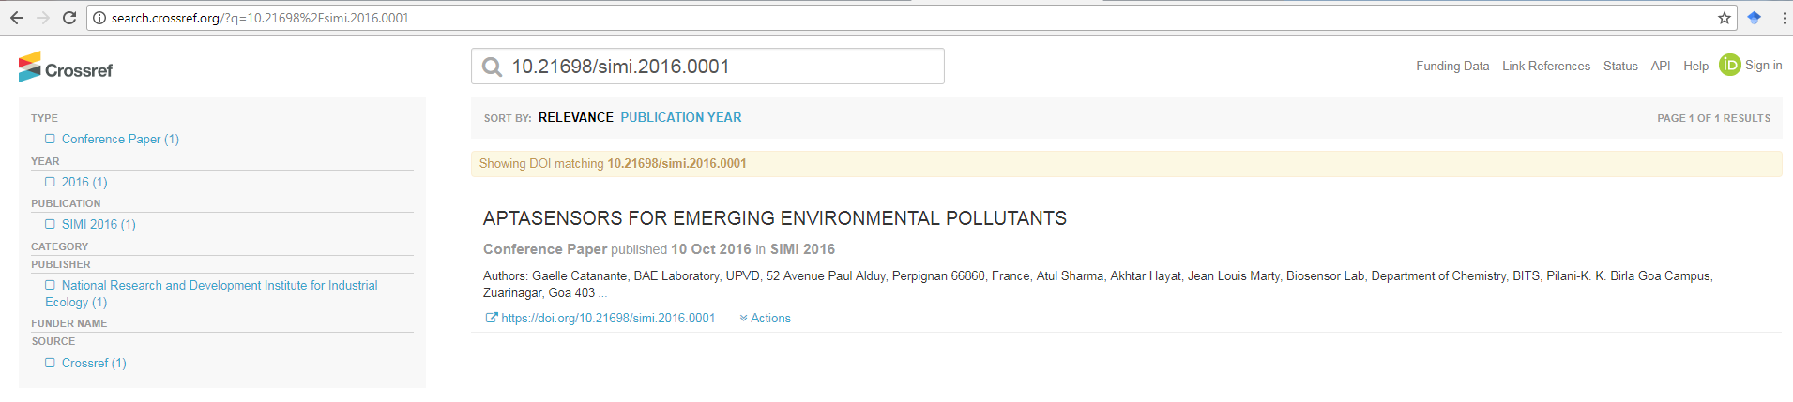
SIMI Indexations
http://search.crossref.org using DOI number

Slide 11

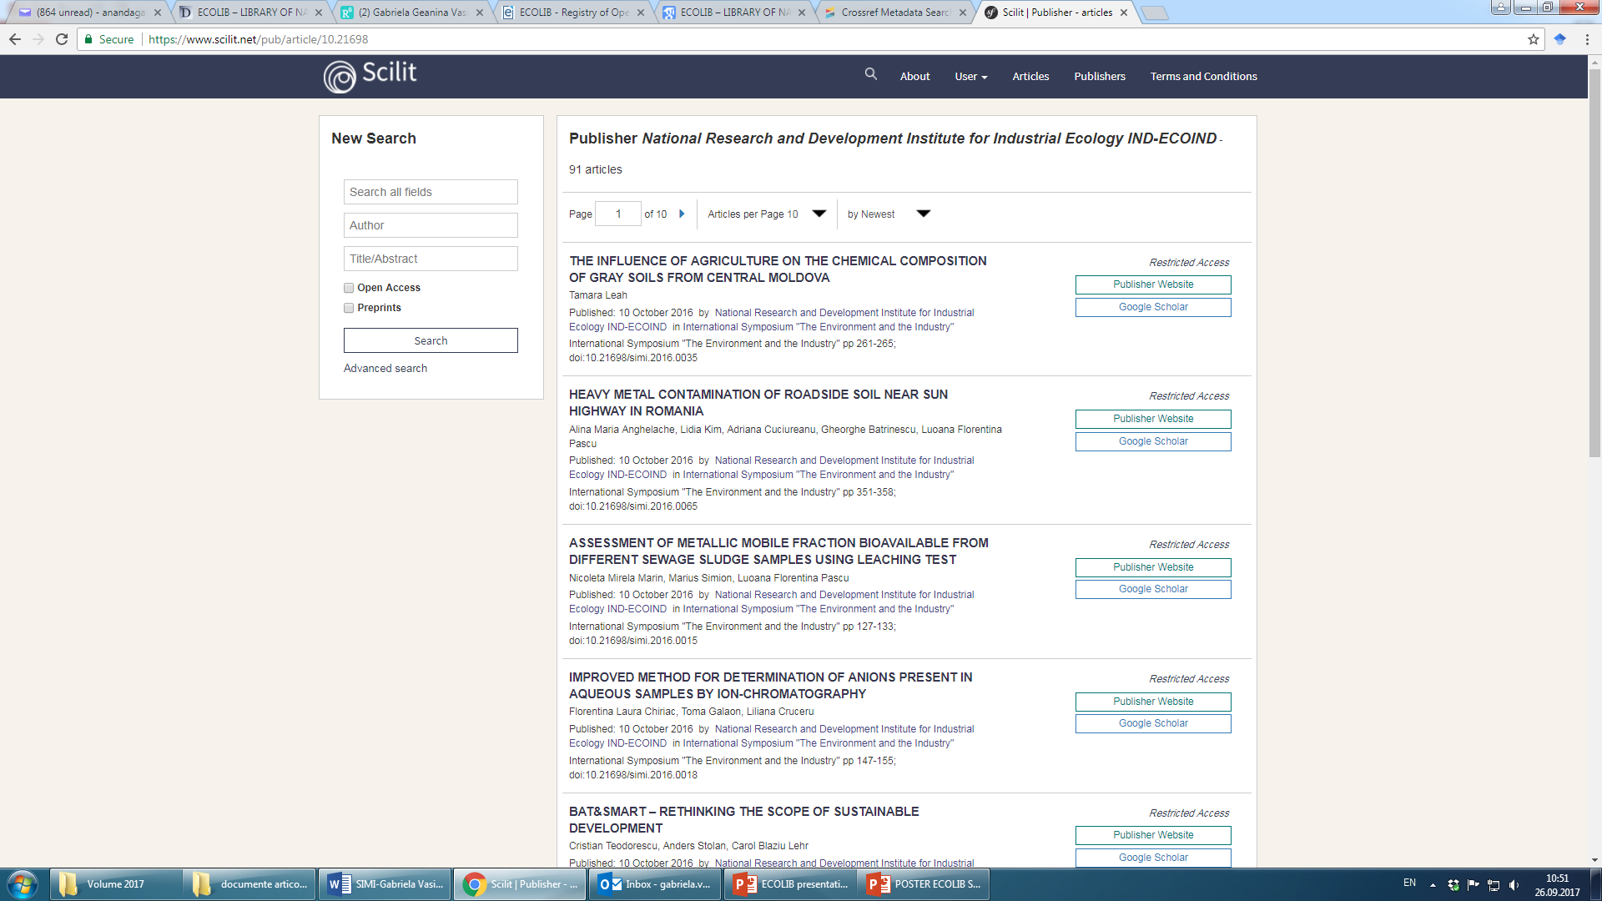
SIMI Indexations
https://www.scilit.net/pub/article/10.21698

Slide 12

NEWS!!!
Agreement to Publish Conference Content Online for SIMI 2016 within CABI Full-Text Products.

Slide 13
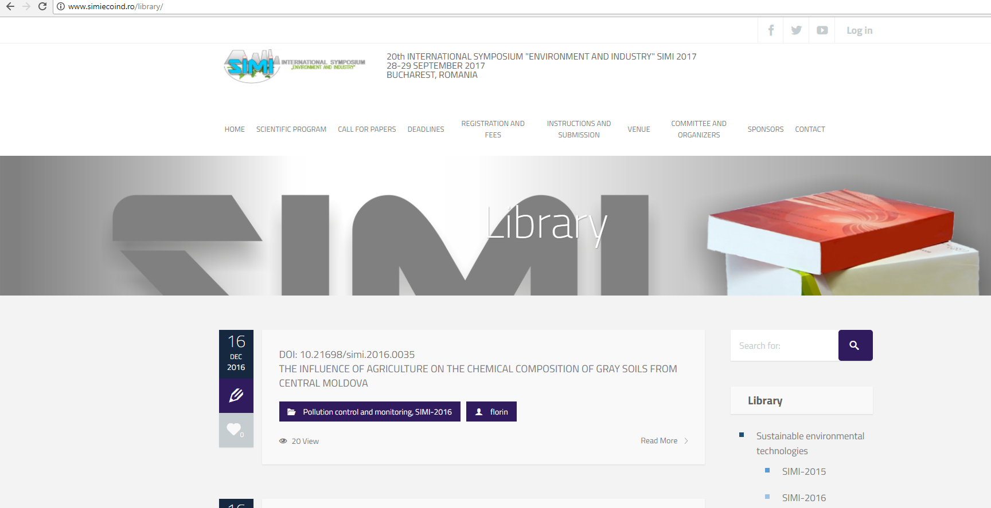
Publisher website: www.simiecoind.ro

Slide 14

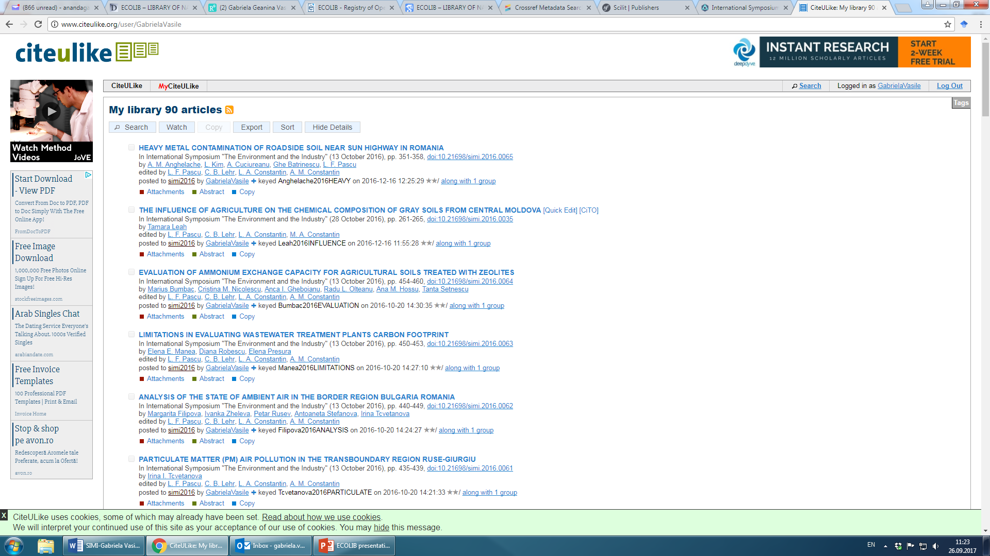
http://www.citeulike.org

Slide 15

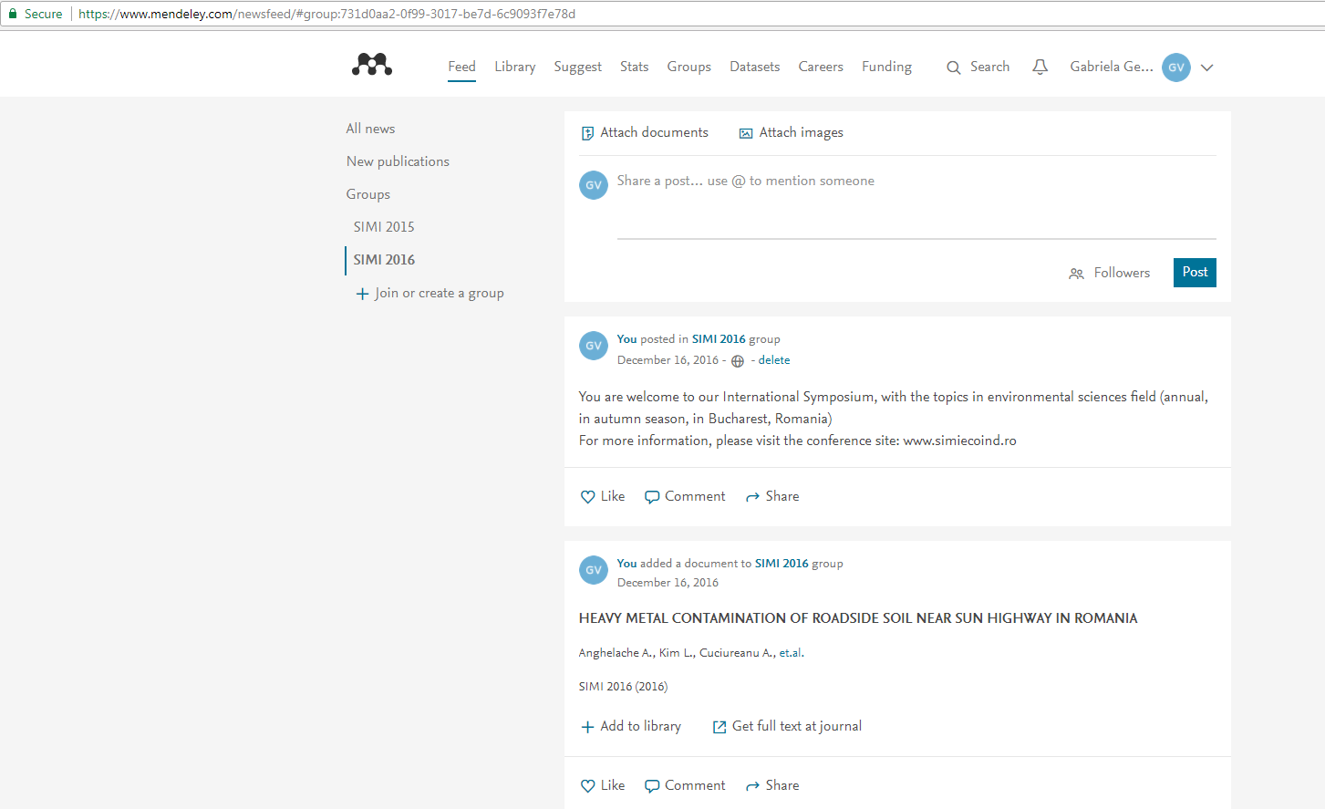
https://www.mendeley.com

Slide 16
www.simiecoind.ro
SIMI 2017 will be submitted to SCOPUS (Elsevier) and ISI Web of Science (Clarivate Analytics) in order to be indexed.

Slide 17
THANK YOU FOR YOUR ATTENTION
e-mail:gabriela.vasile@incdecoind.ro
ionut.popescu@mbmsoftware.com

