Slide 1
3rd International Colloquium Energy and Environmental Protection
14 – 16 November 2018
Petroleum – Gas University of Ploiesti
Romania
Removal of pollutants from wastewater resulted from biodiesel production by means of catalytic oxidation in suspension
Juganaru Traian (*)
Movileanu Daniela Luminita
Petroleum – Gas University of Ploiesti, Romania

Slide 2
INTRODUCTION
conversion of non- or hardly -biodegradable products in readily biodegradable products can be a solution for treatment of wastewater resulted from industrial chemical processes
glycerol is the main pollutant in wastewater resulted from biodiesel production plants

Slide 3
partial oxidation of glycerol in order to transform it into readily biodegradable products can be considered a posibility to reduce the pollution degree of wastewater from biodiesel plants, expressed as BOD5
this study presents the results obtained from partial catalytic oxidation in suspension of glycerol contained in a simulated wastewater

Slide 4
Goals
partial oxidation
readily biodegradable oxygenated products
GLYCEROL
catalyst

Slide 5
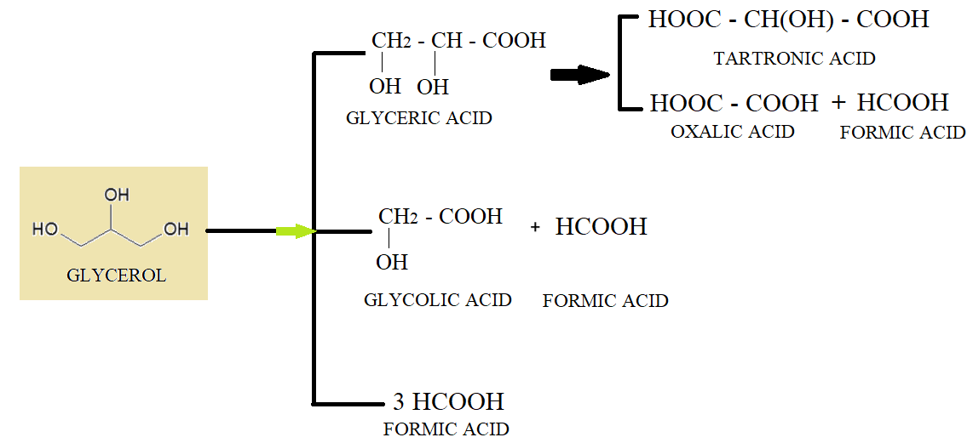
Possible products

Slide 6
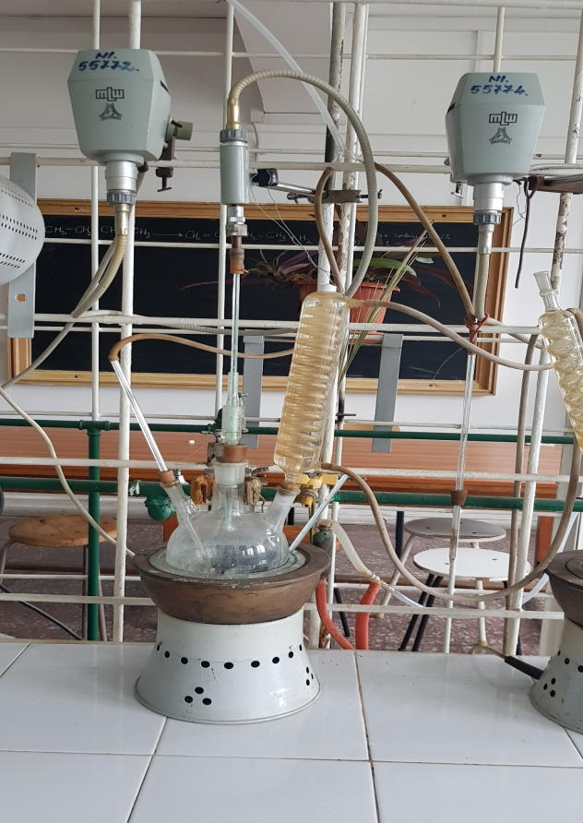
Laboratory plant
stirrer
condensation system
thermometer
reaction vessel
electrical water bath for heating
blowing air system

Slide 7
Feedstock and Catalysts
usually, wastewater from biodiesel plants has ≈ 1% glycerol
simulated waste water preparation
1 % glycerol in water
BOD5 = 315 mg O₂/L

Slide 8
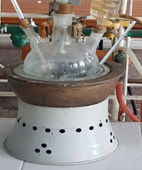
air
400 cm³ simulated waste water
3 g catalyst
a small amount of Ca(OH)₂ in order to control the pH of reaction medium (pH = 8.5-9)
heating to 80-90⁰C
6 h reaction time
1 sample/2h
samples cooling
catalyst filtration
BOD 5 analyse

Slide 9
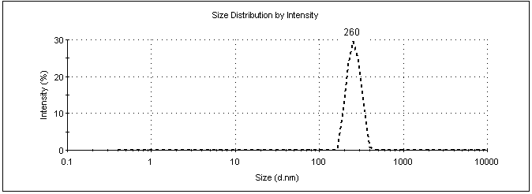
catalysts prepared by ICECHIM Bucharest
Manganese oxides nanoparticles
DLS∗ analysis of manganese oxides : average size 260 nm

Slide 10
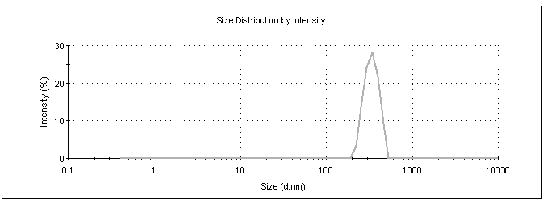
Iron oxides nanoparticles
DLS∗ analysis of iron oxides: average size 337.3 nm

Slide 11
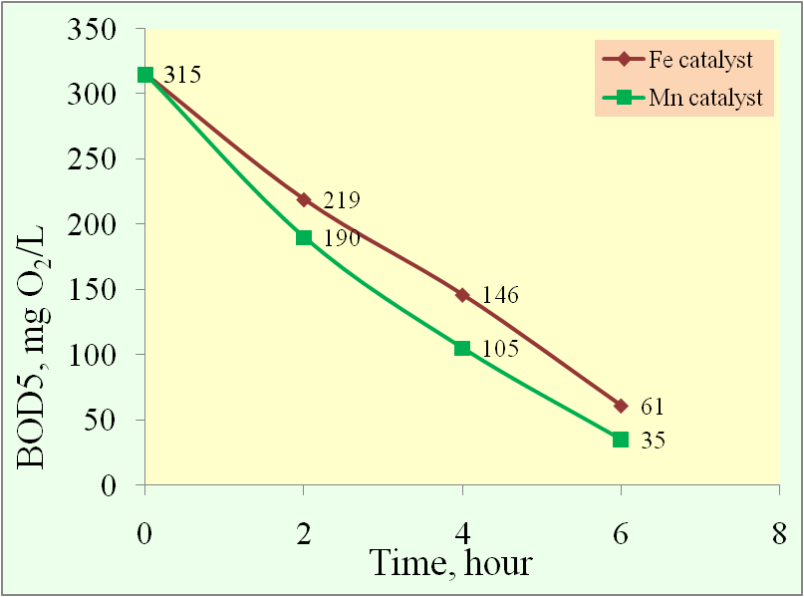
Results and conclusions
significant decrease of BOD5 with reaction time increase, for both catalyst systems (from 315 to 61 for Fe, respectively 35 mg O₂/L for Mn)
higher decrease of BOD5 for manganese oxides catalyst use than iron oxides

Slide 12
the highest decrease of BOD5 was recorded after first 2 hours of reacțion time, for both catalysts (96 mg O₂/L for Fe and 125 mg O₂/L for Mn)
a significant difference between BOD5 values obtained for the two catalysts systems is registered after 4 hours reaction time ⇒ Fe-Mn = 41 mg O₂/L
after reaction time (6h), BOD5/Mn (35 mg O₂/L) is nearly half than BOD5/Fe (61mg O₂/L)

Slide 13
the difference between BOD5 values can be attributed either to the size of the catalysts’ nanoparticles (260 nm for Mn, respectively 337,3 nm for Fe) and/or to the metal nature
extending the reaction time to 8 - 10 hours could lead to a BOD5 decrease in order to reach the maximum limits allowed by actual regulations

Slide 14
THANK YOU FOR YOUR INTEREST!

