Slide 1





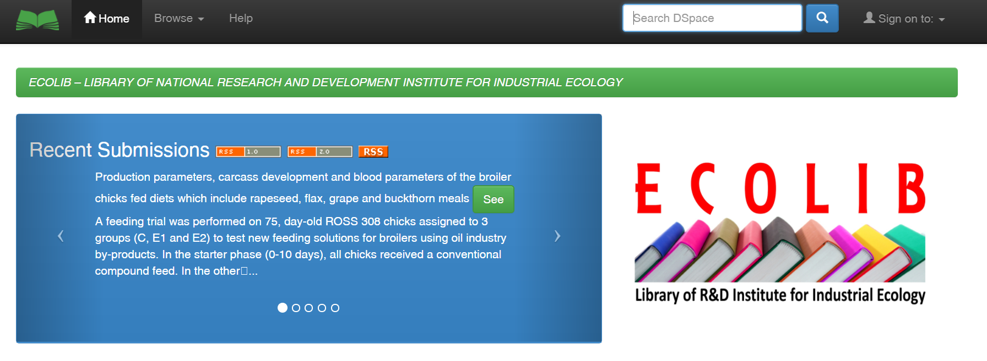
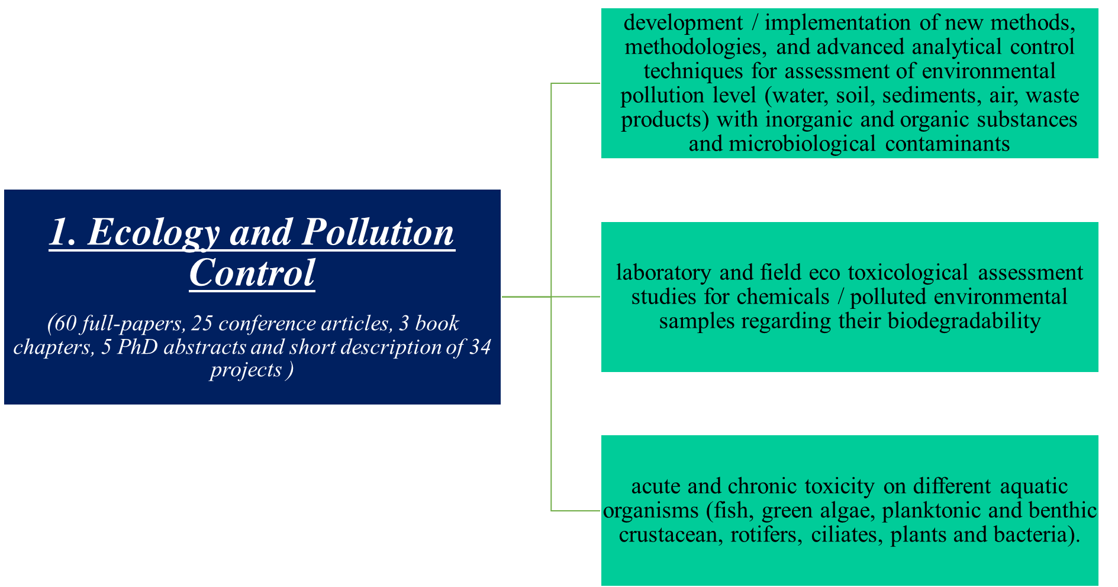

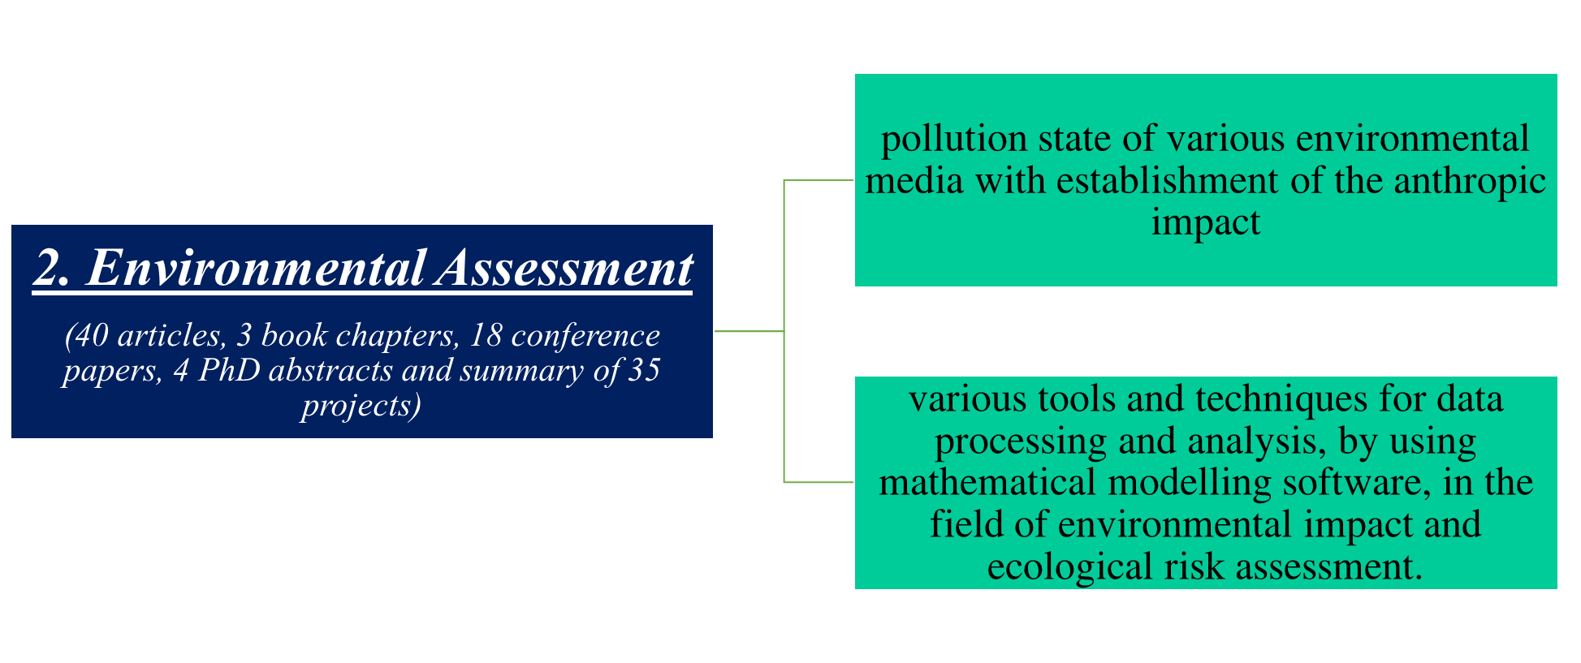


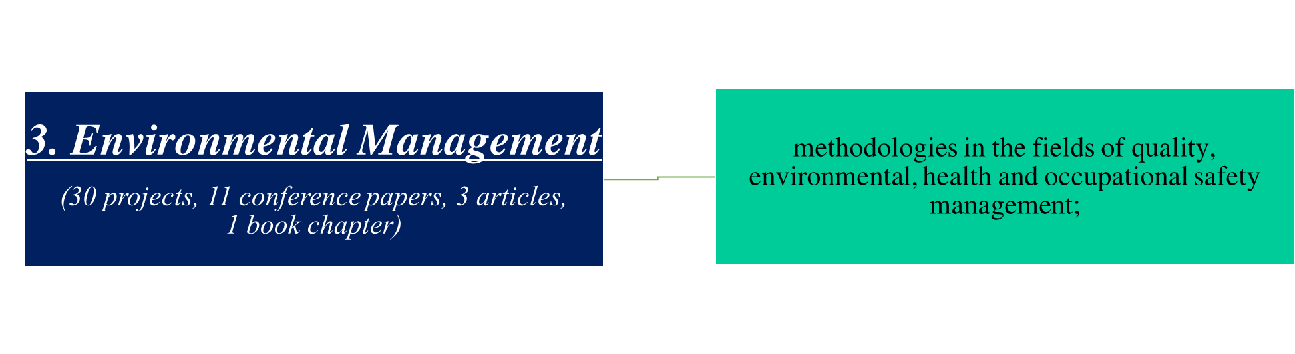

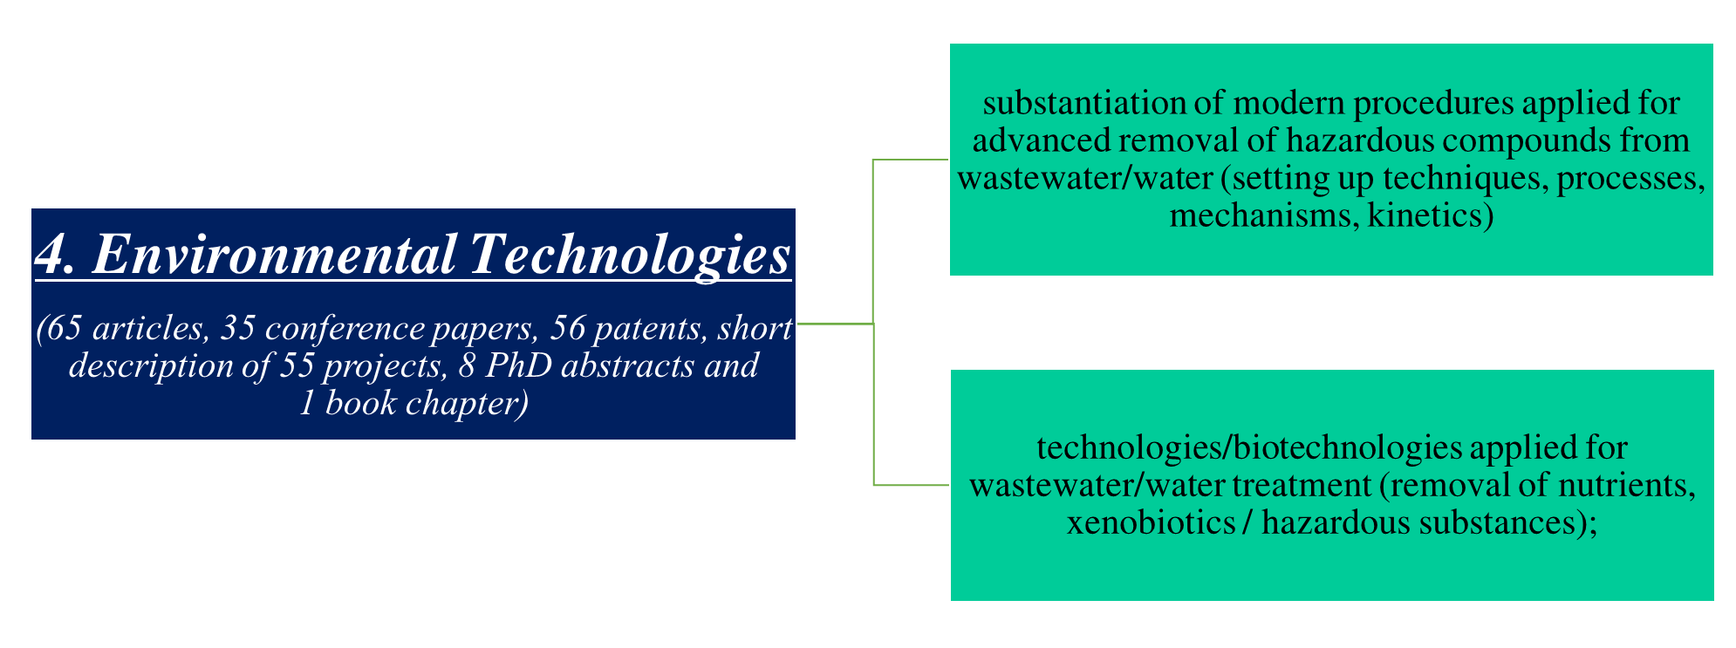

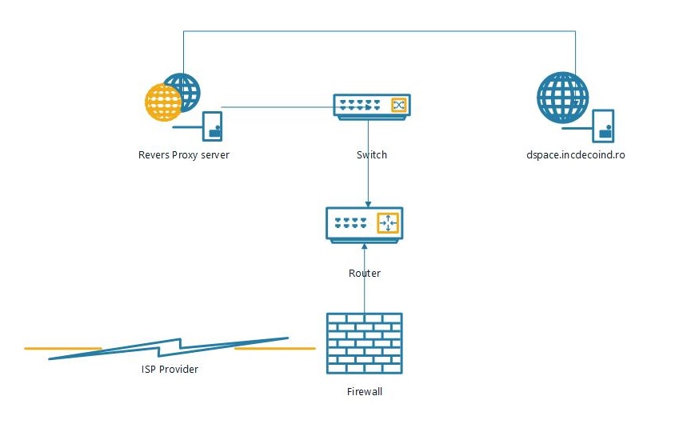
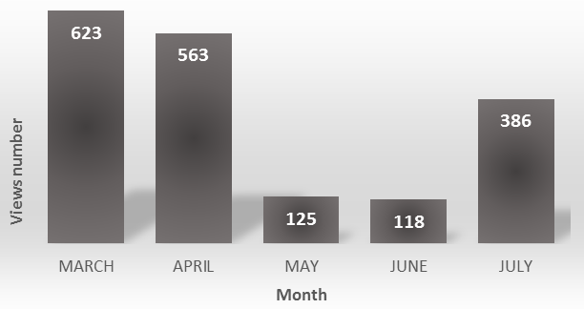
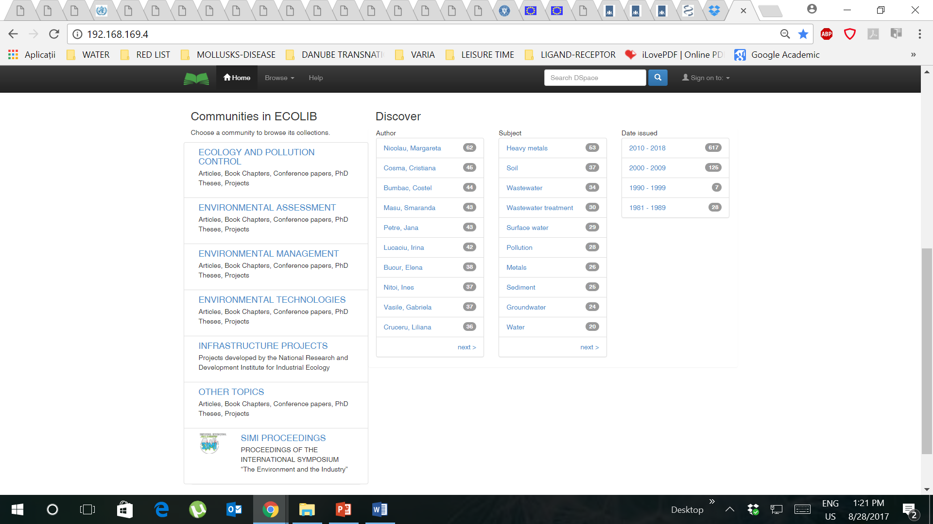
ECOLIB, library of National R&D Institute for Industrial Ecology,
an on-line tool for environmental topics area
Gabriela Geanina Vasile¹, Ionut Radu Popescu², Theodor Iamandi², Lidia Kim¹, Calin Maxim¹, Catalina Stoica¹, Ioana Ionescu¹, Olga Tiron¹, Stefania Gheorghe¹ , Marius Simion¹
¹National Research and Development Institute for Industrial Ecology ECOIND, 71-73 Drumul Podul Dambovitei Street, code 060652, Bucharest, Romania, gabriela.vasile@incdecoind.ro
²MBM Software, 31 Slobozia Street, district 4, Bucharest, Romania
INTRODUCTION
Digital Repository of National Research and Development Institute for Industrial Ecology ECOIND, library was launched on the end of April 2017. ECOLIB Repository is structered in six communities, as follows: Ecology and Pollution Control; Environmental Assessment; Environmental Technologies; Environmental Management; Other Topics; SIMI Proceedings (International Symposium „The Environment and The Industry”: editions 2011, 2013, 2015, 2016). SIMI Proceedings (2015, 2016) are indexed in Scilit, Crossref, Google Scholar, CABI (2016). The Repository web address is: http://dspace.incdecoind.ro.
MATERIALS AND METHODS
Infrastructure
Server Dell, model PowerEdge T130;
CPU: Intel(R) Xeon(R) CPU E3-1230 v5 @ 3.40GHz;
Memory: 8Gb; HDD: 1x1Tb;
OS: VMware vSphare 6 Hypervisor.
Software
DSpace software was used for implementation of Institutional Repository because was compatible with various metadata standards and inter-operability protocols, uses only one programming language, complete documentation is available on-line for free and are various communities that can provide technical support. The version of the used DSpace application is 5.5.
Structure of the Institutional Repository
The repository was structured, by the MBM Software IT specialists, in communities and collections according to the main research activities developed by the scientists from National Research and Development Institute for Industrial Ecology.
Indexing
Starting with June 2017, ECOLIB Library is indexed in Google Scholar. Thus, the digital documents submitted in ECOLIB are indexed in Google Scholar, and as result, the citations can be counted.
In july 2017 was applied for indexing in Registry of Open Access Repositories (ROAR), the application was admitted and so, ECOLIB is indexed in ROAR. ROAR is hosted at the University of Southampton, UK, being part of the Eprints.org network.
Statistics
Starting with end of April, ECOLIB was launched on-line. The number of visitors was low (arround 100), until July 2017 when the number increased four times, mainly do to the indexation in Google Scholar on the end of June. The visitors come from Romania, Hungary, EU and China, the top cities are Bucharest, Cluj, Iasi, Szeged, Hangzhou, Fuzhou, Nanjing.
Figure 1. ECOLIB Repository access scheme
The search in the repository is performed using one of the following options: author name, publication year, title of the document, subject (keywords). Access to the full-text of the resources is either open access or restricted in accordance with the document publication policy.
RESULTS AND DISCUSSION
Communities and collections
The repository is structured in six communities, four of them representing the main research areas of ECOIND.
Figure 2. Resource usage statistics (from March 2017 till July 2017)
CONCLUSIONS
ECOLIB represent the first Institutional Repository in the field of environmental topics from Romania and contain the research results of the scientists from National Research and Development Institute for Industrial Ecology ECOIND. The repository contain more than 550 documents (articles, conference papers, patents, book chapters) and 240 SIMI conference papers.
ECOLIB Repository is indexed in Google Scholar and ROAR, this fact should lead to a long-term increase of the submitted documents visibility on international level.
Acknowledgements This work has been supported by the Romanian Government through the project PN 16 25 04 01, contract no. 38N/2016.

